Slide 1
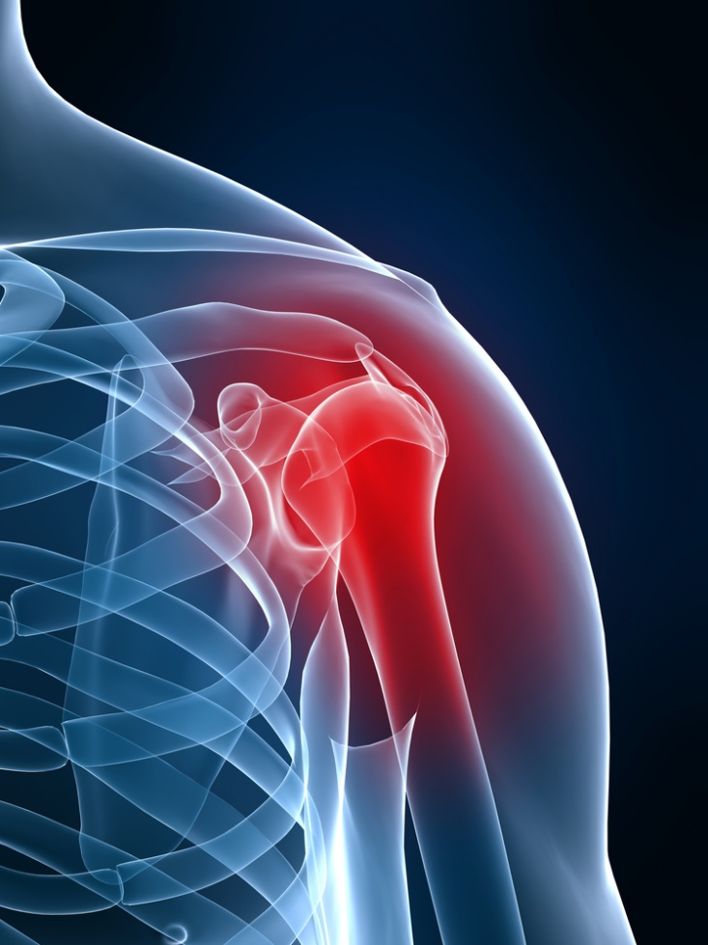
Common shoulder injuries and their treatment
Dale S. Snead MD
Notes:
Start talk with pictures of (1) ER and (2) Star Trek.
Is this really medicine today (ER)and is this the medicine of the future (star trek)? How many of you have seen an episode of ER and Star Trek? The healthcare they depict would be wonderful. It would be fantastic that upon entering the ER you would receive immediate attention with a smile from a courteous and beautiful staff member and life threatening injuries would be treated in the emergency room. Have you been to an ER recently? You know I have never seen the doctors get paid, now that’s real.
How about if we were able to run a wand over your body and immediately be able to diagnosis and treat any ailment that you may have as in Star Trek. That would be great.
Well Hollywood is not totally off base in their perception of how medicine should be. Maybe they can inspire us to be better doctors and surgeons. To smile, to be courteous, to be educated and possess the tools that would make your trip to the doctor painless and satisfying.

Slide 2
How Fast Are You With These Words?
BOO_S
_ _NDOM
P_N_ S
S_X

Slide 3
BOOKS
RANDOM
PANTS
SIX

Slide 4
AGENDA
What are the origins and causes of shoulder problems
Symptoms of common shoulder problems
How are shoulder problems diagnosed
Treatment of common shoulder problems

Slide 5
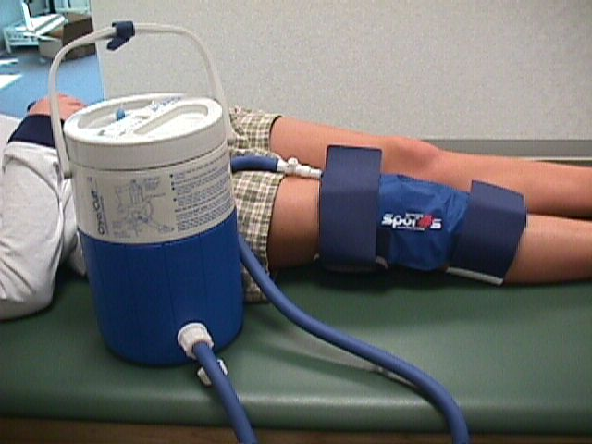
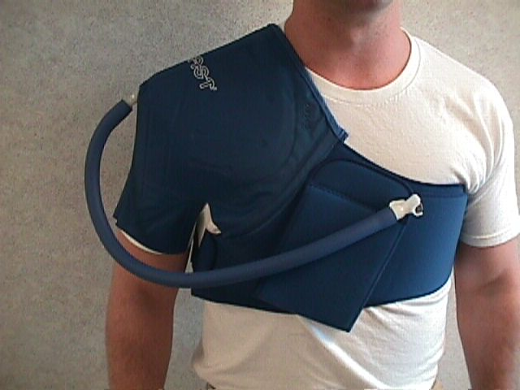
Cryo/Cuff
Notes:
Well, after an injury we have always been told to ice, elevate and wrap the injured extremity. This is a device which was developed and perfected at the Methodist Sports Medicine Center and has been used with great success in assisting to ice and compress an injured extremity. The elevation is your own. This device has been proven successful in decreasing swelling and pain associated with injuries or surgery. By controlling the factors I just mentioned we can concentrate on rehabilitating the injury. The end result is an athlete who can return to his or her sport faster.

Slide 6
ANATOMY

Slide 8
ORIGIN AND CAUSES OF SHOULDER PROBLEMS
It is difficult to determine an exact cause for many problems
Shoulder is commonly injured because the ball of the upper arm is larger than the shoulder socket
Most problems are age related
Overuse can lead to more rapid deterioration
Most people complain of pain in the arm

Slide 9
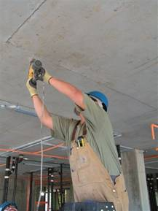
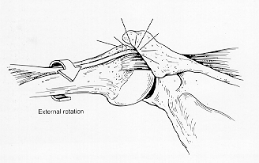
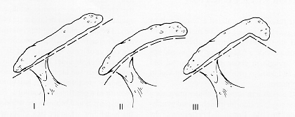
ROTATOR CUFF TENDONITIS
Commonly called bursitis or impingement syndrome
Can occur from overuse, aging or trauma
Inflammation of the rotator cuff tendon
Commonly seen in overhead activities
Pinching of the rotator cuff tendon underneath the acromion

Slide 10
SIGNS AND SYMPTOMS
Discomfort in the shoulder
Difficulty sleeping or laying on the shoulder
Pain in the upper arm

Slide 11
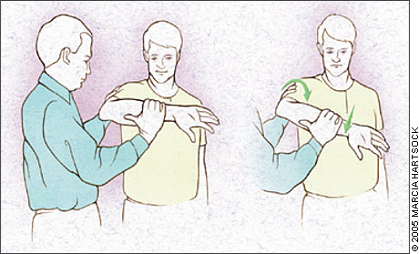
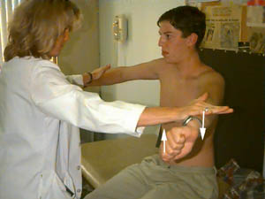
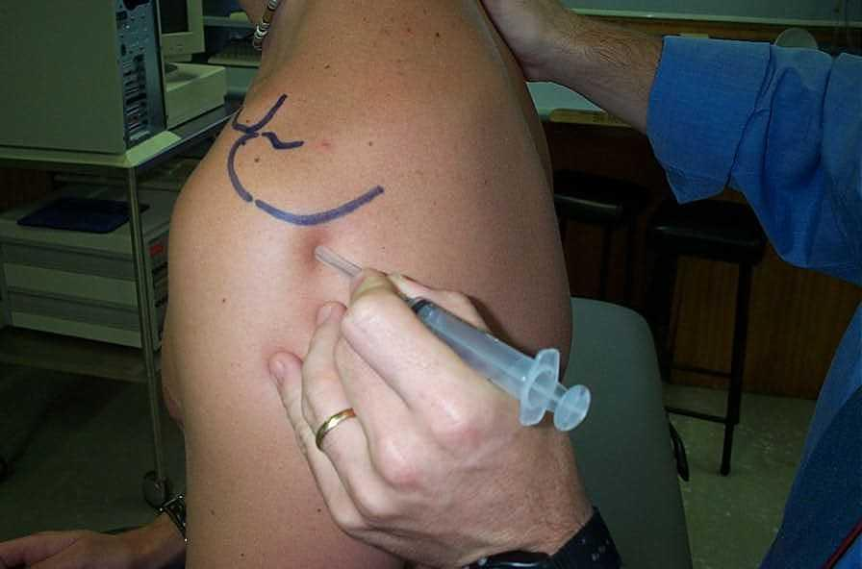
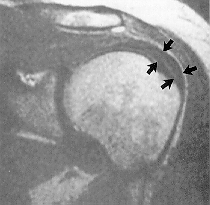
DIAGNOSIS
Pain with overhead activities
Positive impingement sign
Pain with resisted manual muscle testing
Relief of pain with an injection in subacromial space
MRI

Slide 12
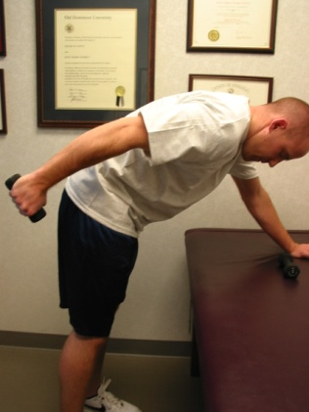
TREATMENT
Non-steroidal medications
Activity modification
Physical therapy
Injections
Surgery

Slide 13
ROTATOR CUFF TEARS
Can occur from overuse, aging or traumatic
Repetitive or overuse injuries may place a significant strain on the cuff muscles
Tendons weaken and tear result
Some tears occur without significant signs
Rotator cuff tears will not heal on their own

Slide 14
SIGNS AND SYMPTOMS
Insidious onset of pain and weakness
Patients may feel a click and pop with shoulder motion
Difficultly with overhead activities
Pain in the arm

Slide 15
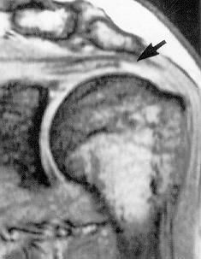
DIAGNOSIS
Weakness with external rotation
Decreased active range of motion
MRI

Slide 16
TREATMENT
Surgery
Open
Arthroscopic

Slide 19
FROZEN SHOULDER
Also known as adhesive capsulitis
Develops majority of the time idiopathicathy
Can occur from mild trauma
Seen commonly in diabetics, endocrine disorders
Common between the ages of 40 – 60
Can take a longtime to resolve

Slide 20
SIGNS AND SYMPTOMS
Insidious onset of pain
Runs thru three phases
Pain
Freezing
Thawing

Slide 21
DIAGNOSIS
History
Physical exam

Slide 22
TREATMENT
Depends on which phase of disease
Pain medication
Physical therapy
Steroids
Oral
Injectable
Surgery

Slide 23
FRACTURE OF PROXIMAL HUMERUS
Traumatic event
R/O neurovascular injuries

Slide 24
SIGNS AND SYMPTOMS
Severe pain
Limited range of motion
Abnormal shape of shoulder

Slide 25
DIAGNOSIS
History
Limited painful range of motion
X-ray

Slide 26
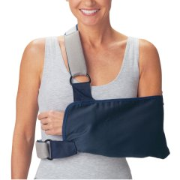
TREATMENT
Non operative
Sling
Early range of motion
Operative
Closed reduction and percutaneous pinning
Open reduction and internal fixation
Joint replacement
Hemi-arthroplasty
Reverse ball and socket arthroplasty

Slide 27
SHOULDER DISLOCATIONS
Most frequently dislocated joint in the body
Unstable joint
Multiple degrees of freedom
Often causes tears of the labrum and leads to instability
Often patients feel a subluxation of the joint
Can dislocate anteriorly, inferiorly or posteriorly

Slide 28
DIAGNOSIS
History
Physical exam – decreased external rotation
X-rays (axillary view)
MRI

Slide 29
SIGNS AND SYMPTOMS
Pain
Limited range of motion
Shoulder can have a normal appearance
Patient can experiences numbness and tingling in the hand

Slide 30
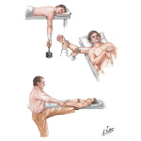
TREATMENT
Reduce joint
Repeat x-rays to confirm reduction
Check range of motion
Sling and early range of motion
Surgery
Recurrent instability
Irreducible dislocation
Large glenoid fractures

Slide 31
GLENOHUMERAL INSTABILITY
Unstable joint
Traumatic vs. atraumatic
Age, frequency and patient’s needs dictate treatment

Slide 32
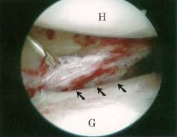
GLENOHUMERAL INSTABILITY
Unstable joint
Traumatic vs. atraumatic
Age, frequency and patient’s needs
dictate treatment
Seen more commonly in people less than 25
Common after dislocations of the glenohumeral joint

Slide 33
SIGNS AND SYMPTOMS
History
Feeling the shoulder “slip”
Pain with range of motion
Apprehension with arm abducted and externally rotated
Numbness and tingling in the hand

Slide 34
TREATMENT
Depends on age, activity level and symptoms
History
Physical therapy
Activity modification
Surgery

Slide 35
Left Shoulder Arthroscopy
Clip Two
Clip Three

Slide 36
CLAVICLE FRACTURE
Commonly fractured
Traumatic event

Slide 37
SIGNS AND SYMTOMS
Deformity of clavicle
Pain with range of motion

Slide 38
DIAGNOSIS
History
X-ray

Slide 39
TREATMENT
Non operative
Sling for comfort
Early range of motion
Surgery

Slide 40
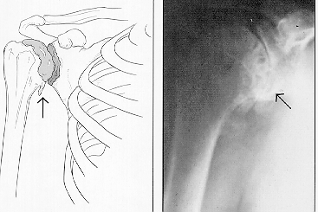
ARTHRITIS OF THE SHOULDER
Destruction of the cartilage of the shoulder joint (osteoarthritis)
Inflammation of the lining if the joint (rheumatoid)

Slide 41
SIGNS AND SYMTOMS
Pain particularly at night
Crepitus with range of motion
Limited range of motion
Pain in upper arm

Slide 42
DIAGNOSIS
History
Decreased range of motion
Crepitus with range of motion
X-ray
MRI

Slide 43
TREATMENT
Nonsteroidal medications
Activity modification
Physical therapy
Injections
Surgery
Hemi-arthroplasty
Total joint arthroplasty
Reverse ball and socket arthroplasty

Slide 44
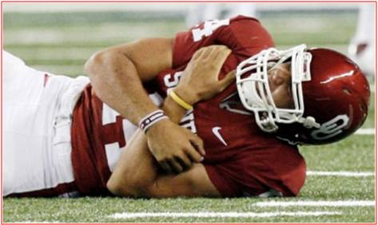
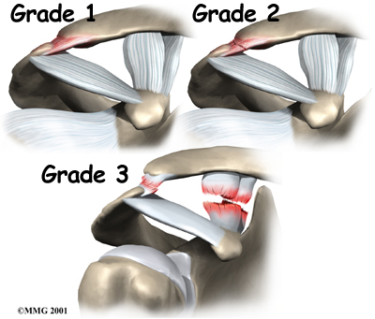
AC INJURIES
Results from a fall onto the tip of the shoulder or repetitive use of the shoulder
Sprain or separation
Six grades of separation
Degenerative changes of the joint

Slide 45
SIGNS AND SYMPTOMS
Pain over AC joint
Pain with adduction of the arm
Difficulty sleeping
Crepitus with range of motion
Deformity of joint
Enlarged
Elevated

Slide 46
DIAGNOSIS
History
Positive AC signs
Pain with overhead activities
X-rays
Deformity of joint
Injection of AC joint

Slide 47
TREATMENT
Nonsteroidal medications
Activity modification
NO physical therapy
Injections
Surgery
Excise distal end of clavicle
Arthroscopic
Open
Reconstruct ligaments of AC joint

Slide 48
Video of DC repair

Slide 49
Xrays and postop reconstruction

Slide 50
THE END
Thank You

Slide 51
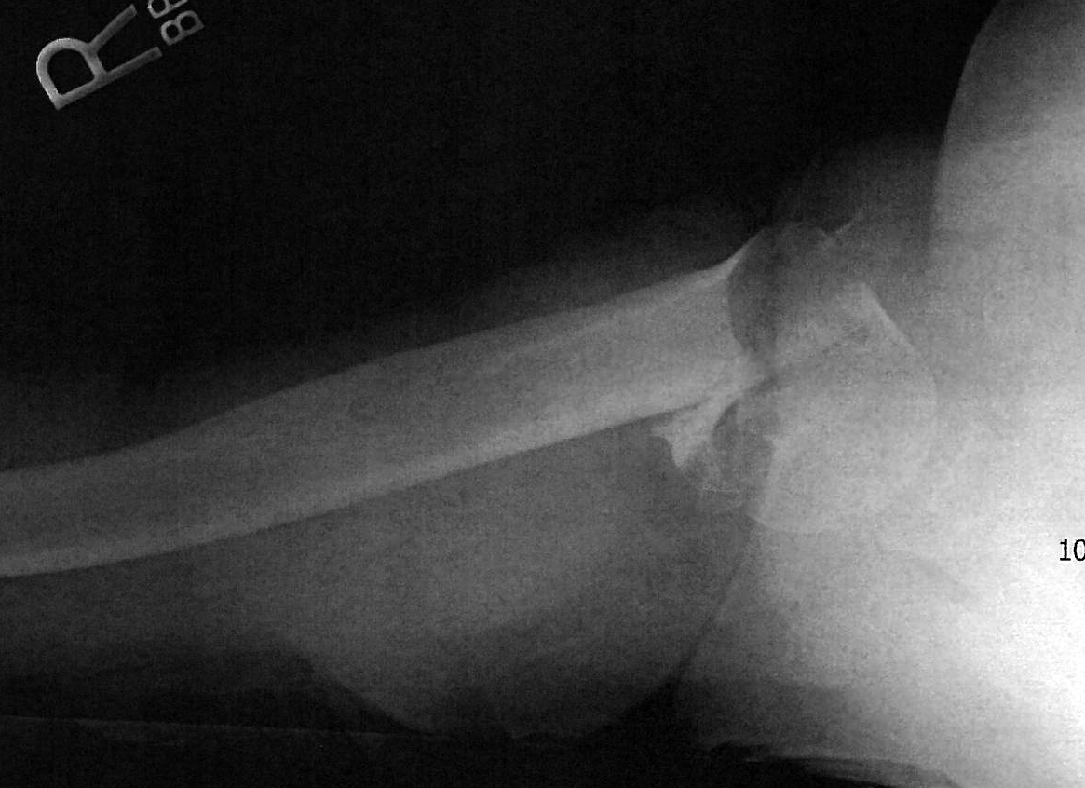
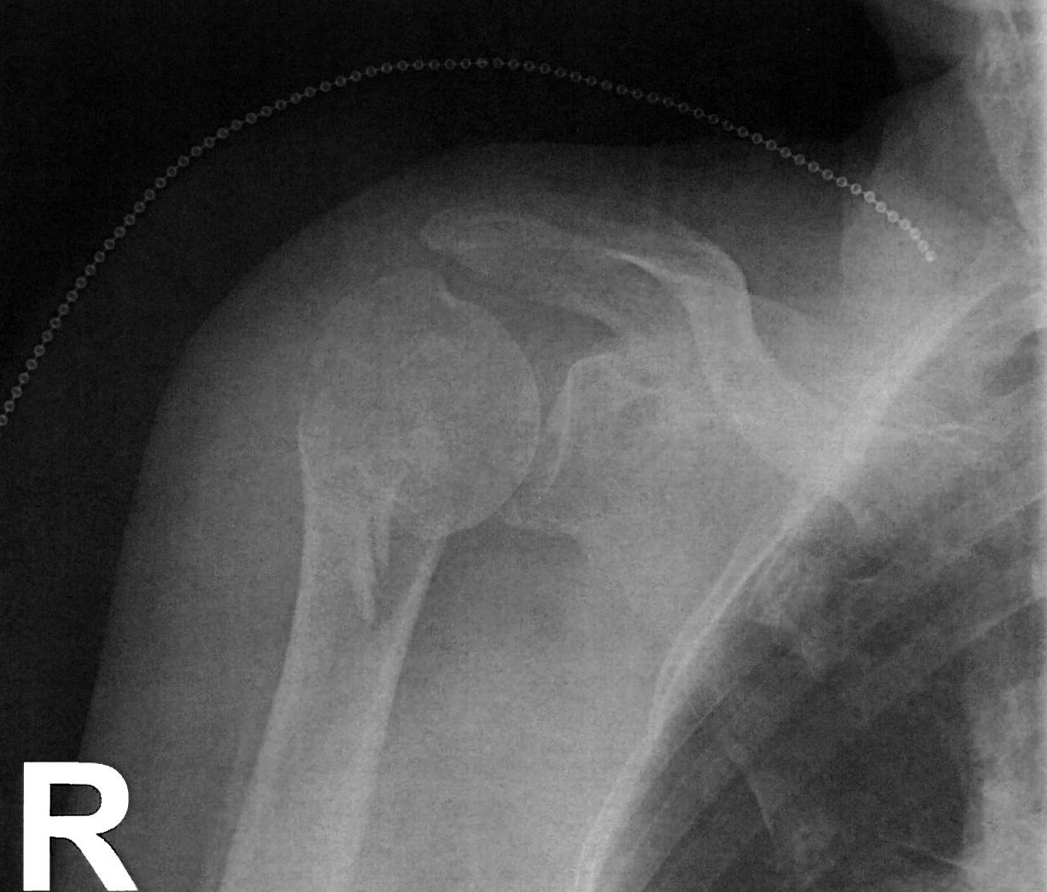
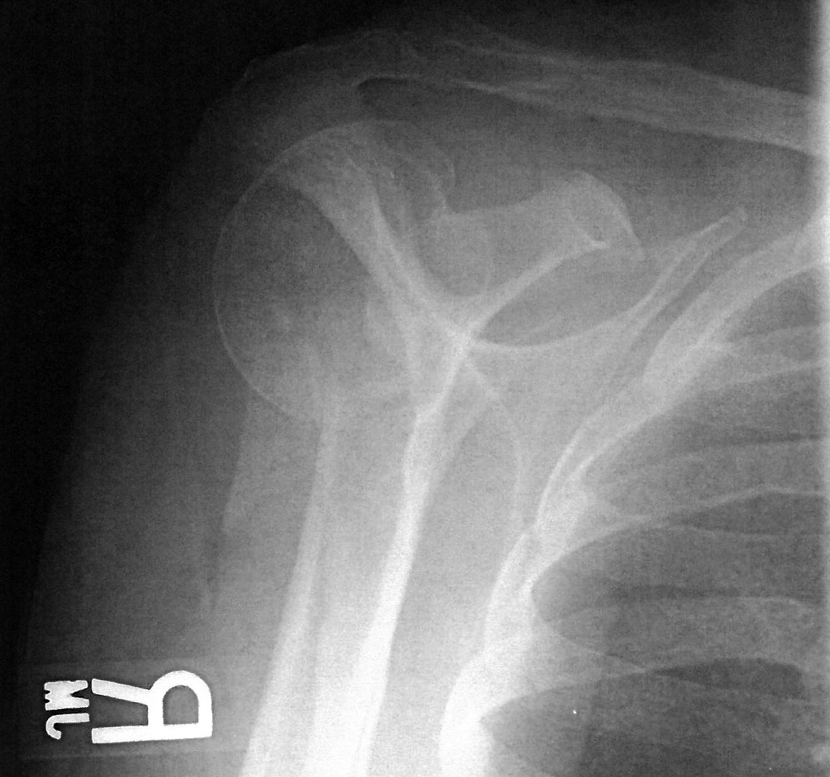
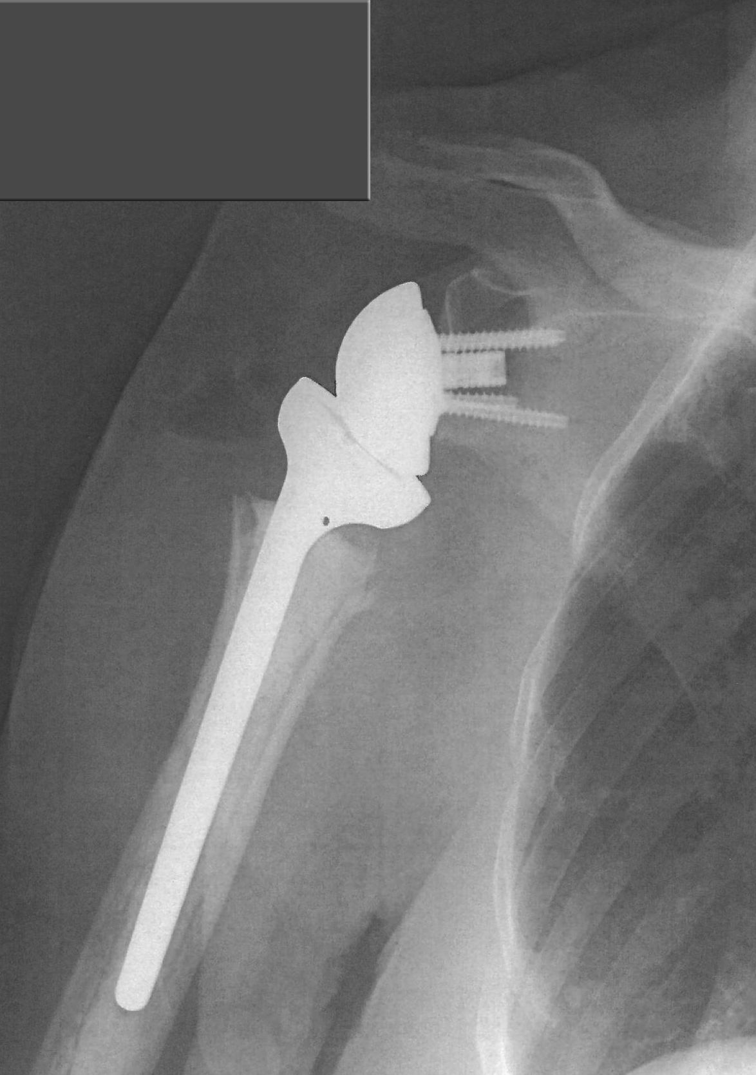
Proximal Humerus Fx

Slide 52
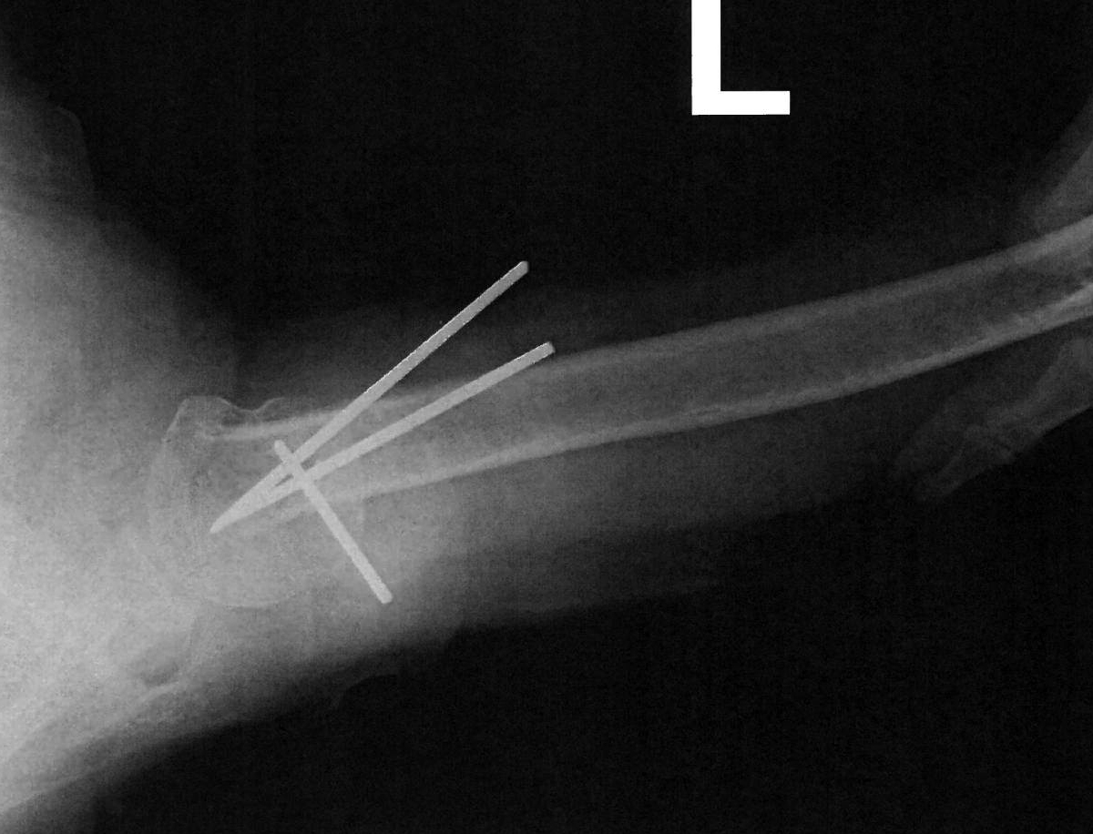
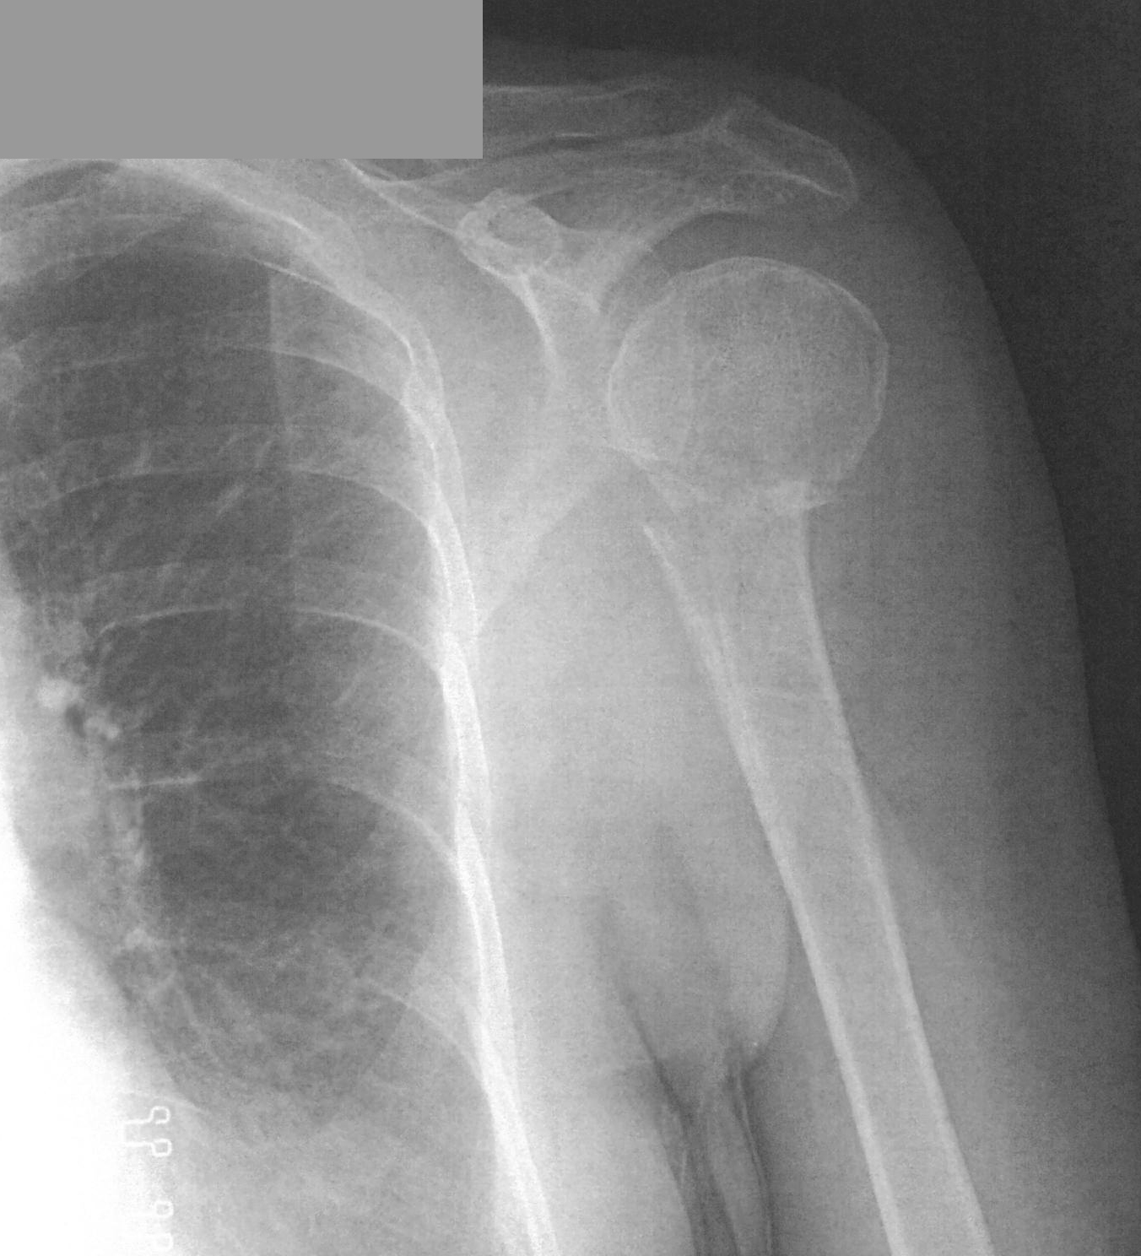
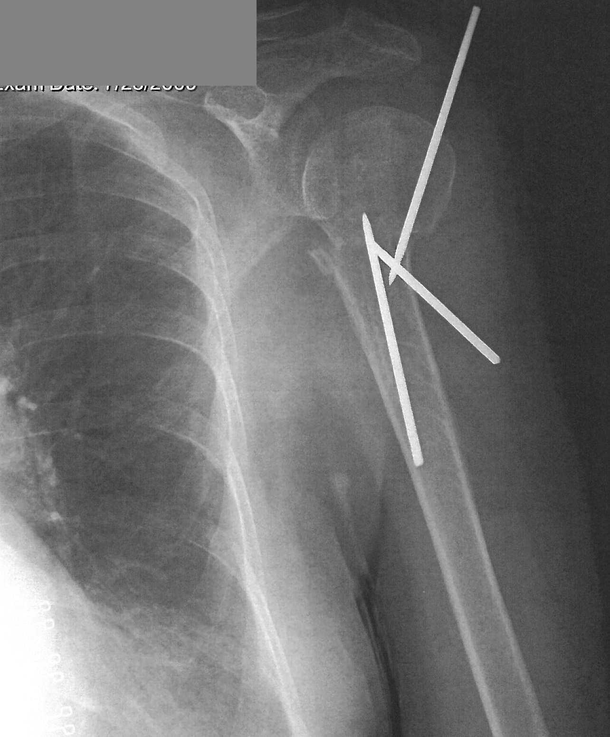
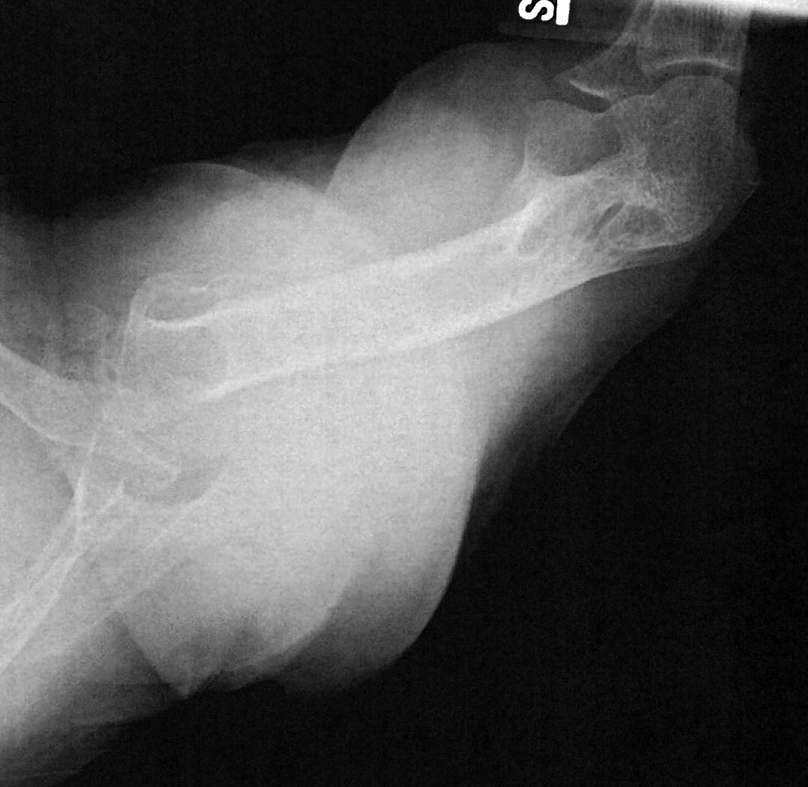
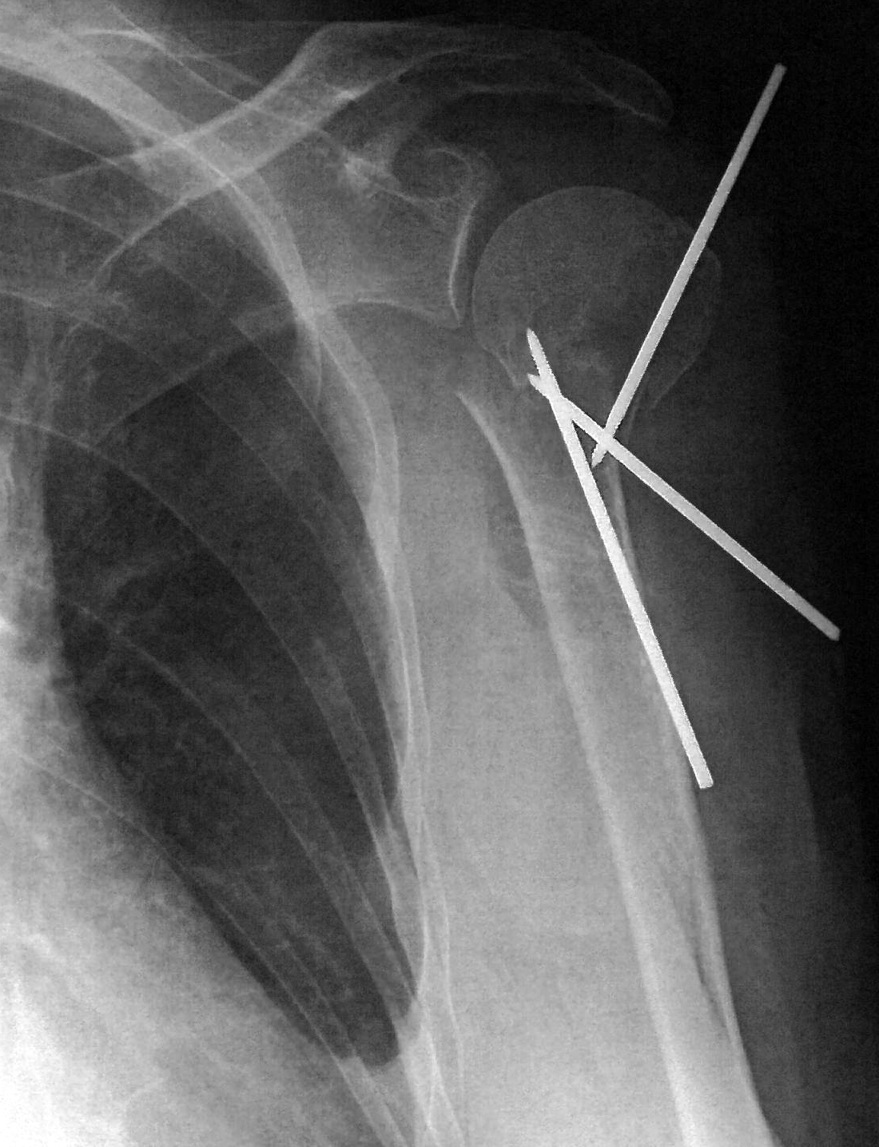
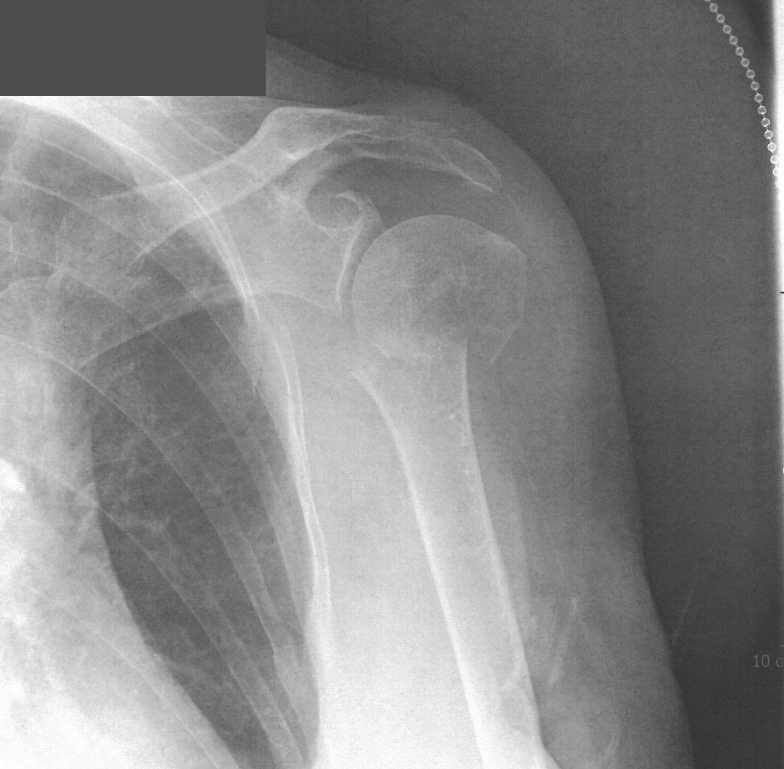
CR Prox Hum Fx

Slide 53
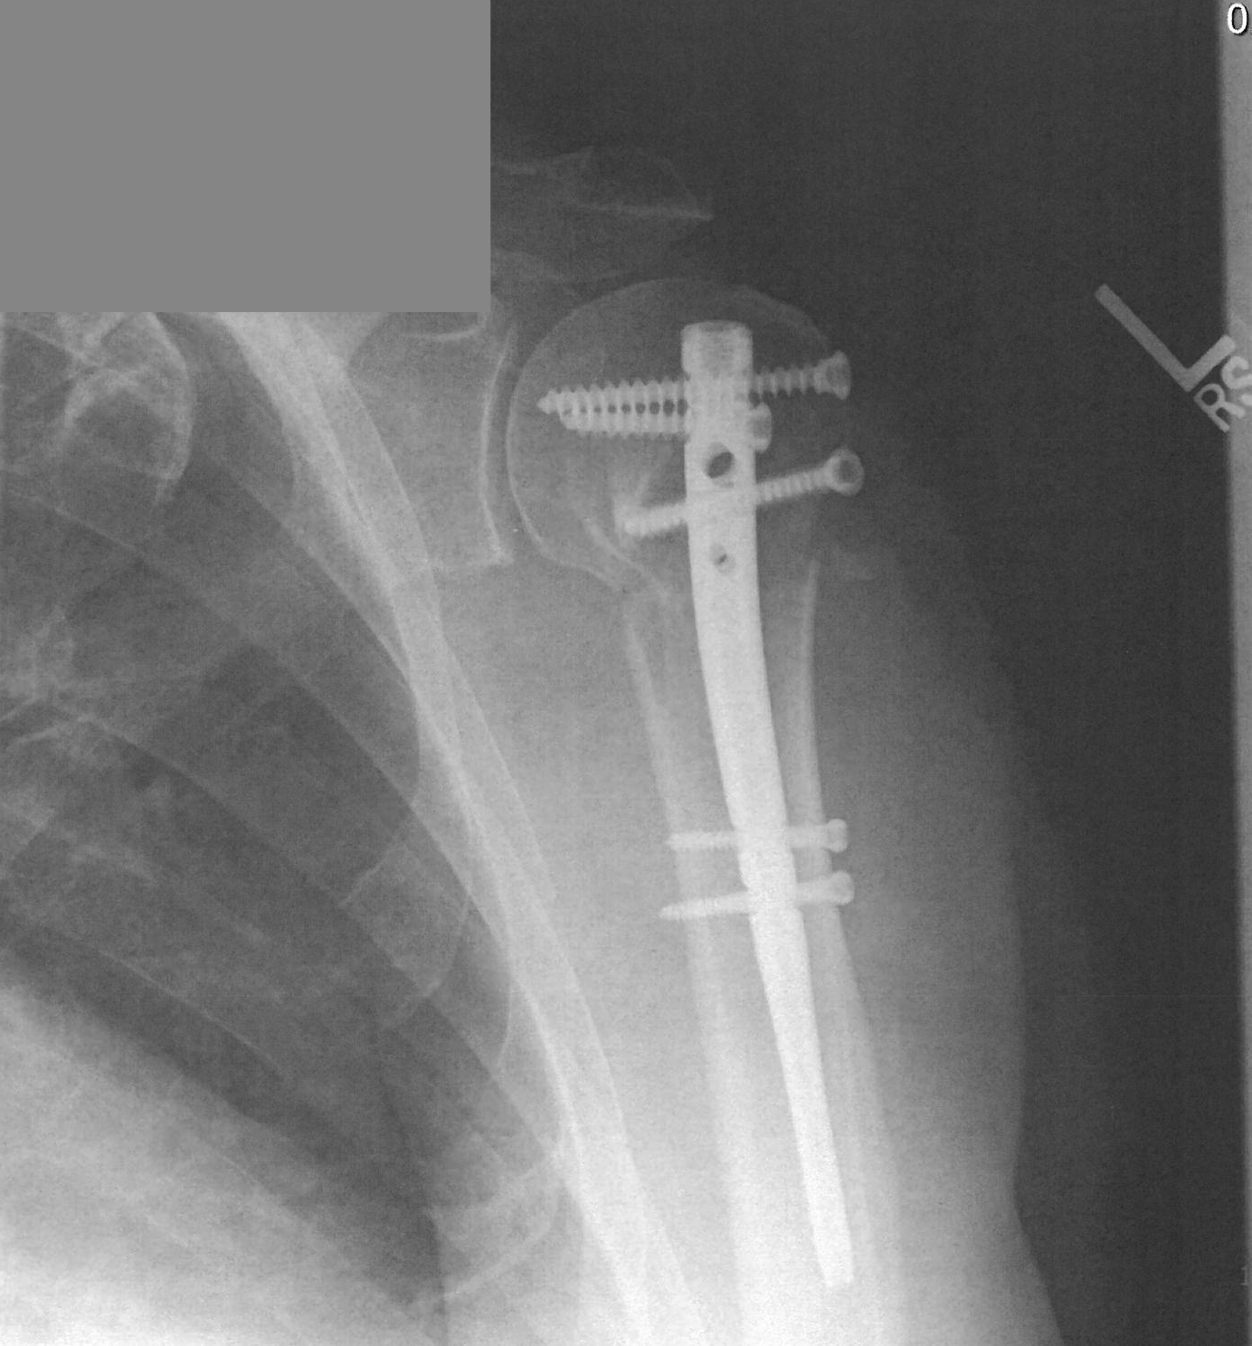
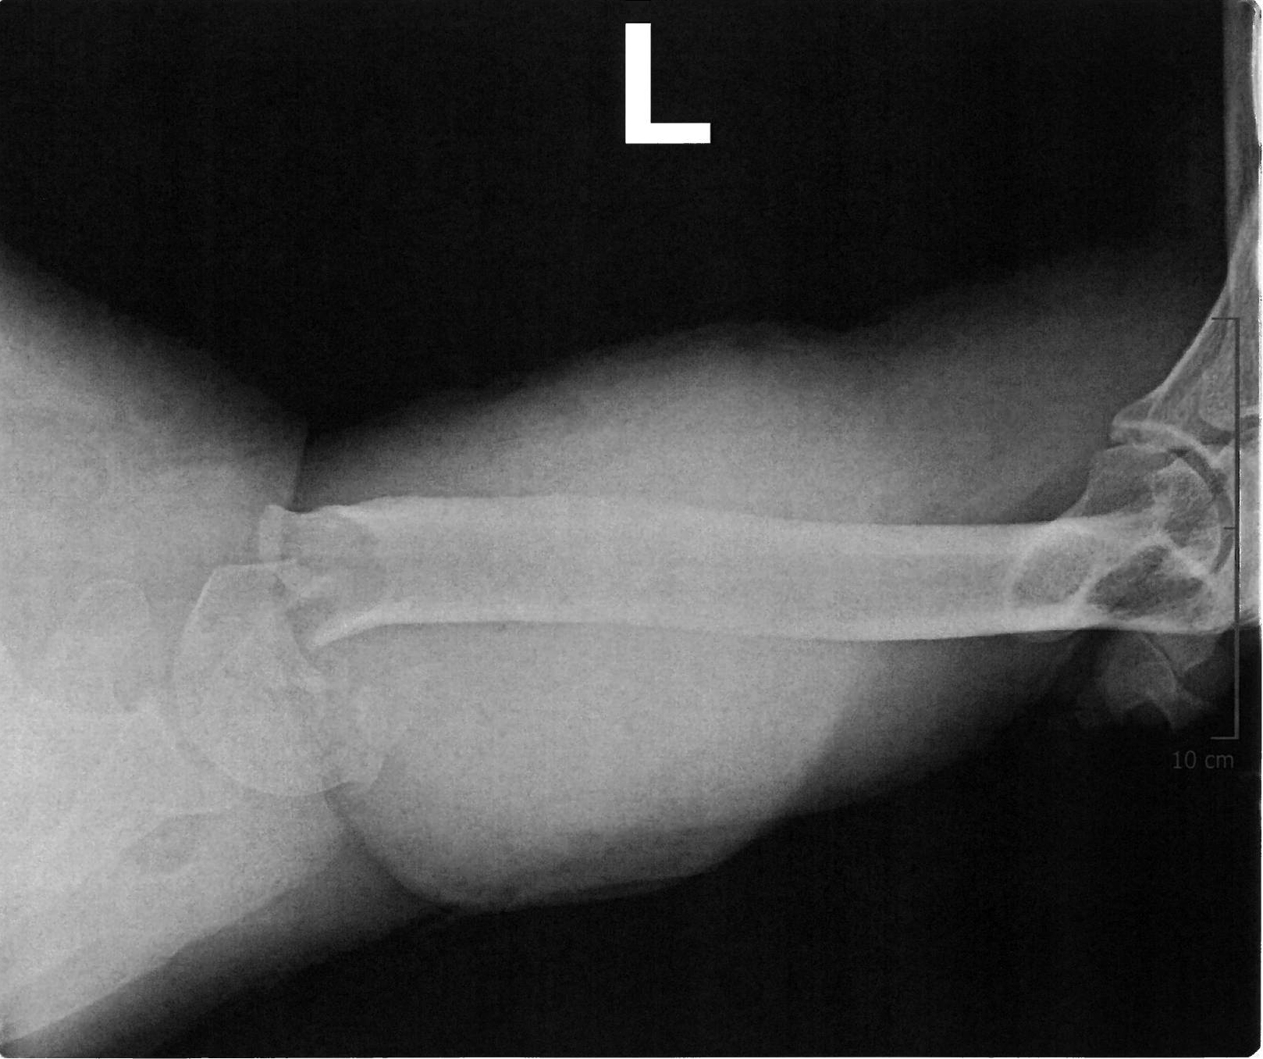
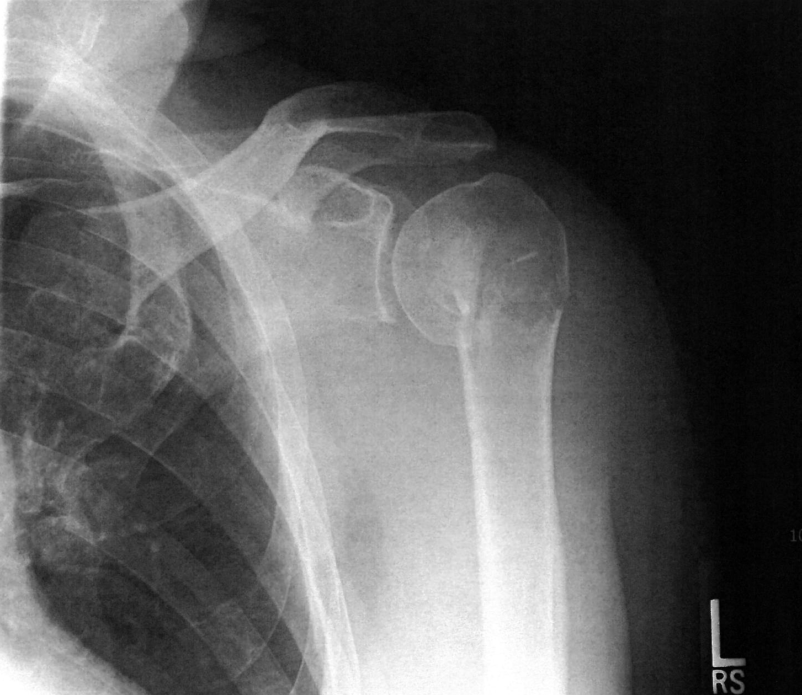
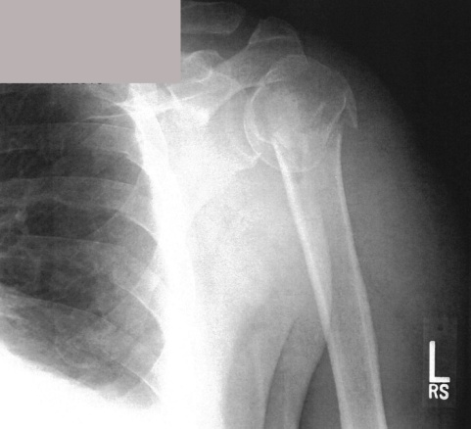
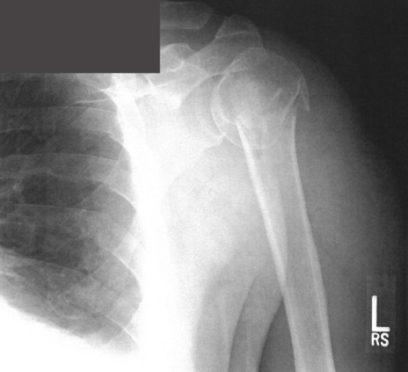
CR IM Rod

Slide 54
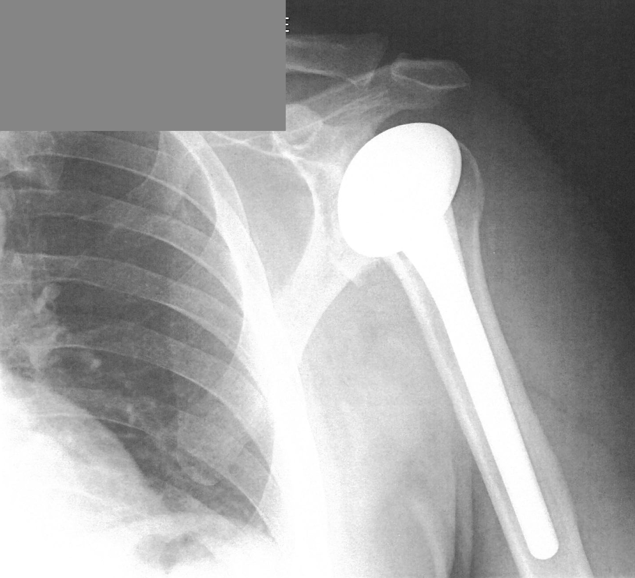
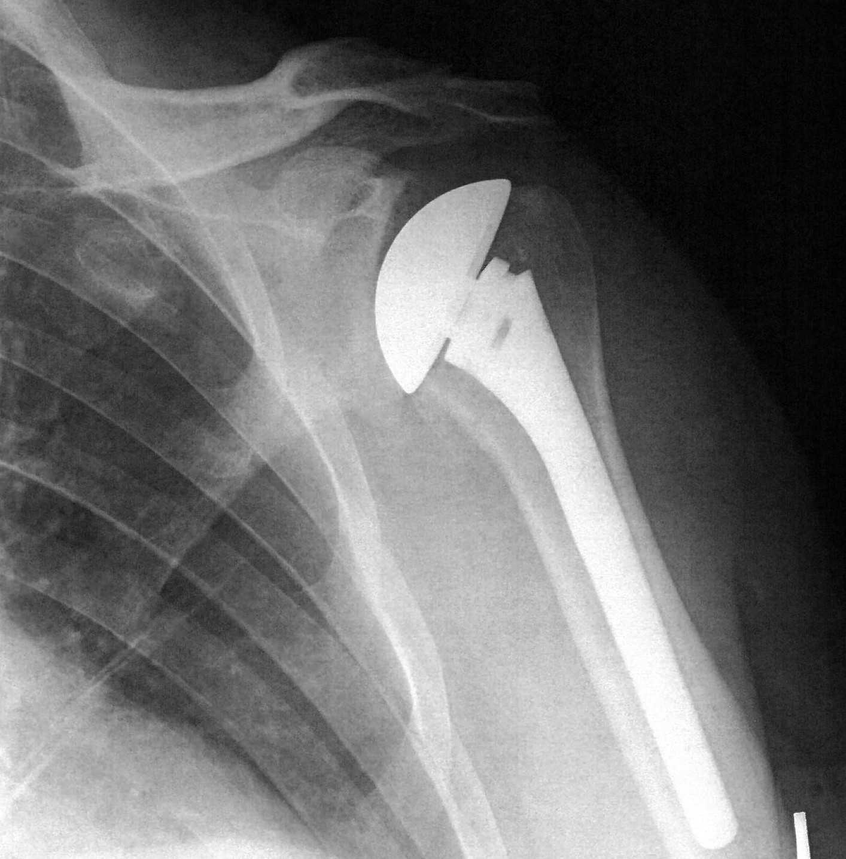
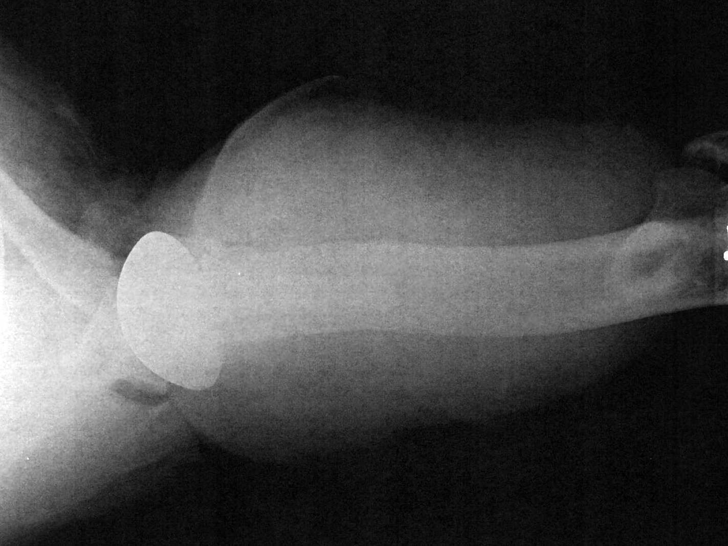
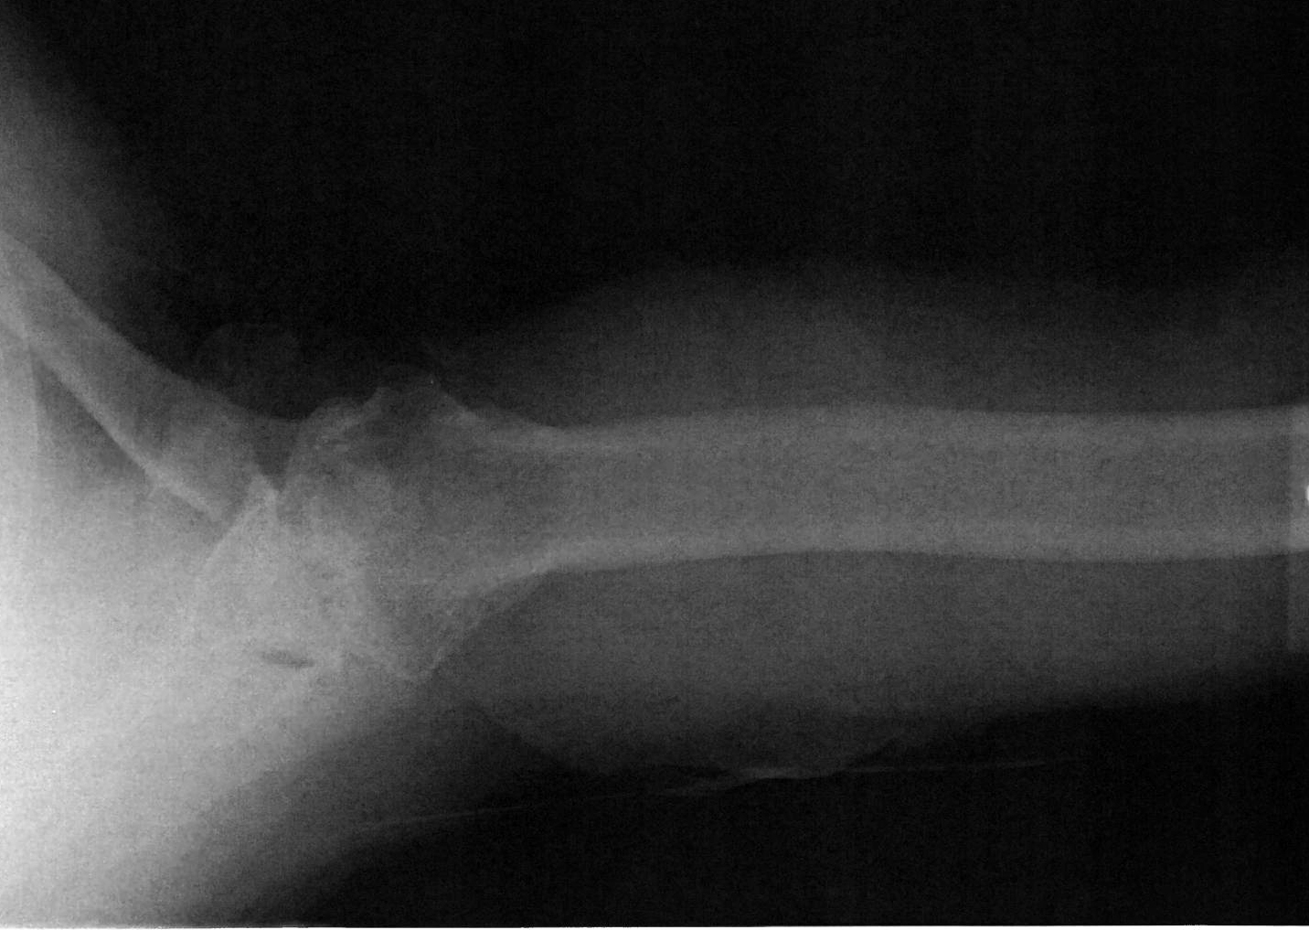
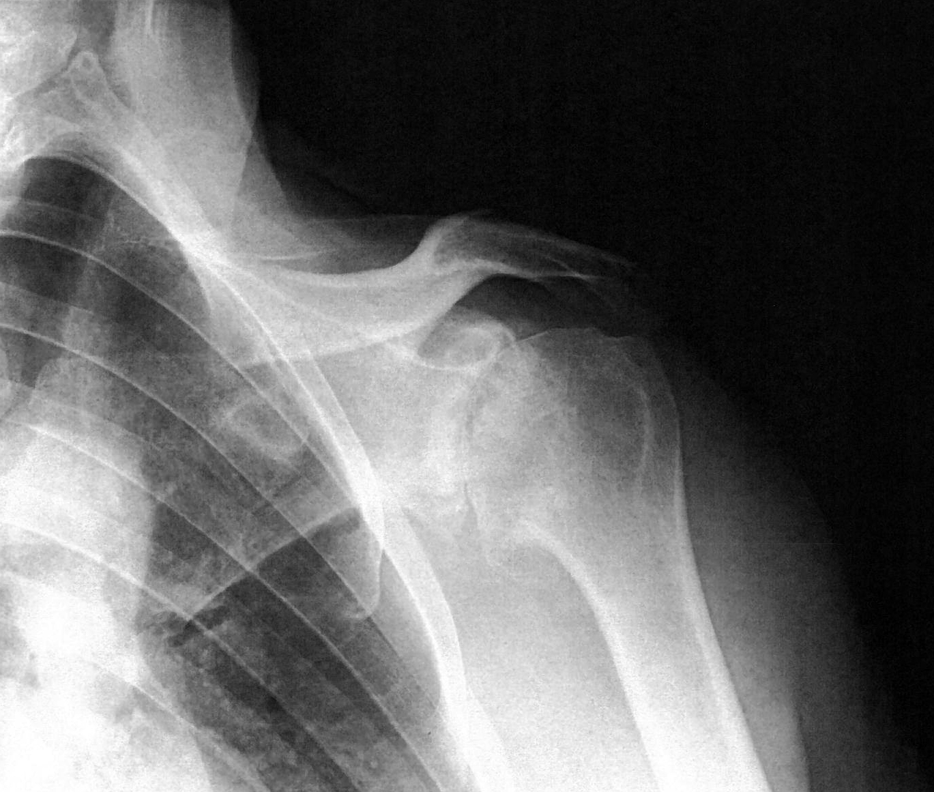
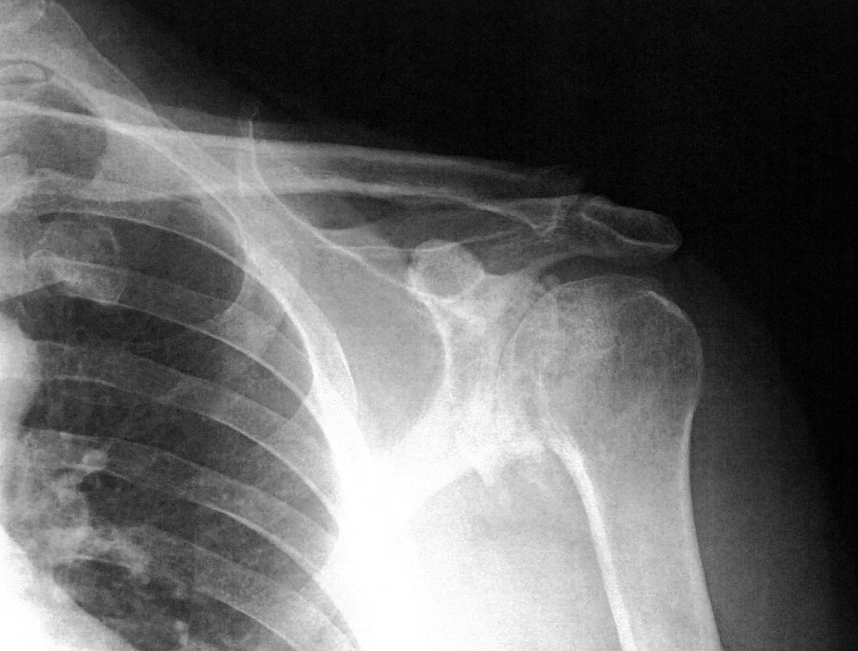
OA Hemi

Slide 55
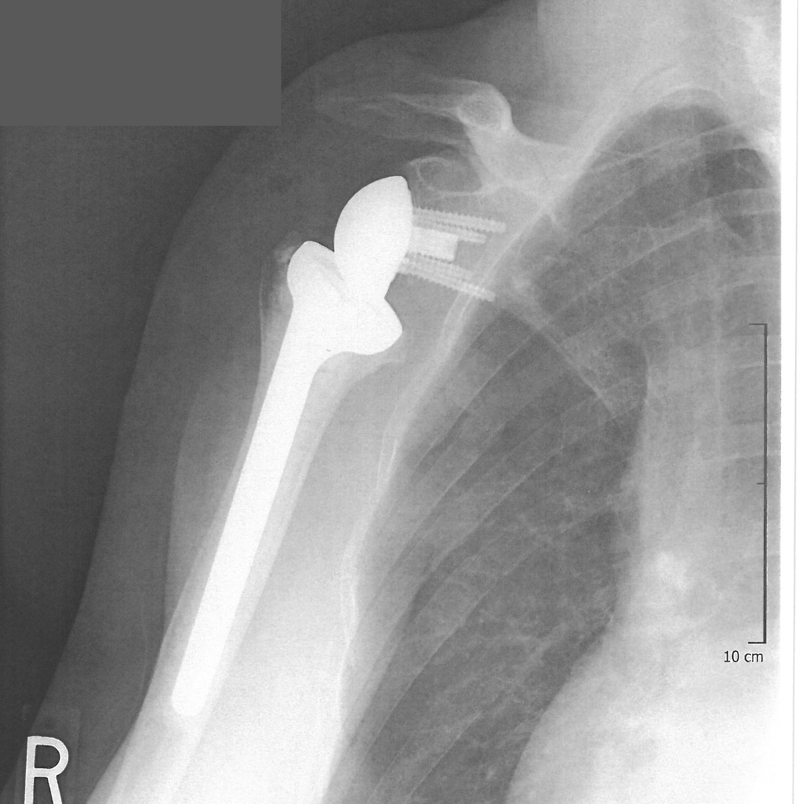
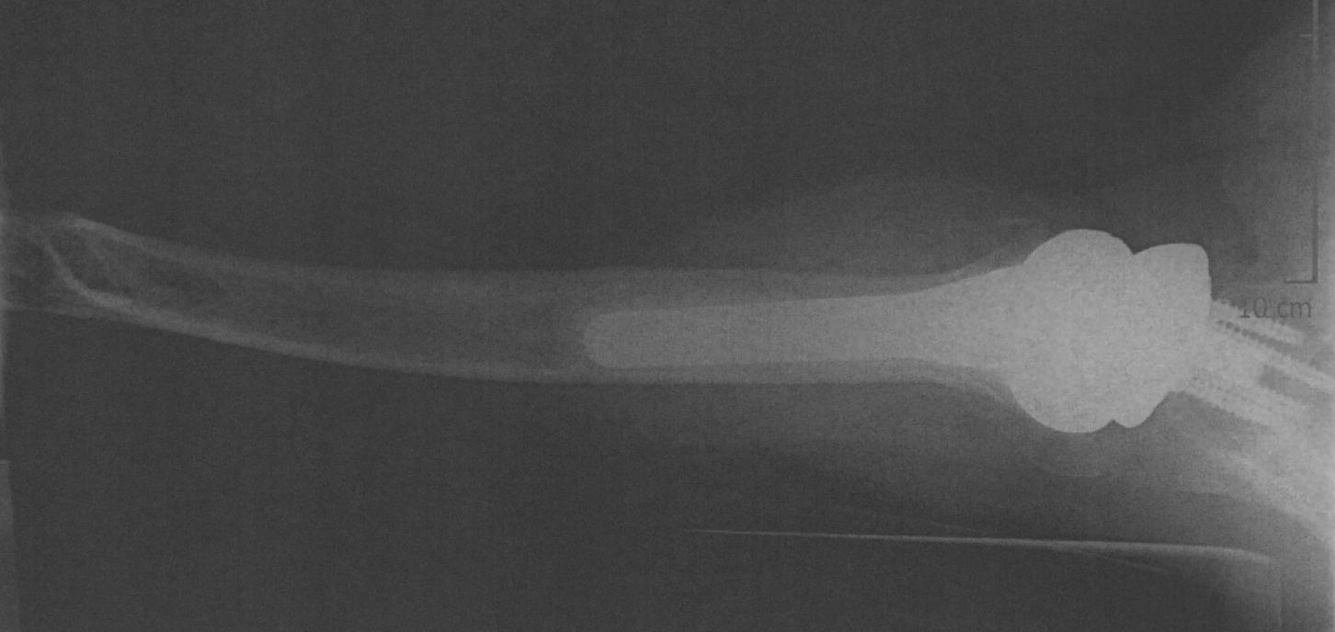
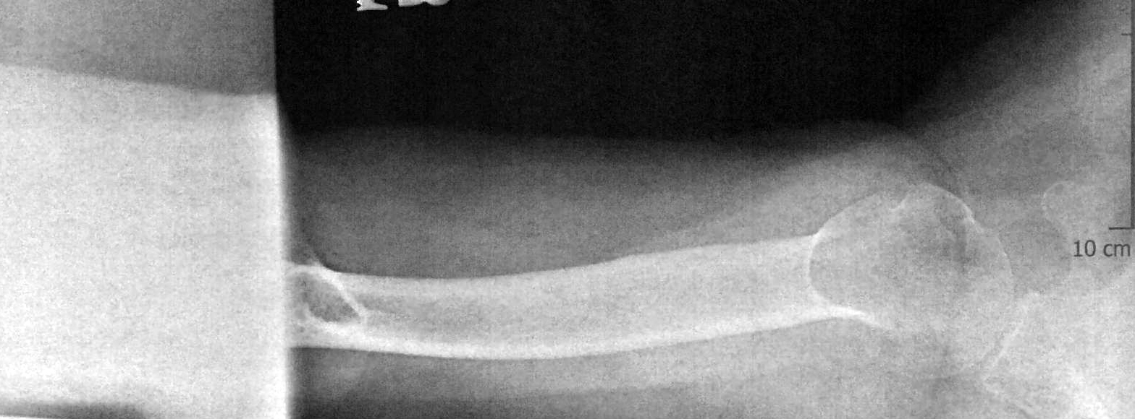
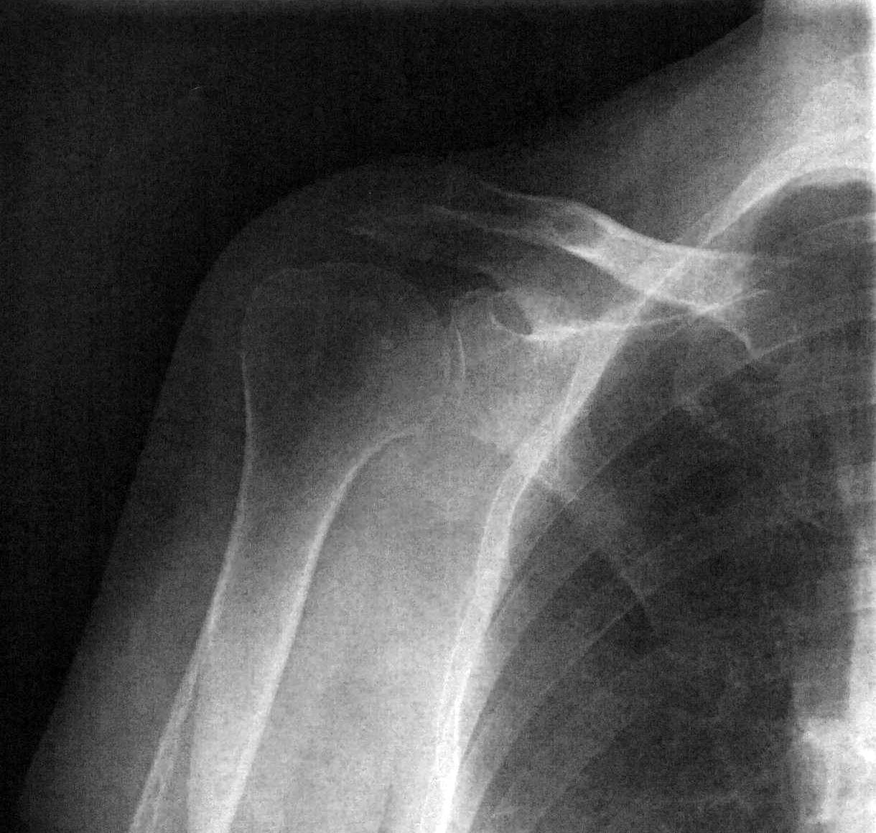
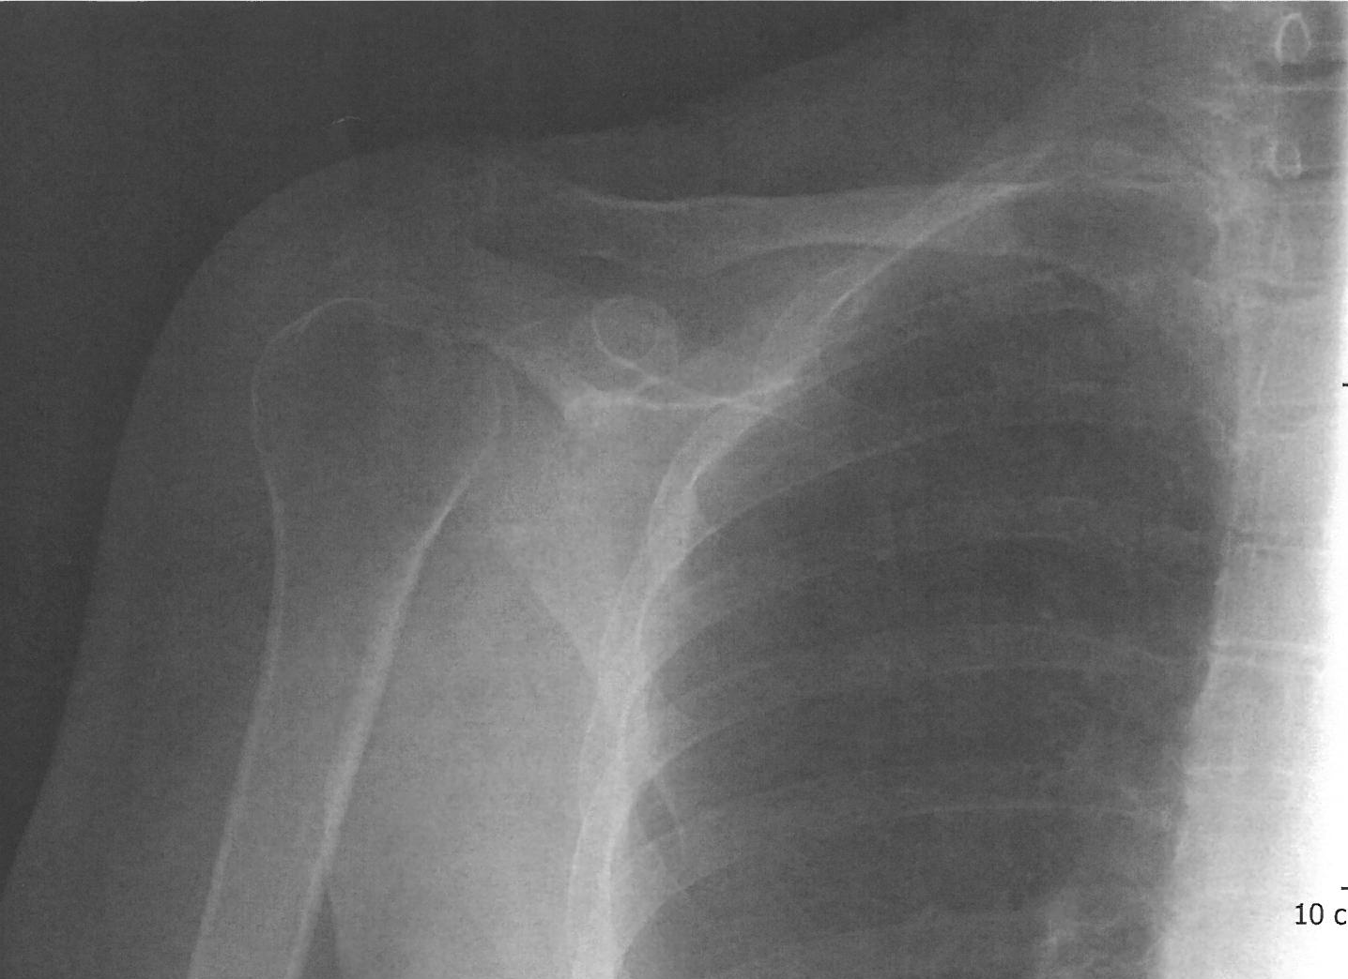
Reverse TSA

Slide 56
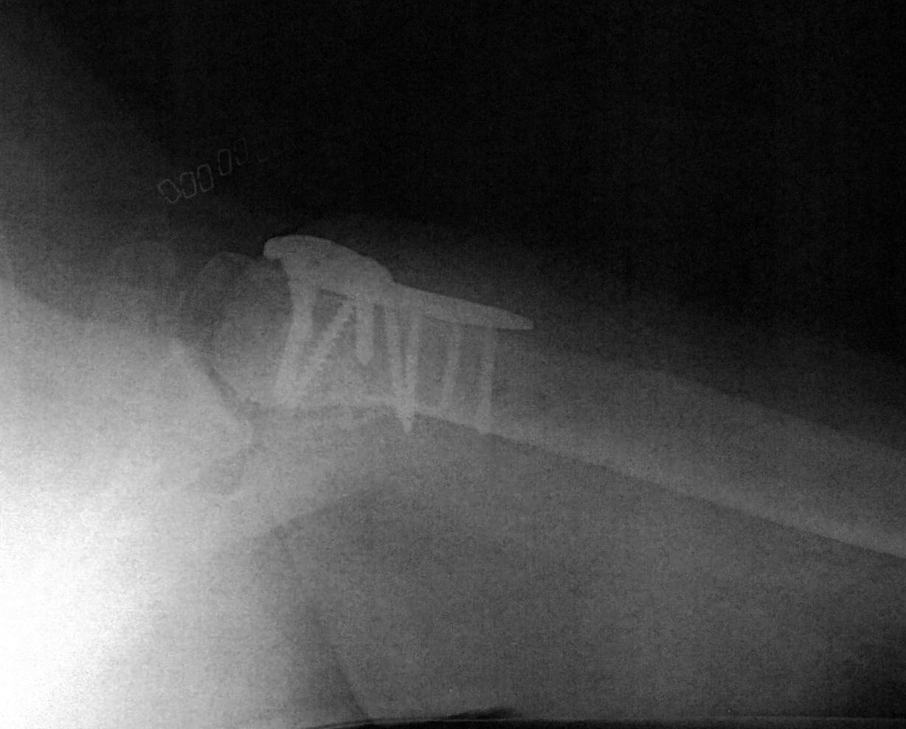
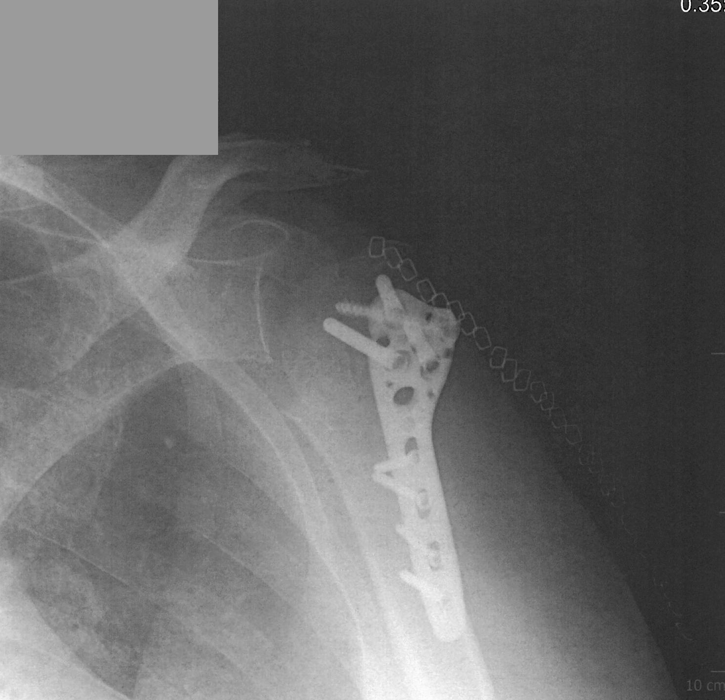
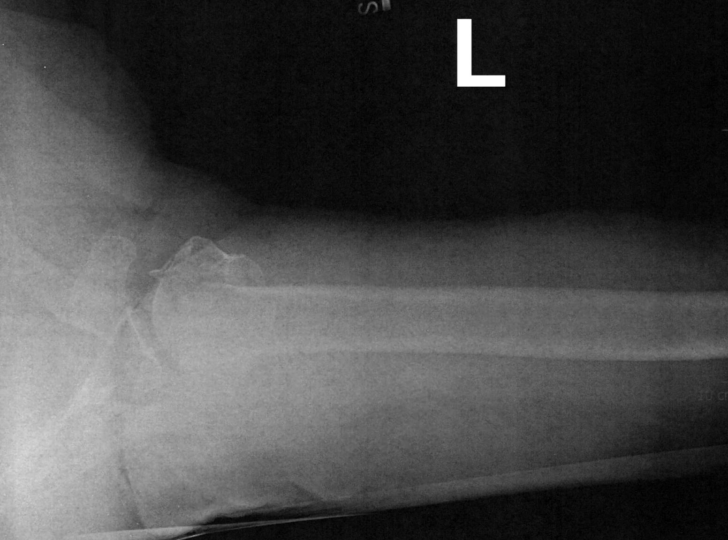
ORIF

Slide 57
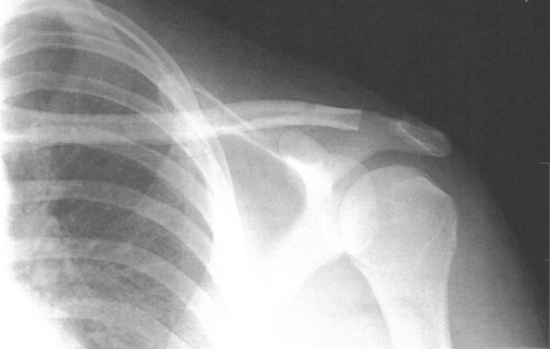
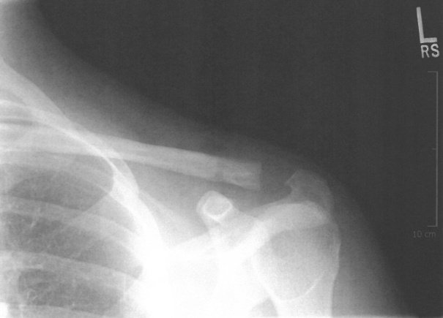
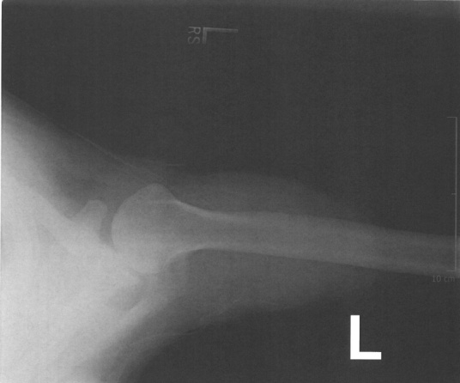
DC

Slide 58
DC excision

Slide 59
AC Recon

Slide 60
Glenoid Fx

Slide 61
AC Recon

Slide 62
Plated Clavicle Fx

