Slide 1
Interventional Pain Management Procedures
Sydney Harman MD

Slide 2
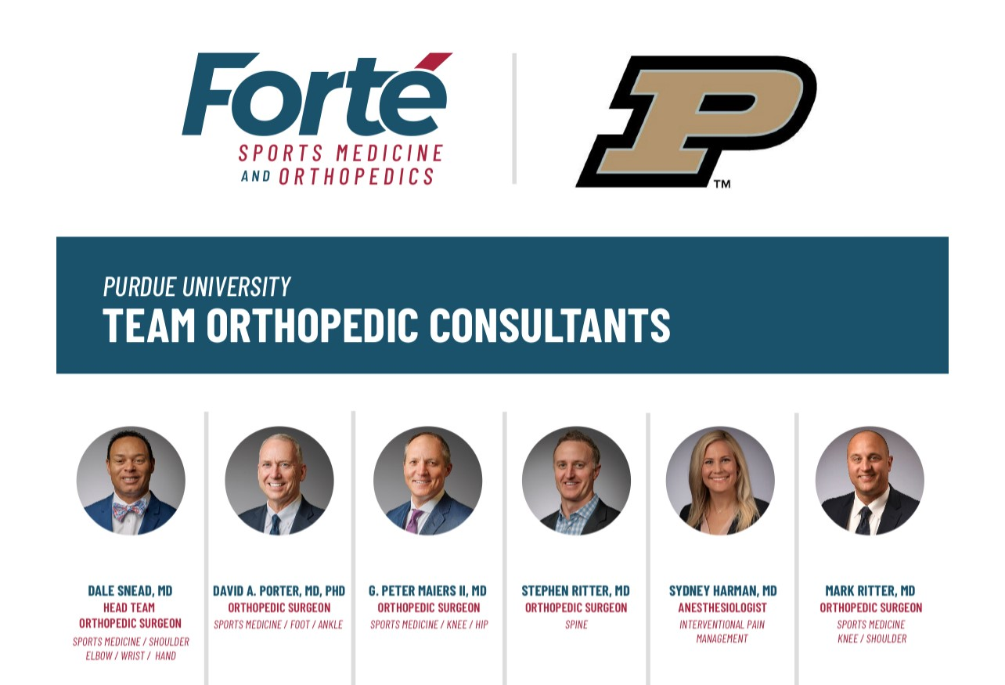
Interventional Pain Management
What does that mean??
Clinic to assess new and return patients, ages 14+
Procedures 2 days/week in ASC
No chronic opioid prescribing

Slide 3
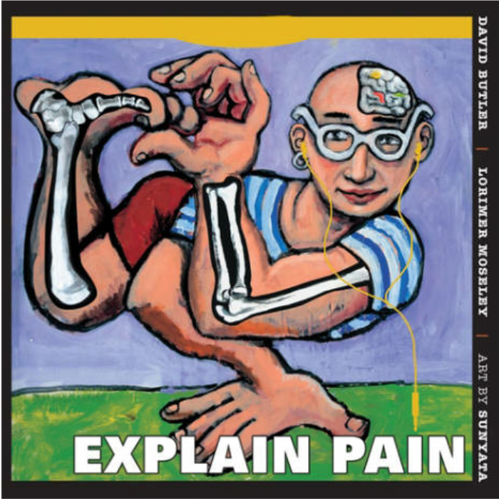
My philosophy
Role of procedures
Education
Tools to decrease pain and allow the patient to participate meaningfully in rehab/lifestyle changes/multimodal treatment
Pain neuroscience education (NOI group)

Slide 4
Education
Pain Neuroscience Education = where I spend most of my time with patients
150K Americans went into a clinic today for back pain… how many of them get education about pain???

Slide 5
The Fear-Avoidance Model
Developed to identify and explain why patients with CLBP develops from an onset of acute LBP
Patients connecting movement to pain can lead to fear and avoidance of what they need most…
…. Movement. “motion is lotion”
The Patho-Anatomic model may help cement this cycle
Slide courtesy of Chris Gray DPT

Slide 6
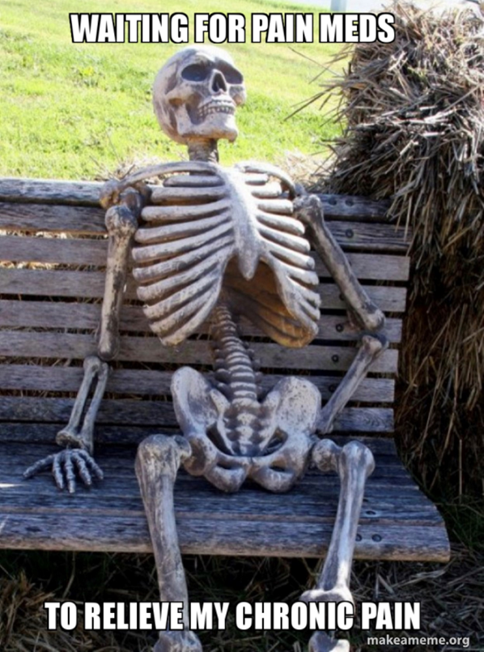
PNE Content
Metaphors and appropriate language to explain:
Neurophysiology of pain
Nociception
Neurons
Synapses
Action potential
Inhibition and facilitation
Central sensitization
Nervous system plasticity
How do we convey these concepts to patients in a digestible manner?
Through metaphors and stories
Example: the body’s alarm system
Slide courtesy of Chris Gray DPT

Slide 7
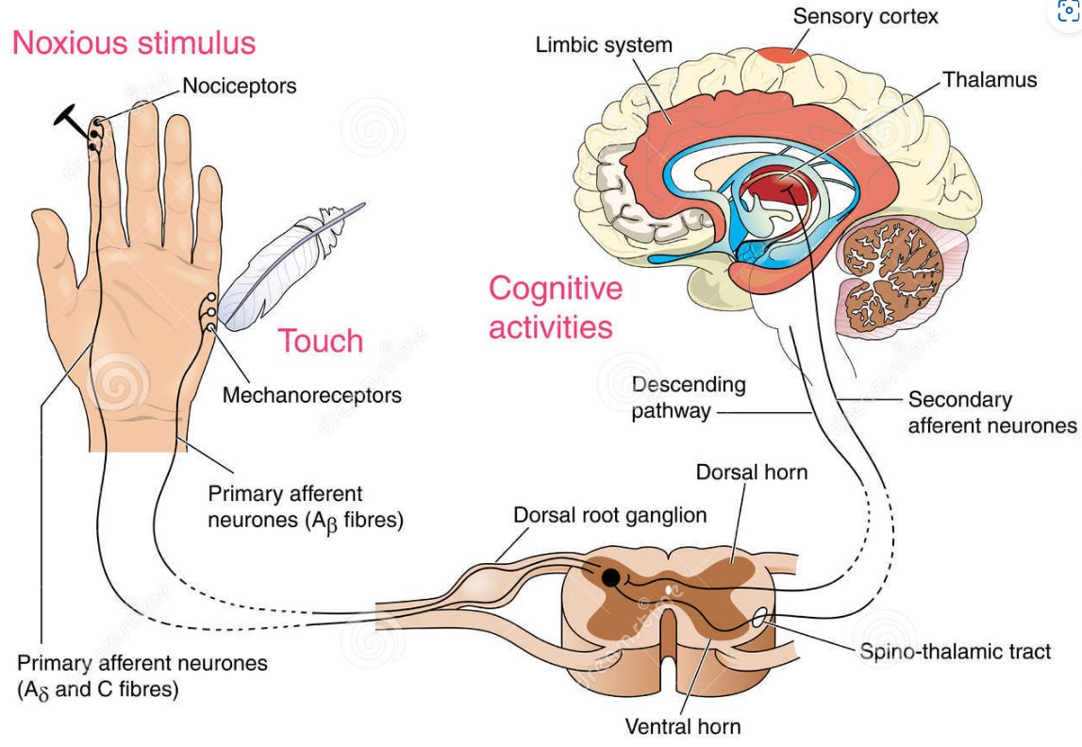
Why bother?
Systematic reviews find strong evidence for:
improving pain ratings
pain knowledge
disability level (increased function)
pain catastrophization
fear-avoidance
attitudes and behaviors regarding pain
physical movement
health care utilization ($)
Slide courtesy of Chris Gray DPT

Slide 8
Procedures
-Minimal sedation
-Expectation setting is KEY
-I follow SIS guidelines

Slide 9
ESI: Transforaminal vs Interlaminar
Indications:
-Cervical or lumbar RADICULAR pain
Contraindications:
-Anticoagulation/bleeding disorder
-Active infection
-Uncontrolled DM
-Contrast allergy that we can’t pretreat

Slide 10
TFESI
-Does not require intact ligamenum flavum for LOR technique
-Diagnostic specificity / SNRB

Slide 11
A word on cervical TFESI…
-Higher risk of vertebral artery related complications
-I do not perform them other than as cervical selective nerve root blocks for diagnostic confirmation and surgical planning
-I use modified approach as developed by Dr. David Levi et al and taught by SIS

Slide 13
Interlaminar ESI
-More diffuse spread of medication (multiple levels)
-Ability to inject greater volume

Slide 14
Medial branch neurotomy
Cervical, thoracic, lumbar facetogenic pain
Three step process
-MBB x2
-RFA
6 month average duration of action = springboard for building confidence and advancing activity (breaking fear/avoidance cycle)
Recent literature suggests it does not cause advancement of spondylolisthesis, however I educate on this possibility

Slide 15
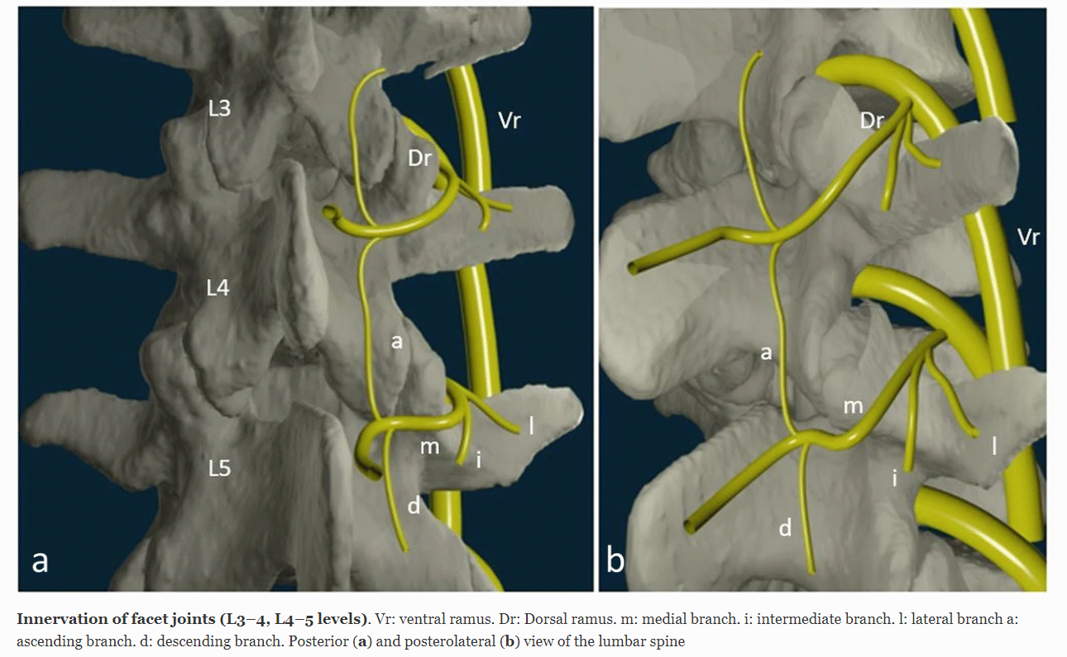
58 year old female, right sided low back pain with lumbar extension, prolonged walking or standing on hard surface, no radicular component
Persistent despite formal PT, chiropractic care, anti-inflammatories, lifestyle modification
Lumbar medial branch blocks → RFA

Slide 16
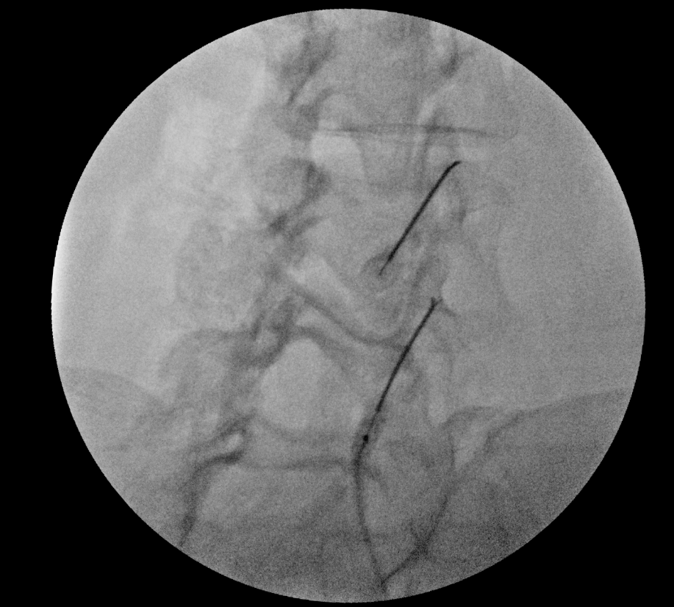
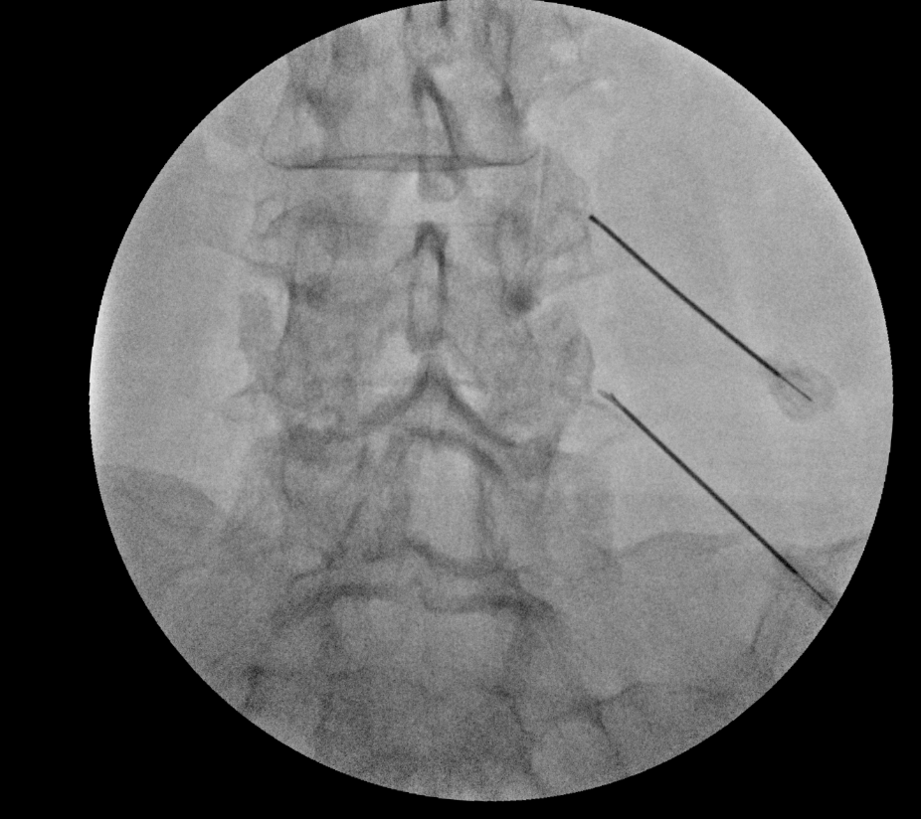
90 second cycle at 80 degrees Celsius after injection of 0.5ml of 2% lidocaine
Patient returned 6 weeks post, 95% relief of LBP, walked 20k steps a day on vacation

Slide 17
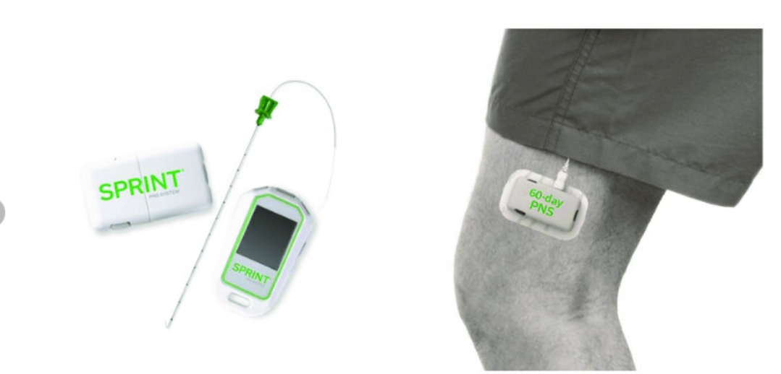
Peripheral neuropathies
Most common targets
Lateral femoral cutaneous
Saphenous

Slide 18
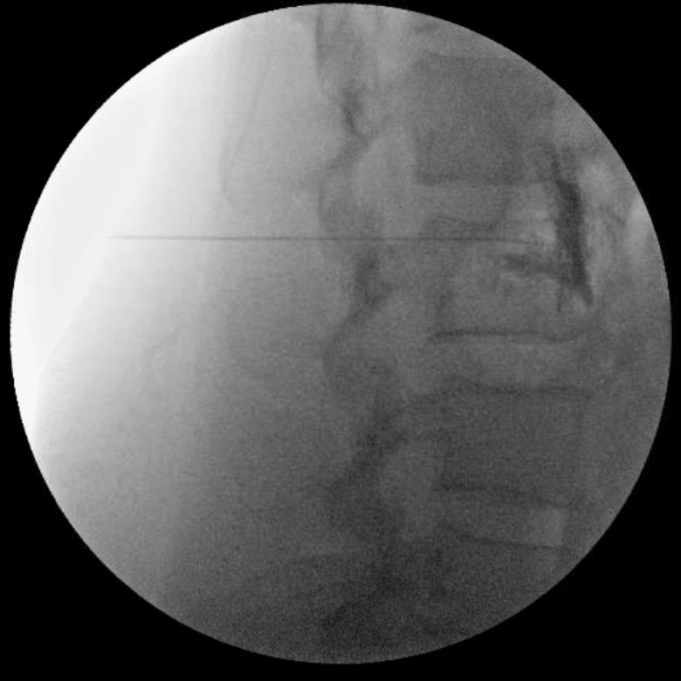
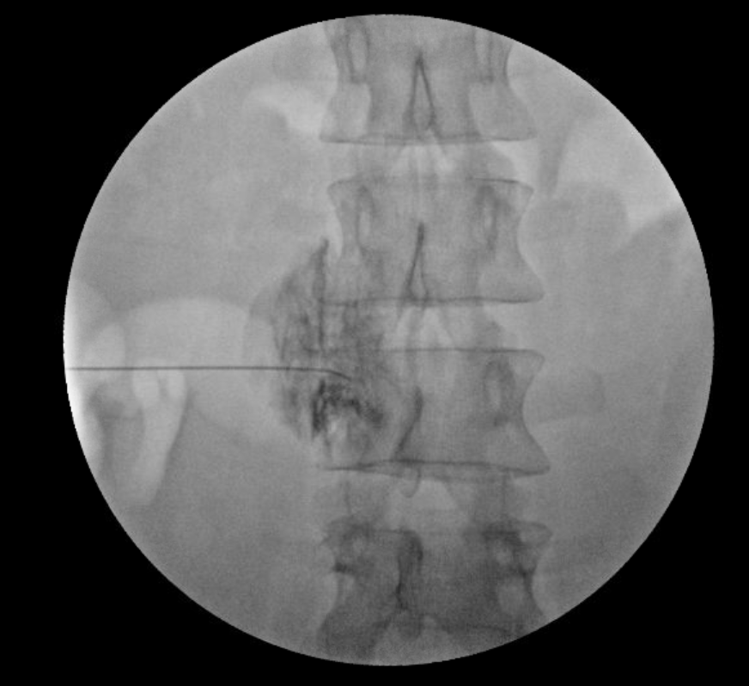
Sympathetic blocks Sympathetically maintained pain = abnormal connections between sympathetic and sensory nervous systems -Stellate ganglion -Covid anosmia? -Lumbar sympathetic

Slide 19
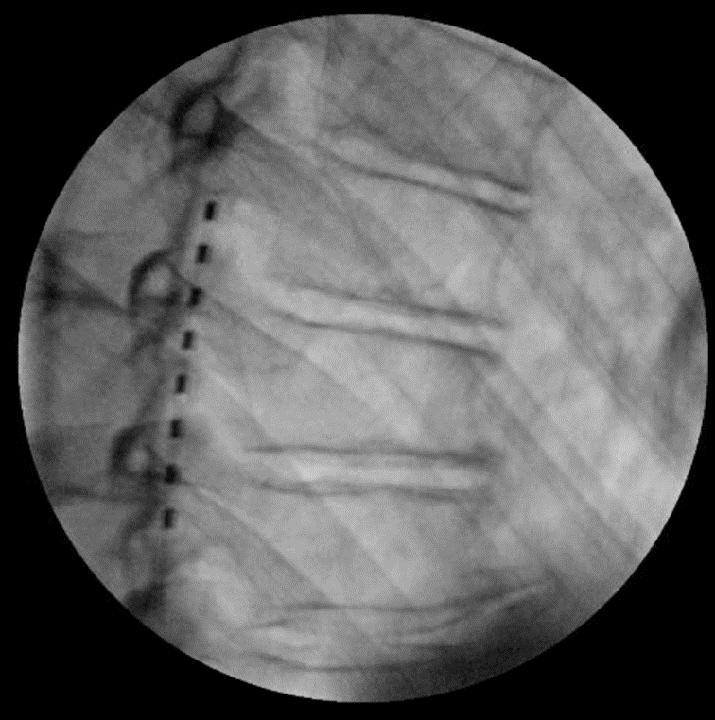
Spinal Cord Stimulation
(Trials only)
-Failed back surgery syndrome
-Peripheral mononeuropathy
-CRPS

Slide 20
Other Fluoro Procedures…
Intra-articular hip
Sacroiliac joint injection
Sacroiliac RFA
Piriformis

Slide 21
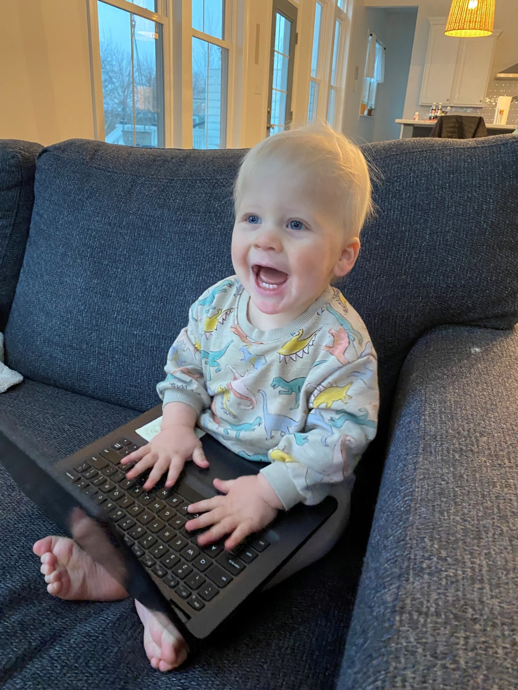
THANK YOU
FIRST UP CONSULTANTS
Sydney Harman MD
Clinical assistant: Cristie Anstead
canstead@forteortho.com
Office: 317-419-6027
Cell: 319-310-6496
sharman@forteortho.com
https://forteortho.com/

