Slide 1
Hindfoot Deformity- Cavovarus and Pes Planovalgus
Andrew Wohler, MD
4/29/23

Slide 2
Disclosures
No relevant financial disclosures to report

Slide 3
Outline
Summary/Anatomy
Presentation/Imaging
Treatment Options

Slide 4
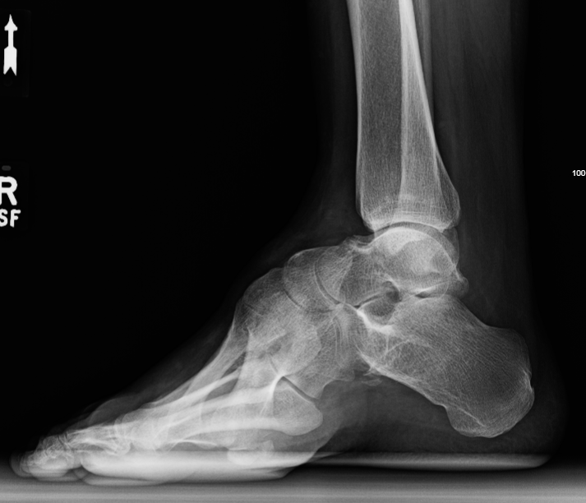
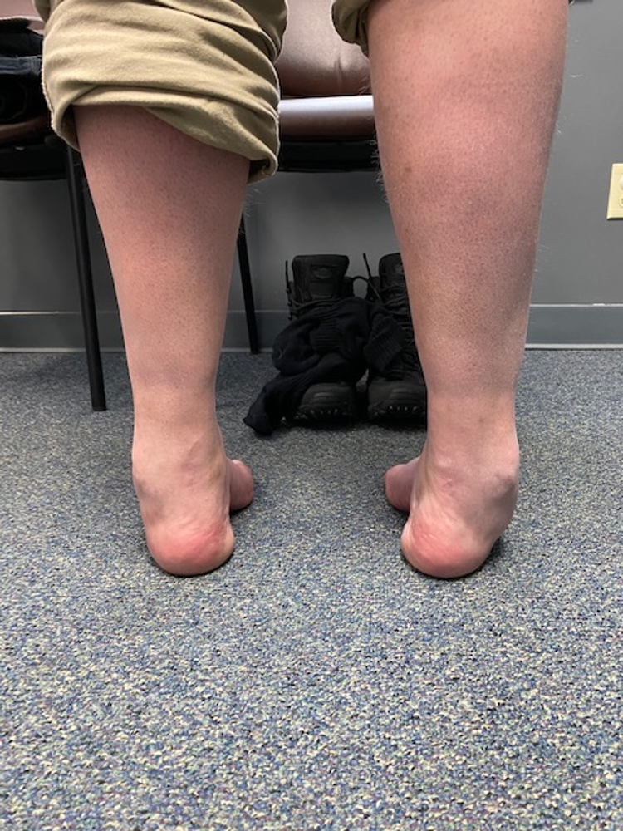
So whats the big deal?

Slide 5
Pes Planovalgus
15-20% of adults in the USA have flatfeet, and the vast majority
Are flexible and asymptomatic
Never require orthopedic intervention
Do NOT develop physical or functional limitations
No (non-surgical) treatment at any point in their lifetime will change the ultimate foot posture
Juvenile/adolescents with rigid flatfoot
Tarsal coalition- Recurrent ankle sprains

Slide 6
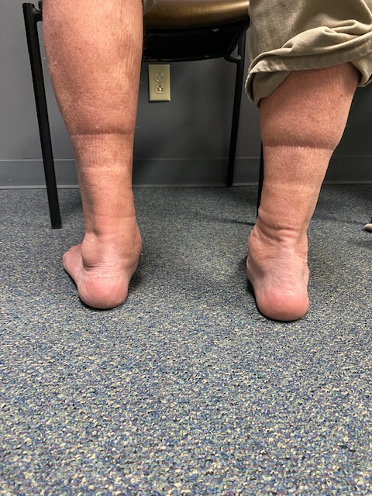
Pes Planovalgus
Posterior tibial tendon dysfunction*
Midfoot instability, midfoot arthritis
Traumatic- spring ligament rupture, acute posterior tibial tendon rupture

Slide 7
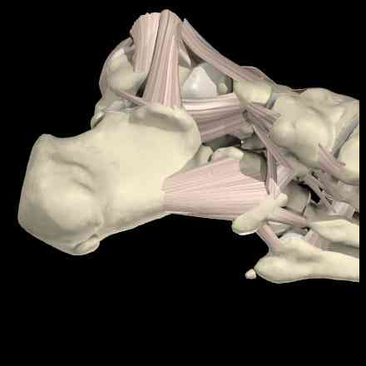
Anatomy
Spring ligament- calcaneonavicular ligament
Plantar fascia aponeurosis- Windlass effect with DF of the MTP joint
Spring Ligament

Slide 8
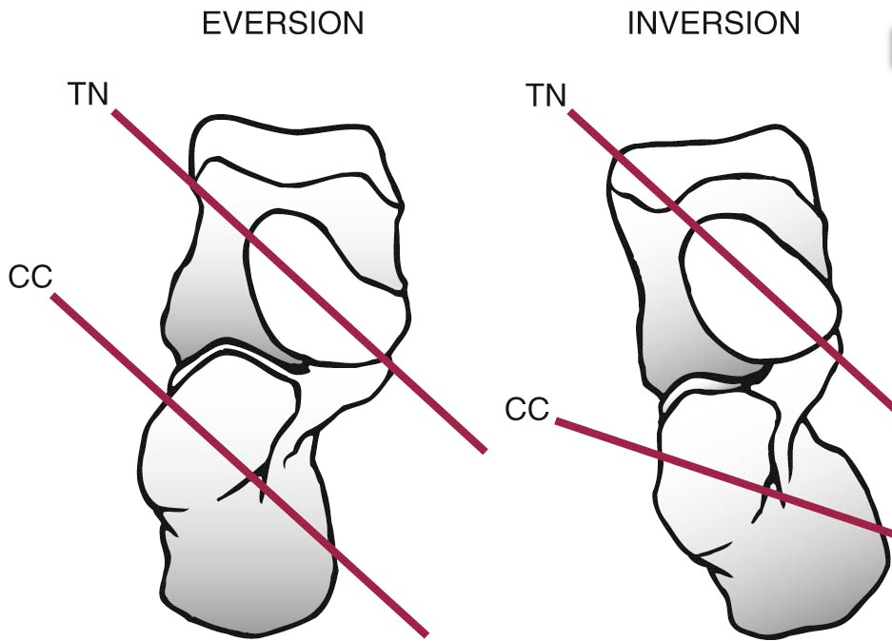
Posterior Tibial Tendon Dysfunction
Most common cause of adult acquired flatfoot deformity
“Progressive collapsing foot deformity”
PTT- inversion of the hindfoot
Locks the transverse tarsal joint to allow triceps surae to drive plantarflexion and heel rise

Slide 9
Presentation
Pain at PTT insertion, medial swelling
Pain in sinus tarsi/subfibular region
Weakness and progressive pain with activity
Worsening foot deformity
Exam-
Increased hindfoot valgus
Forefoot abduction- “too many toes sign”
Gastrocnemius tightness
Pain over PTT or in sinus
Inability to single leg heel rise

Slide 10
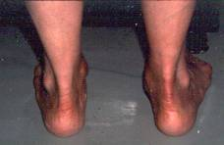
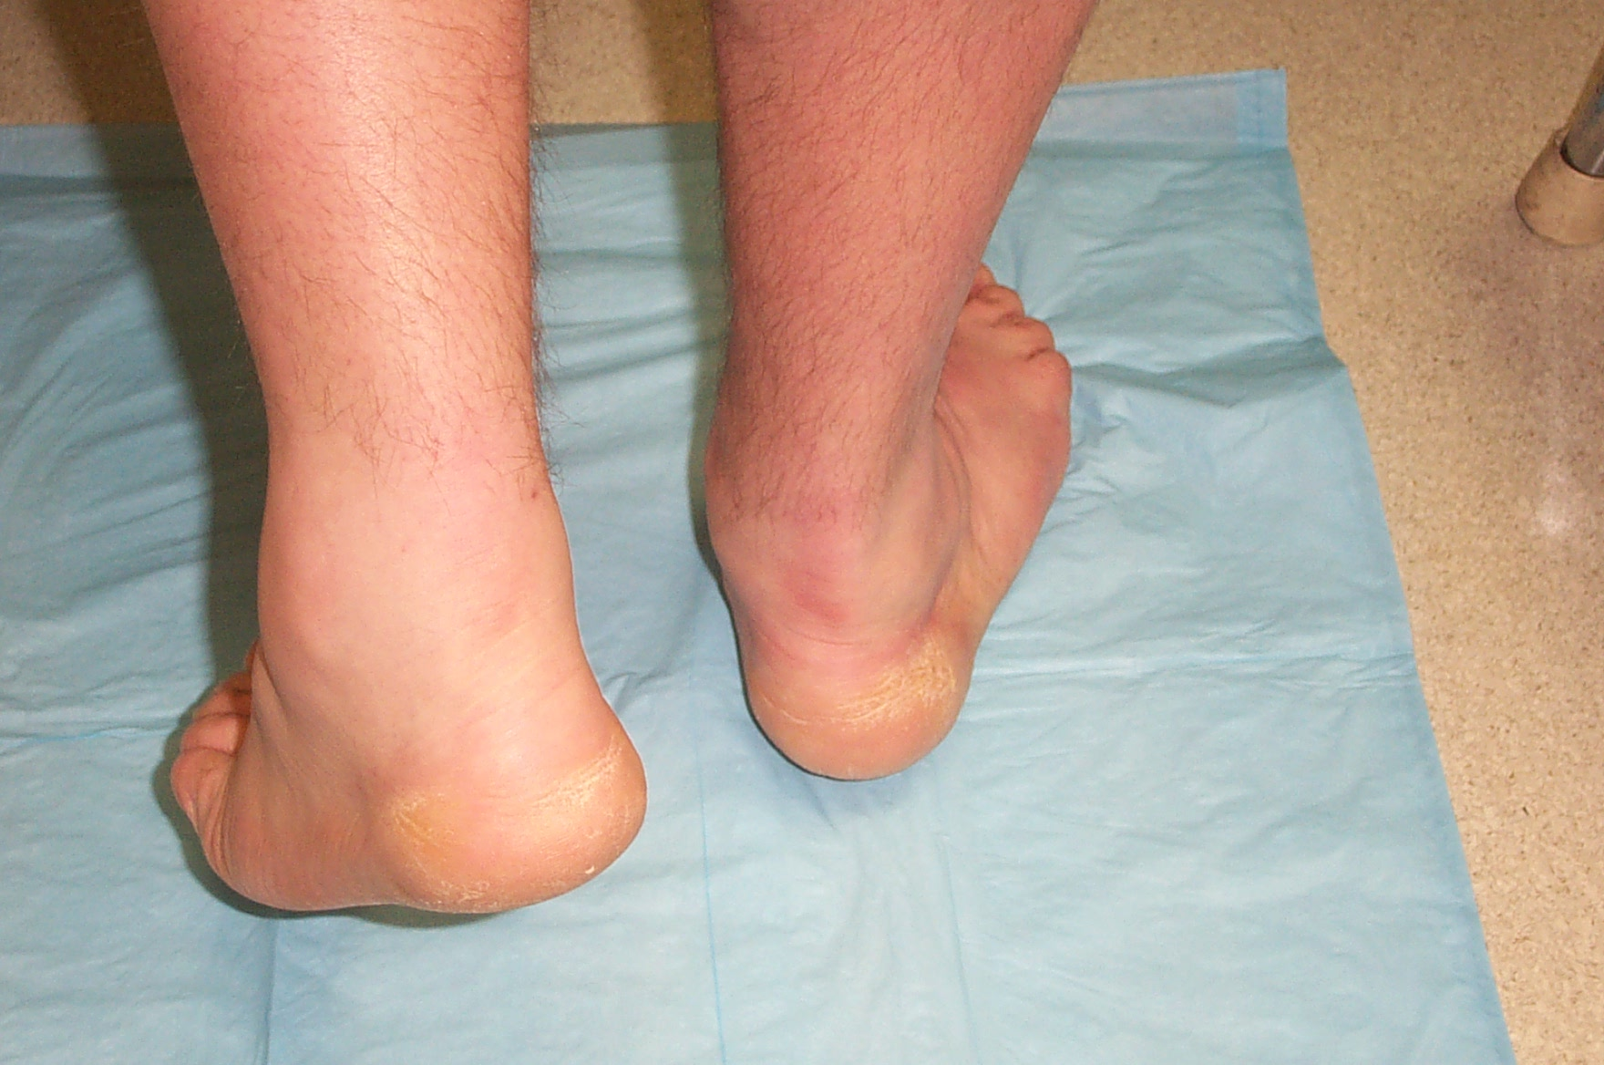
Presentation

Slide 11
Cavovarus
Neurologic
CMT (HSMN)
Syringomyelia, diastematomyelia, tethered cord (Unilateral)
Post-stroke, poliomyelitis
Post-traumatic- talar neck malunion, calc malunion
Congenital- clubfoot
Muscular imbalance-
PT>PB leading to adduction and varus
PL>TA leading to 1st ray plantarflexion, varus, supination
Extrinsics>Intrinsics leading to claw toes

Slide 12
Presentation
Lateral pain and swelling (peroneals)
Ankle instability
5th metatarsal base stress fractures
Lateral column pain
Metatarsalgia/sesamoiditis
Exam-
Increased hindfoot varus
Cavus and adduction (Peek-a-boo heel)
Gastrocnemius tightness
Pain over peroneal tendons

Slide 13
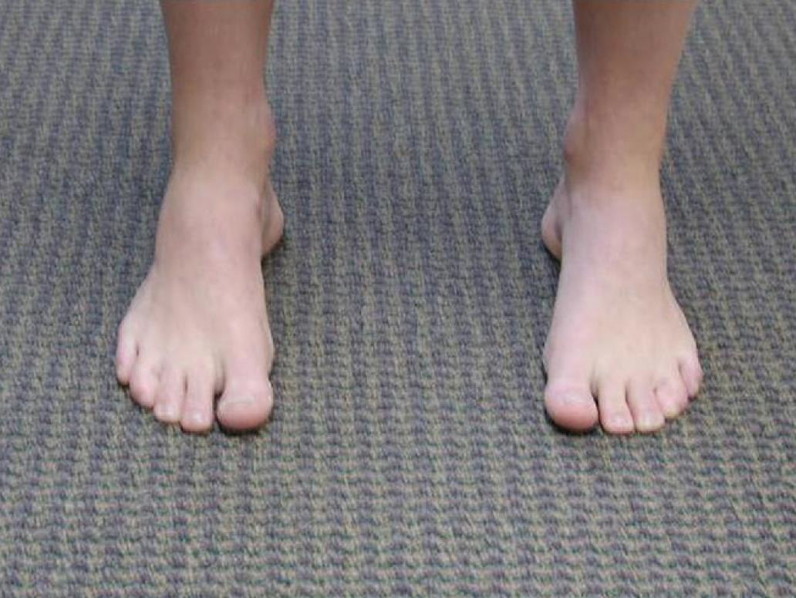
Presentation

Slide 14
Radiographs
STANDING series

Slide 15
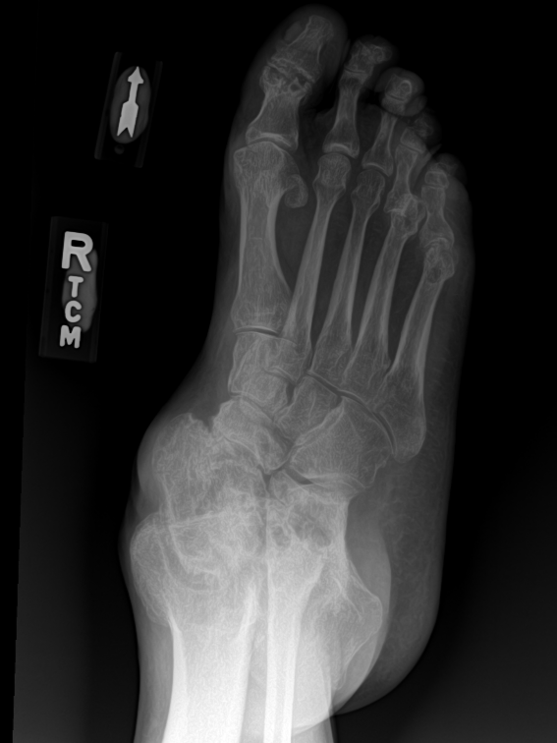
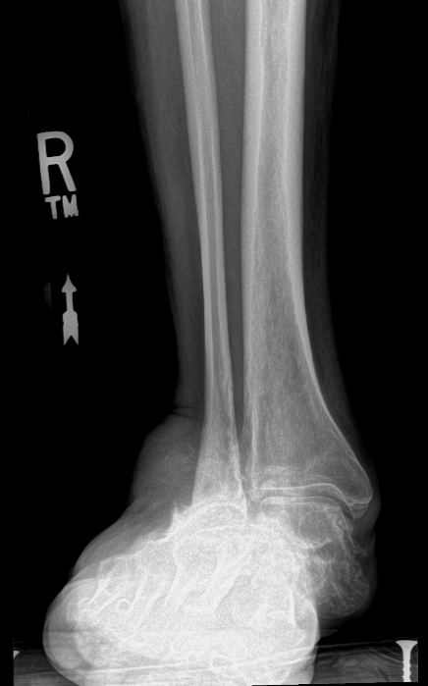
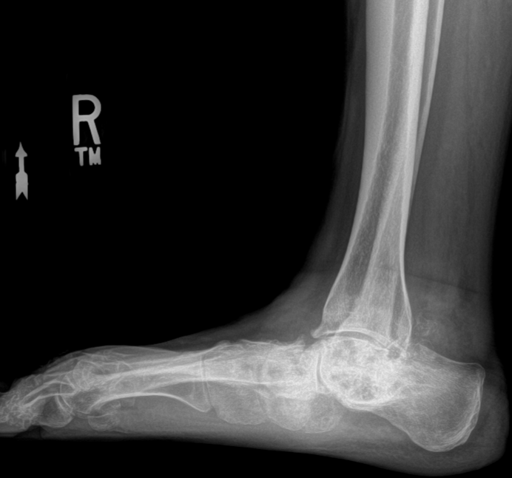
Radiographs

Slide 16
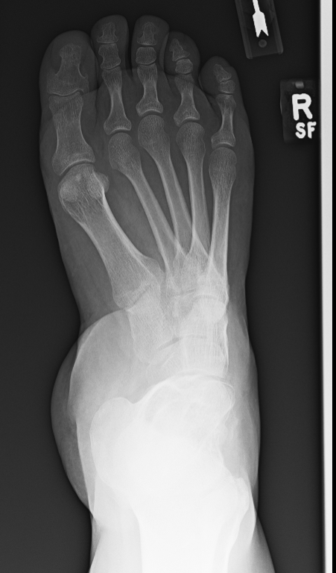

Slide 17
Treatment
Conservative
Custom orthotics
Bracing (OTC vs custom)
Activity modification
NSAIDs
Address secondary issues
Orthotics- Use to drive in flexible deformity
Planovalgus- medial post, medial arch support
Cavovarus- lateral heel post, recess first ray

Slide 18
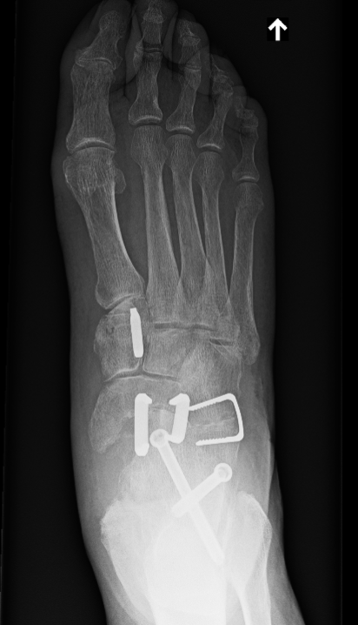
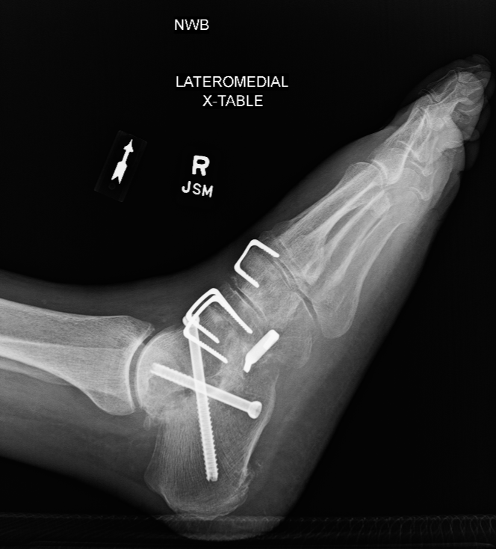
Surgical Management- Planovalgus
Flexible deformity
Calcaneal osteotomy (MDCO)
Cotton osteotomy
FDL→PTT tendon transfer
Rigid deformity
Triple arthrodesis
Often need gastrocnemius recession for contracture

Slide 19
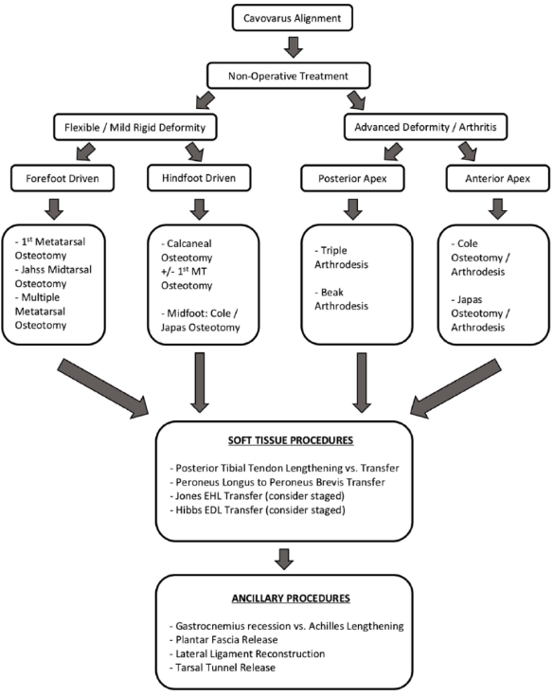
Surgical Management- Cavovarus
Flexible deformity
Calcaneal osteotomy (LDCO)
Dorsiflexion 1st MT osteotomy
PL to PB transfer
Plantar fascia release
PTT lengthening vs transfer
Lateral ligament reconstruction
Rigid deformity
Triple arthrodesis
Often need gastrocnemius recession for contracture
Kaplan JRM, Aiyer A, Cerrato RA, Jeng CL, Campbell JT. Operative Treatment of the Cavovarus Foot. Foot & Ankle International. 2018;39(11):1370-1382.

Slide 20
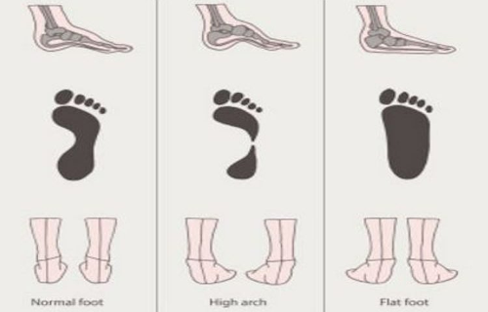
Take Home
Hindfoot deformity is fairly common
Common associated symptoms for each deformity
Medial pain for PCFD, lateral symptoms for cavovarus
Recognize hindfoot position on standing exam

Slide 21
forteortho.com

