Slide 1
Shane Rose MD
Medical Director Rayus Radiology

Slide 2
c/o Stiff neck

Slide 3
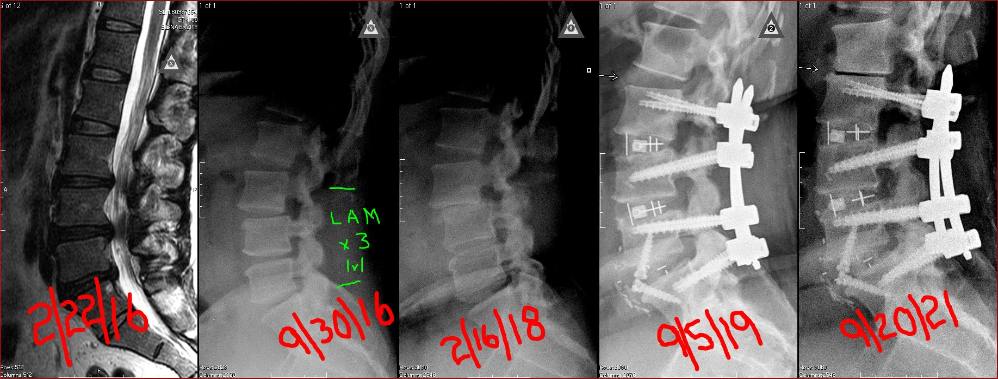

Slide 4
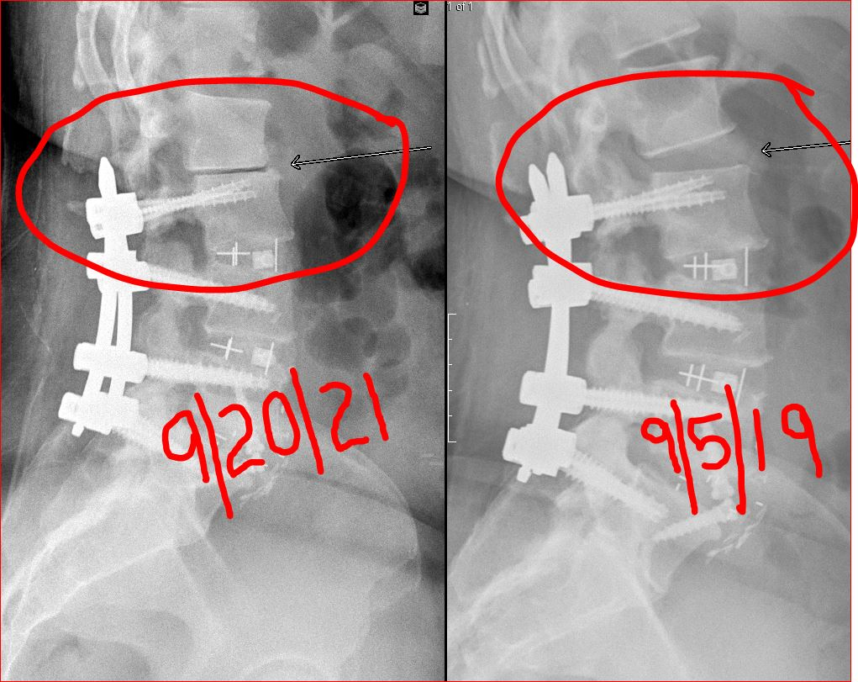
2yr ASD

Slide 5
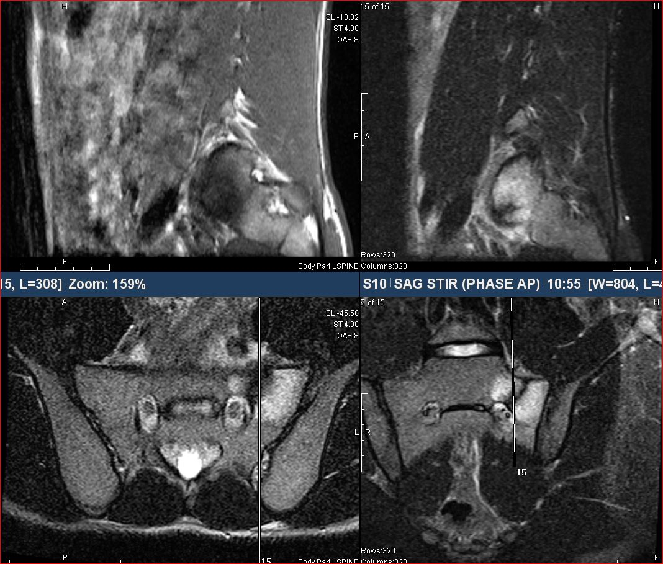
Unilateral partial Sacral Fx

Slide 6
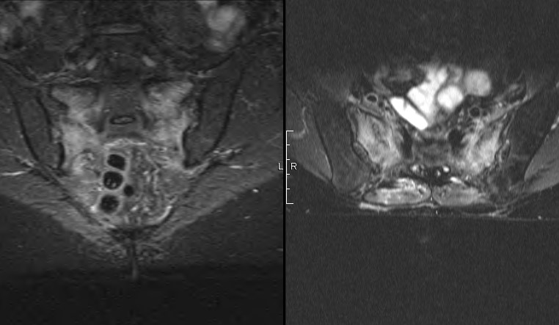
Bilateral Sacral Fx

Slide 7
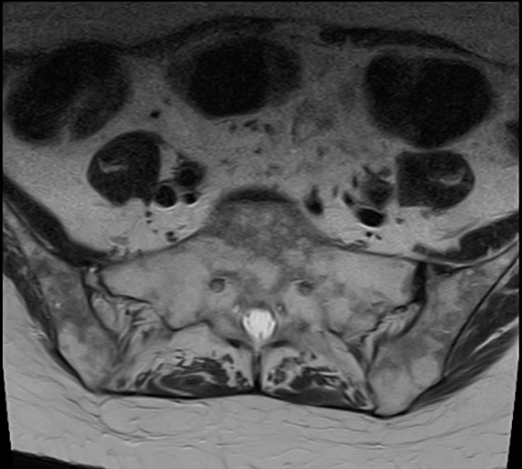
Fatty Infiltration of Bone Marrow

Slide 8
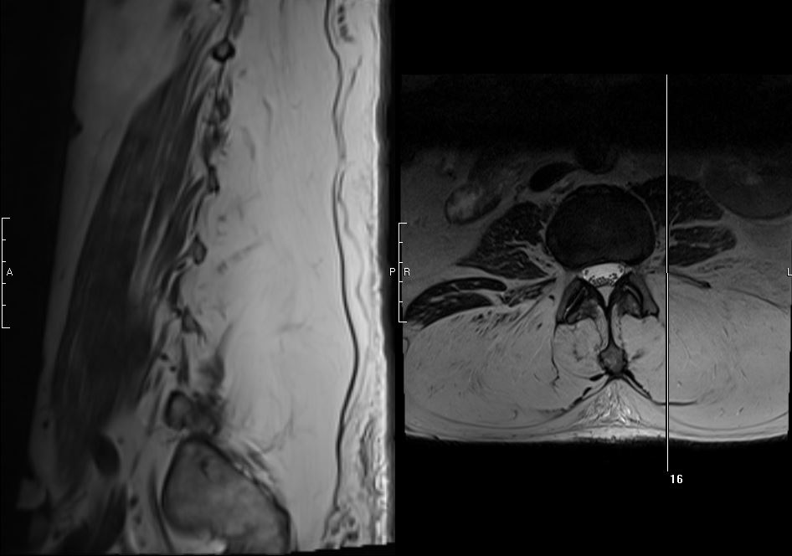
Complete fatty replacement of spinal musculature

Slide 9
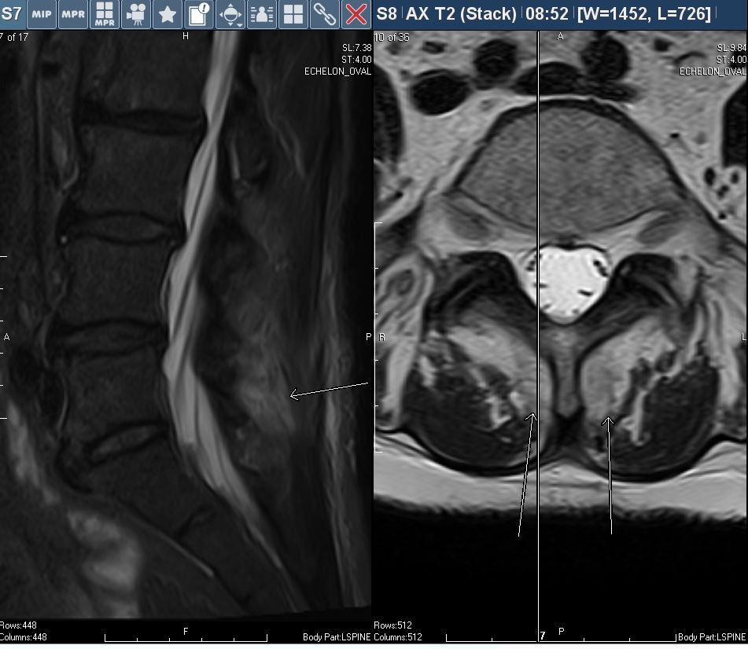
Multifidous Strain

Slide 10
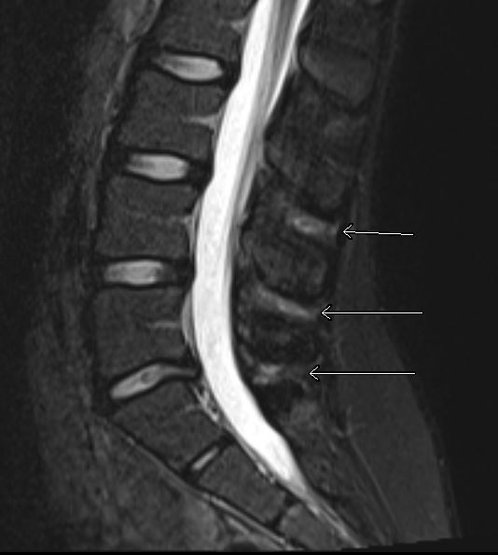
Transient positional pseudarthrosis of the spinous processes

Slide 11
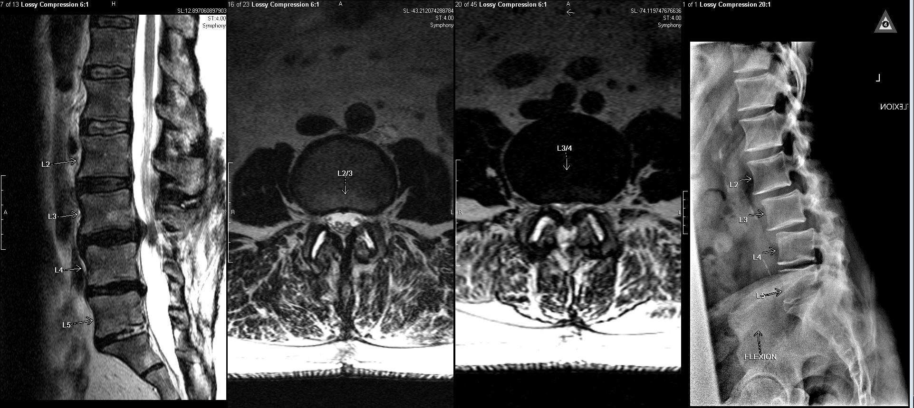
Lumbar Instability

Slide 12
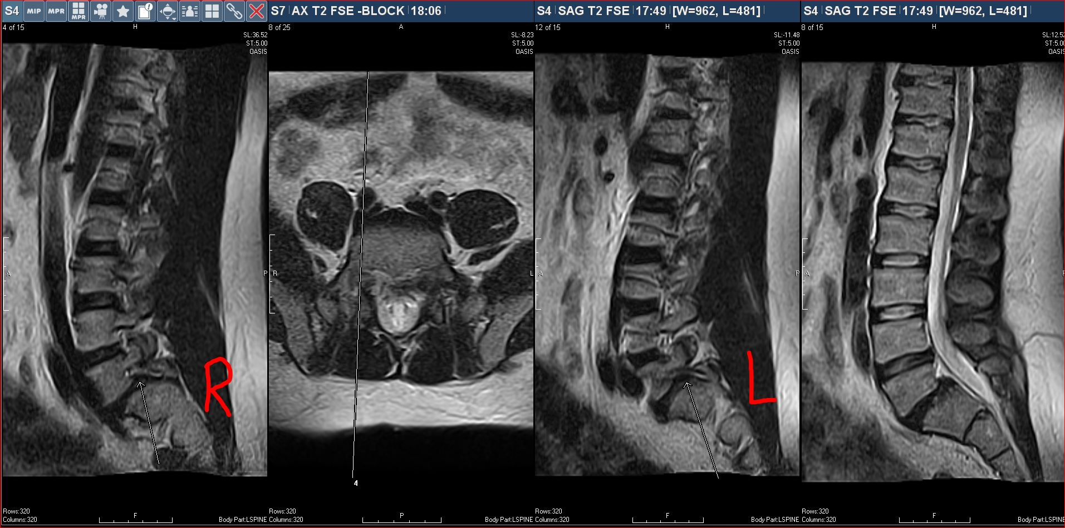
Bilateral Pars Fx – foraminal compression

Slide 13
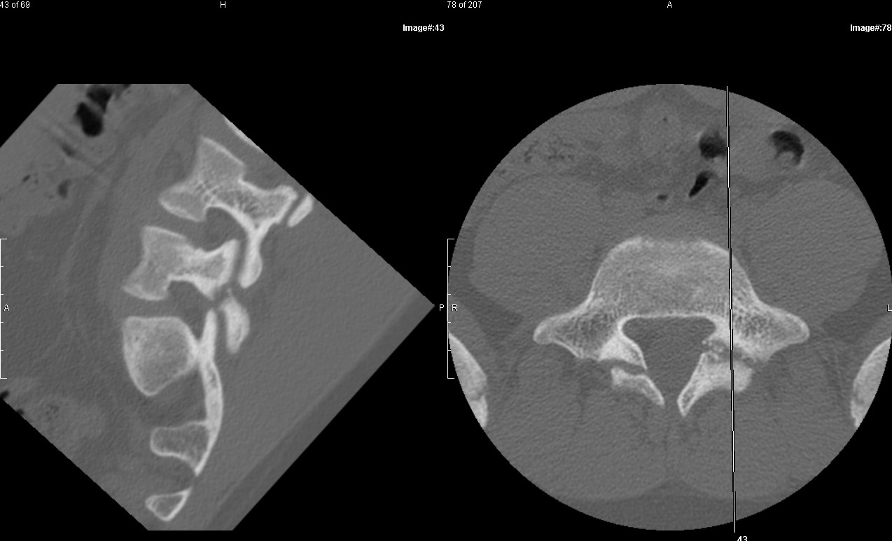
Bilateral Pars fx. Chronic Right and subacute left

Slide 14
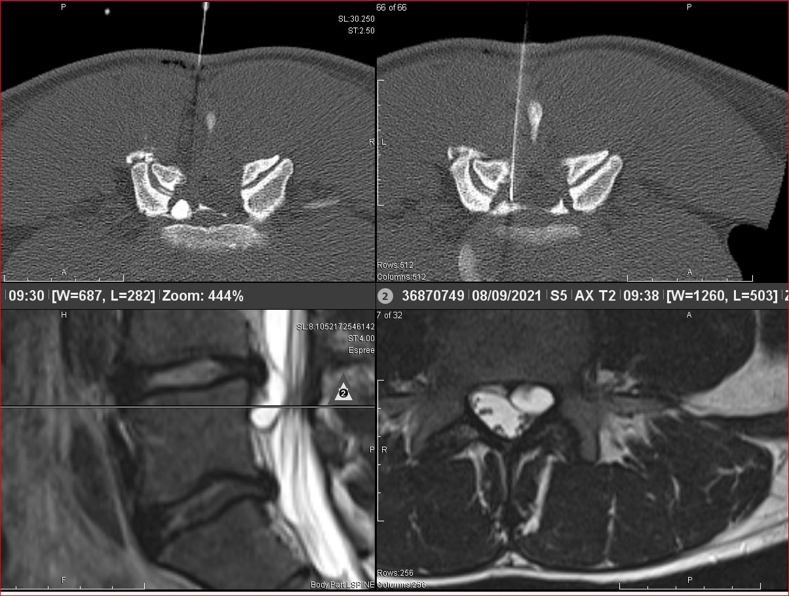
Discal Cyst rupture

Slide 15
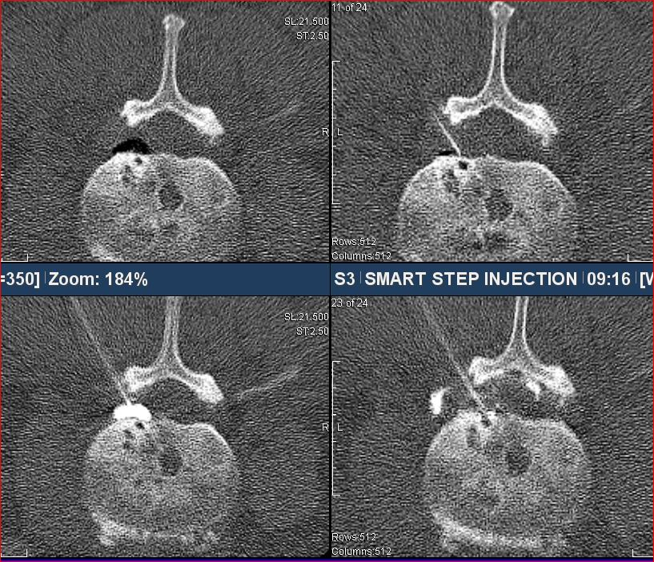
Vacuum Discal cyst rupture

Slide 16
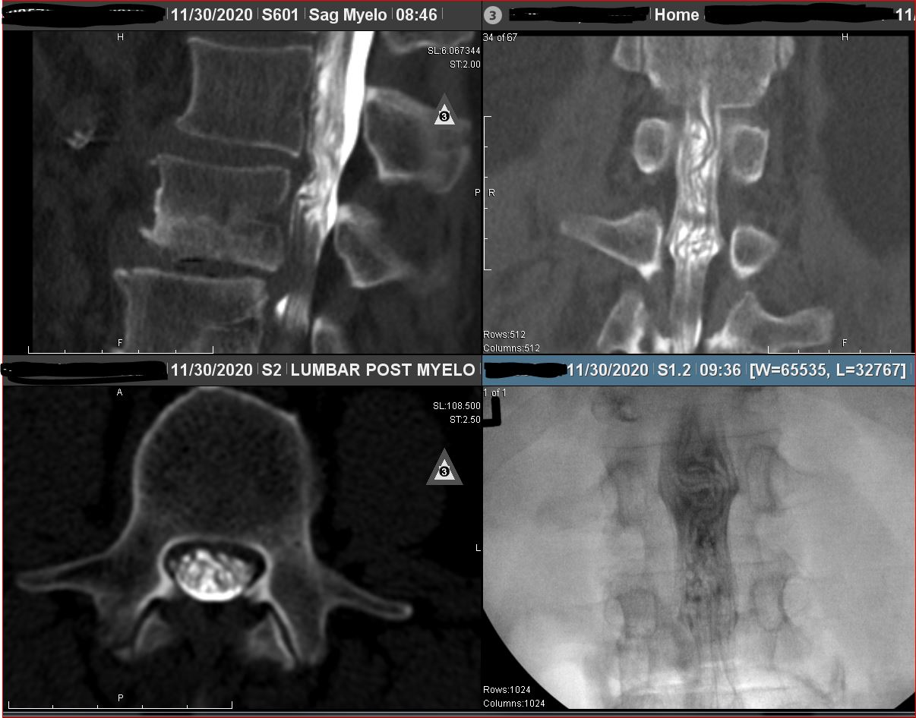
Intrathecal Nerve Root redundancy due to high grade stenosis

Slide 17
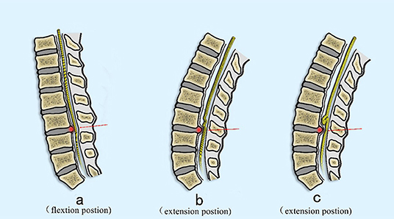

Slide 18
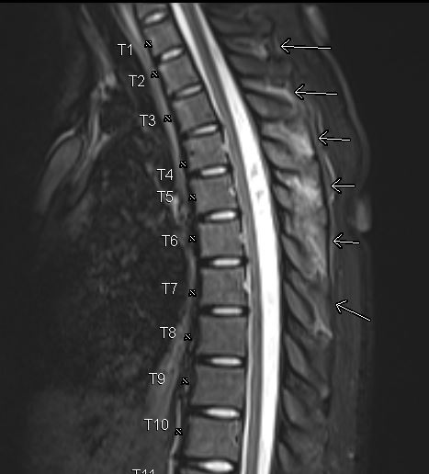
ISL strain and disruption after MVA

Slide 19
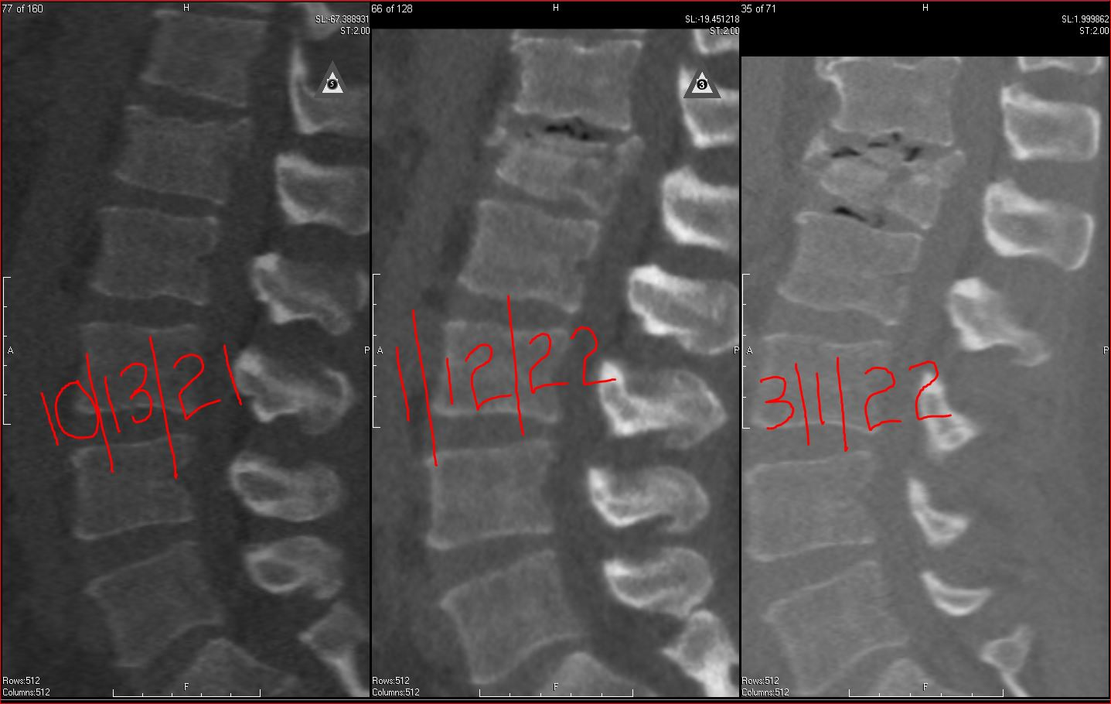
Compression fracture - Observed

Slide 20
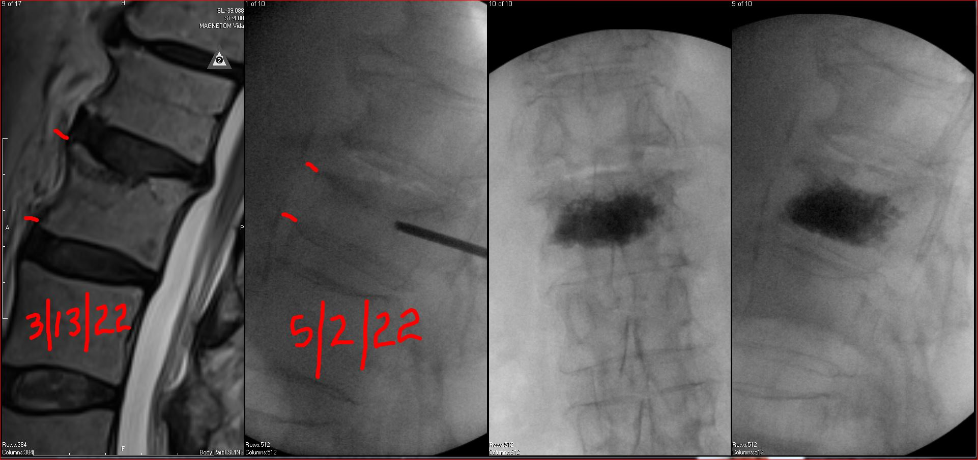
6wk progression during observation

Slide 21
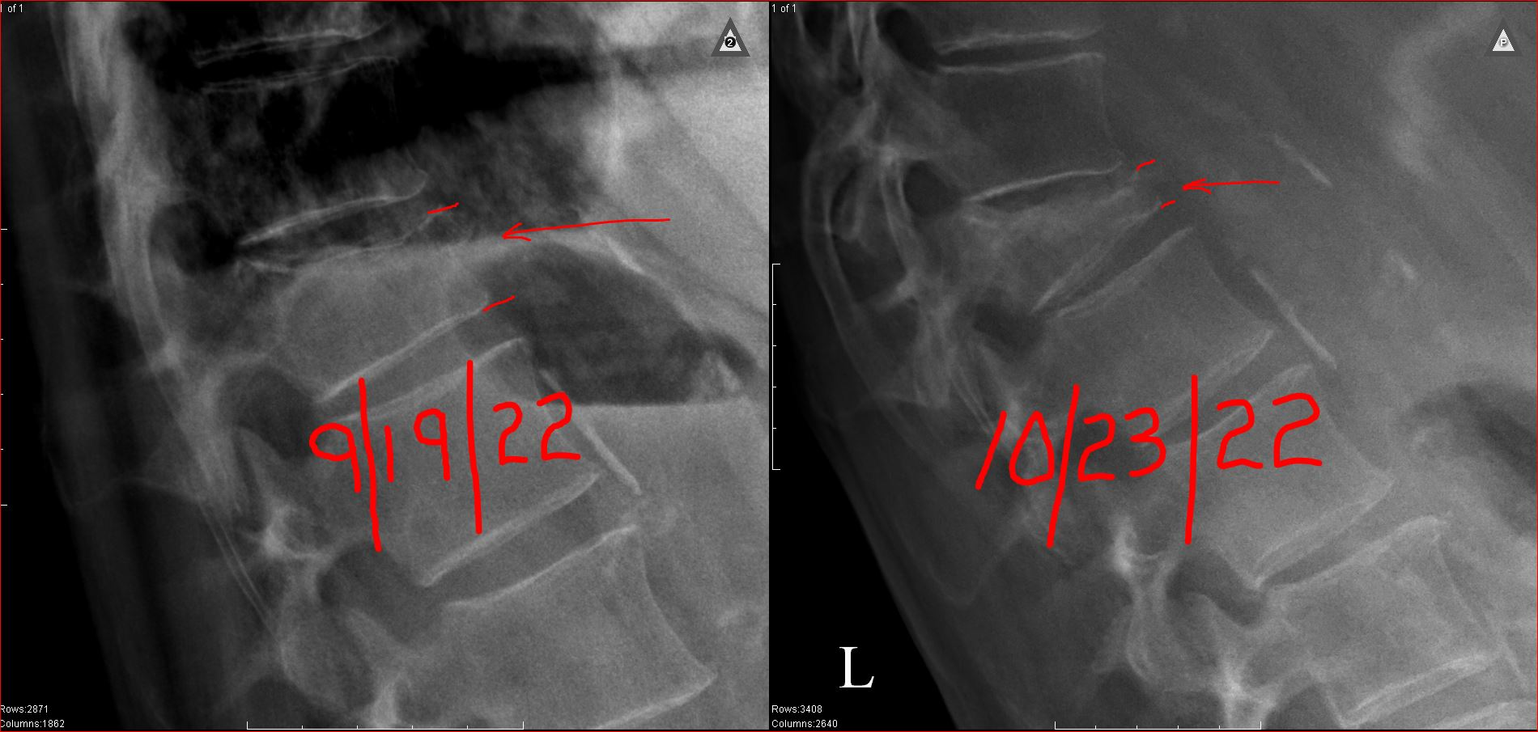

Slide 22
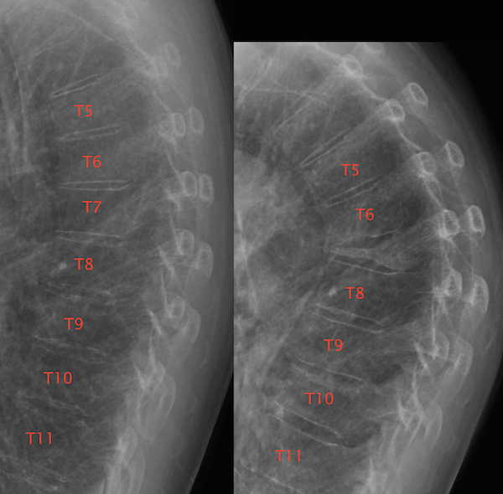

Slide 23
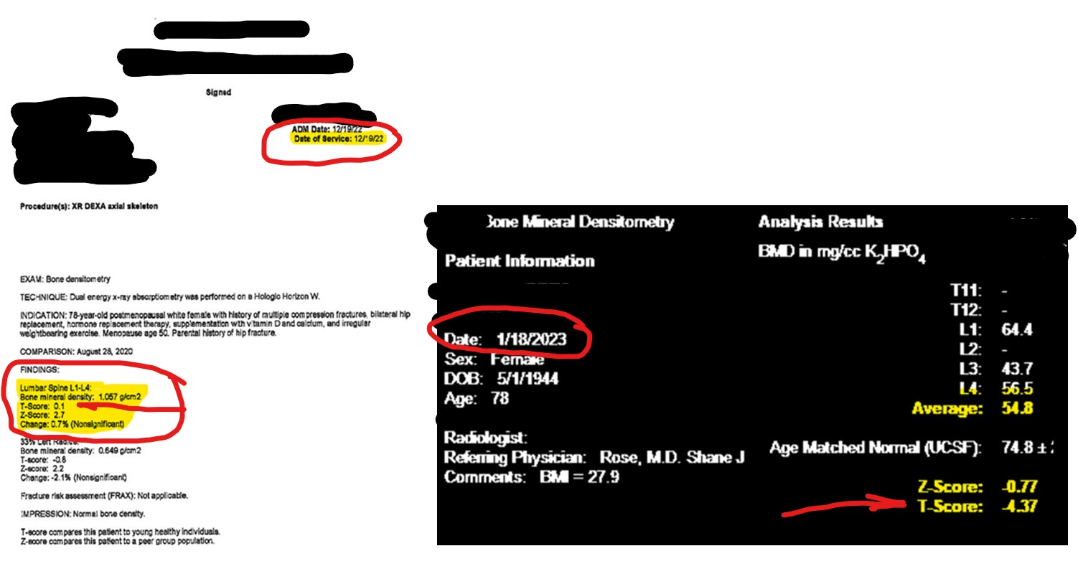

Slide 24
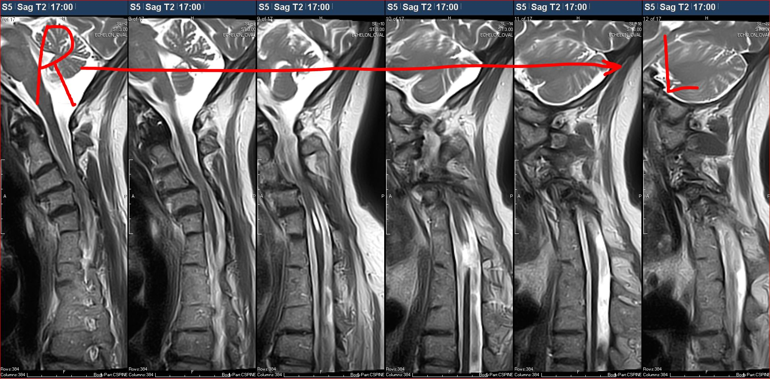
Diastematomyelia

Slide 25
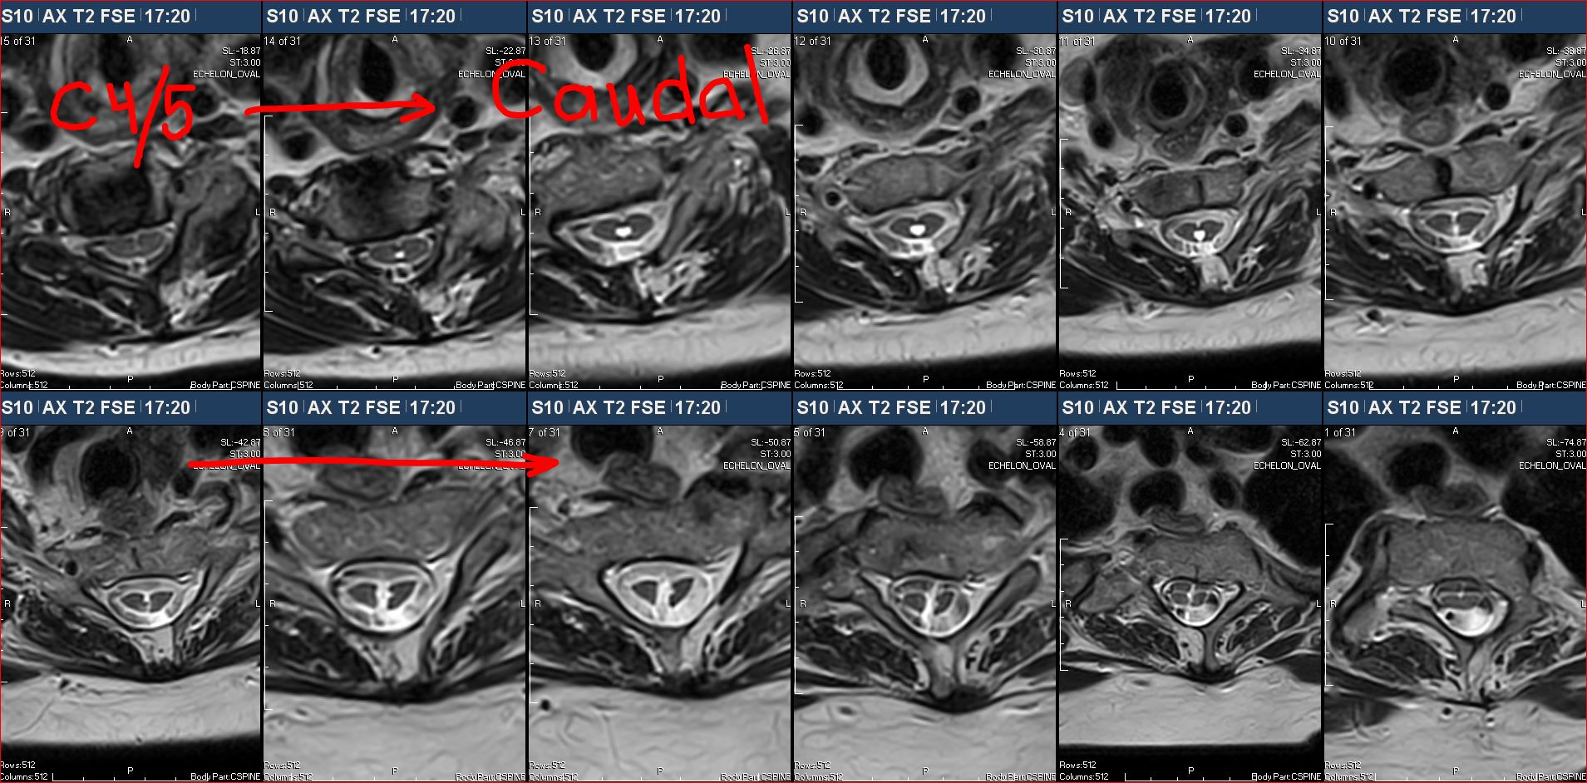
Diastematomyelia

Slide 26
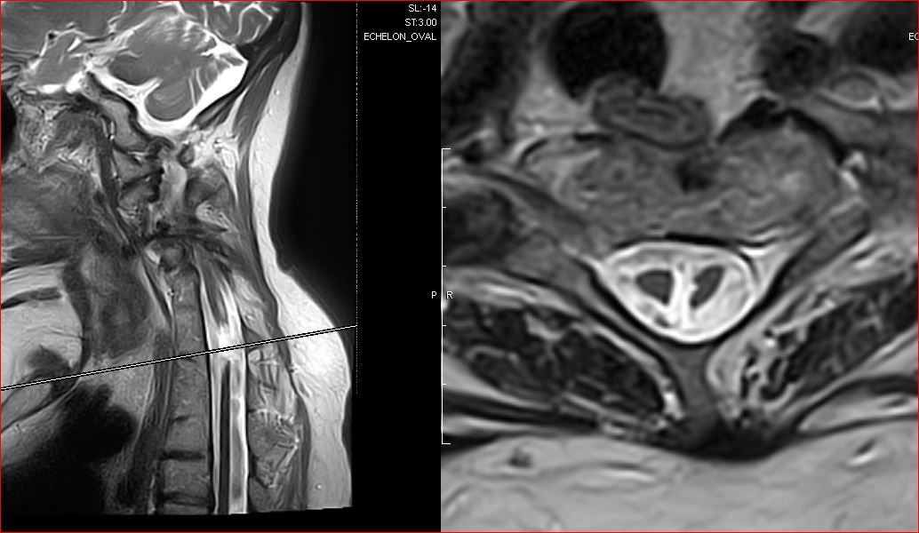
Diastematomyelia

Slide 27
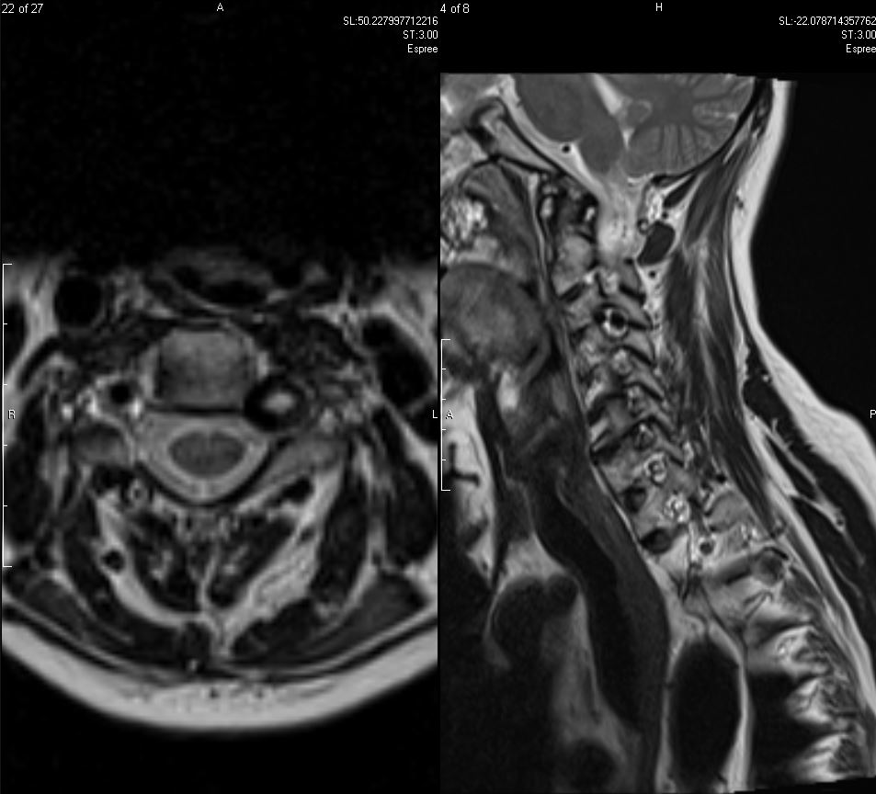
Looping foraminal Vertebral Artery

Slide 28
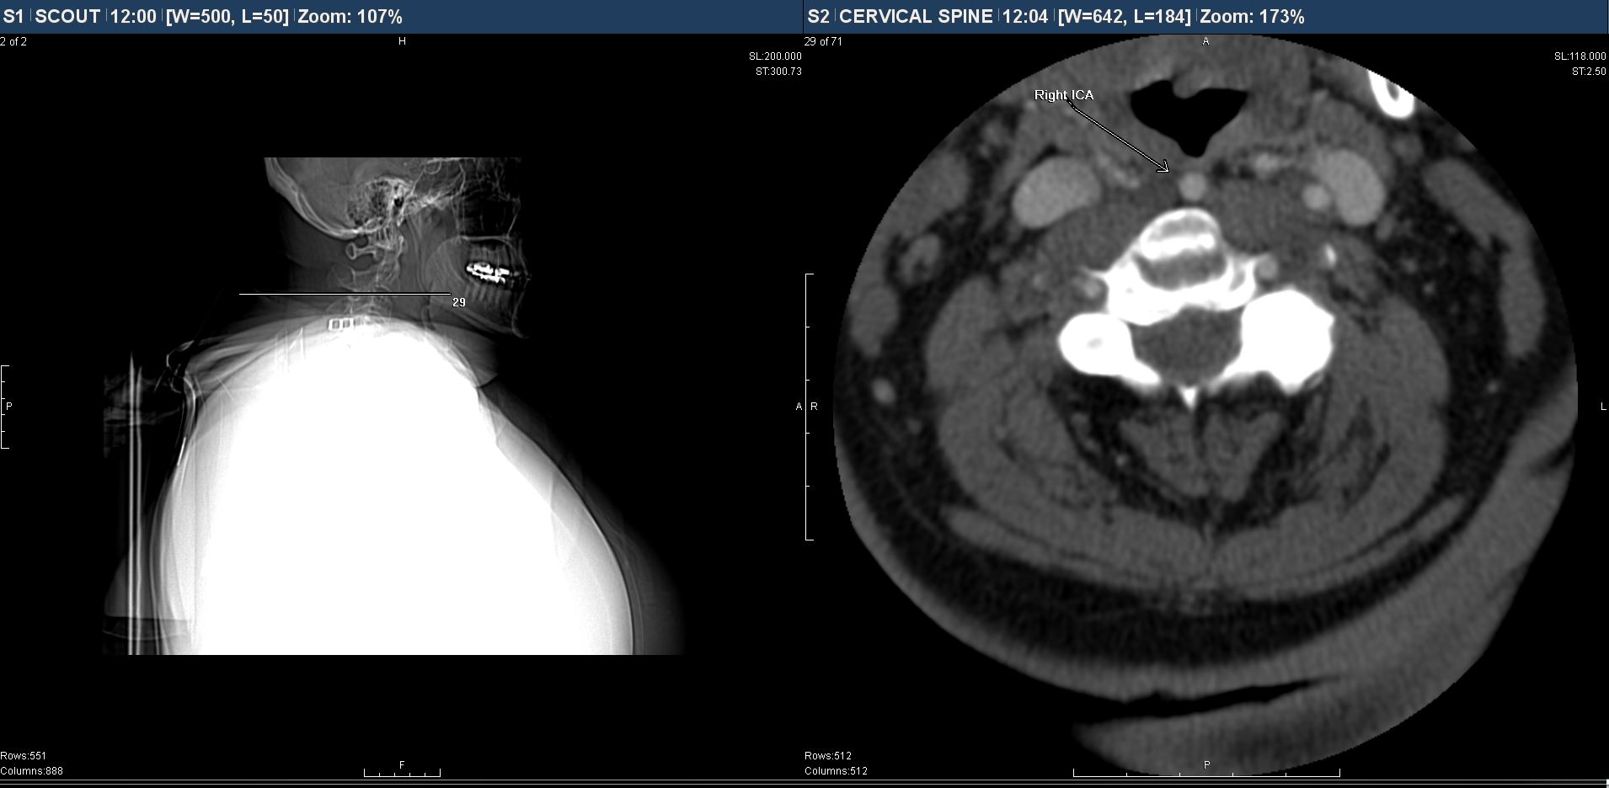
ICA Variant course

Slide 29
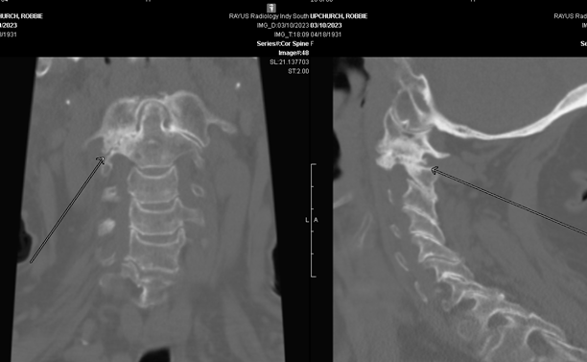
C1/2 lateral Mass DJD

Slide 30
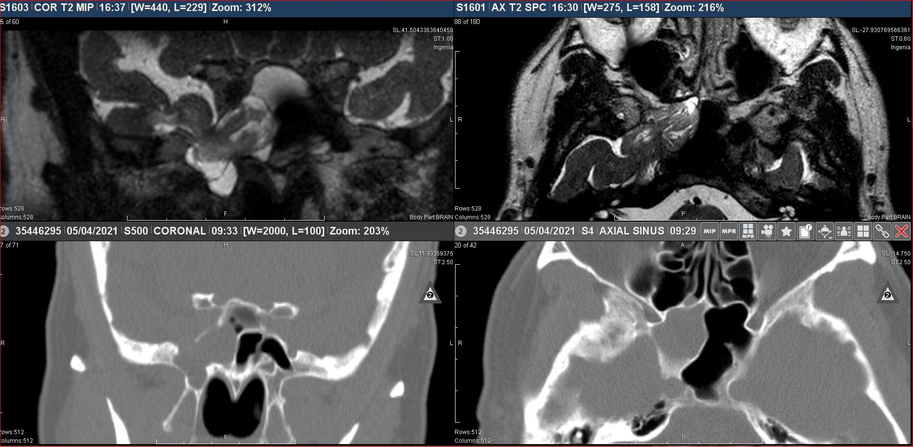
Encephalocele

Slide 31
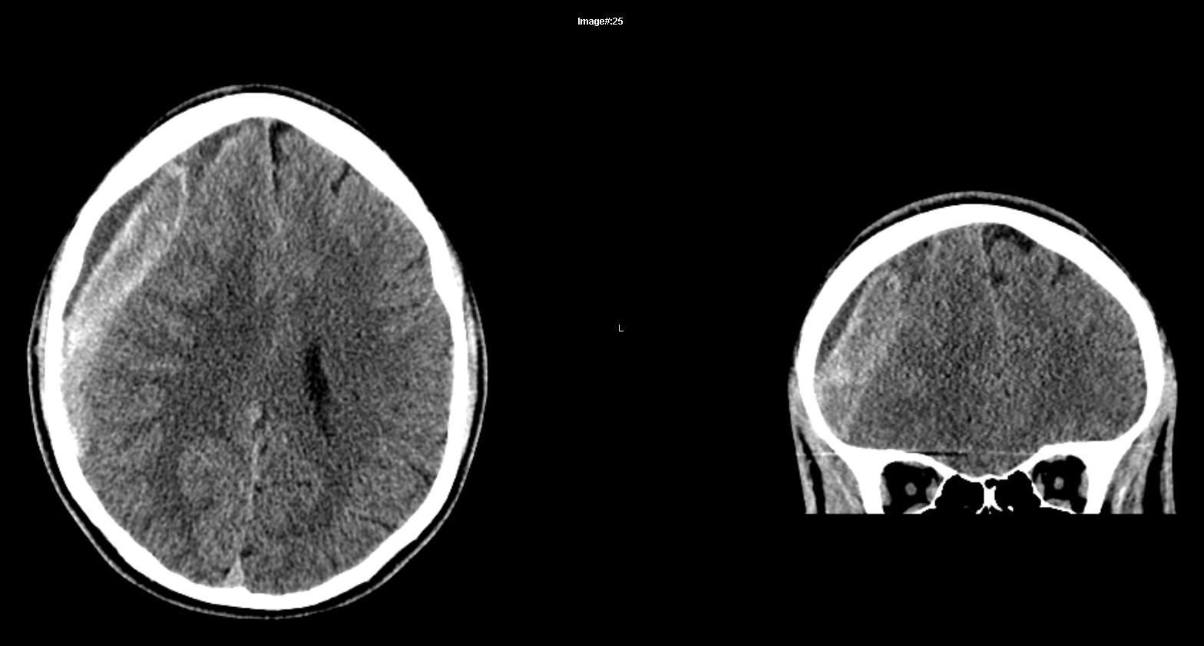
19yo 4 days severe headache after ‘Slap-fight’

