Slide 1
Adolescent Spine Injuries in Sports
Tony Origer D.C., A.T.C./L
Forte Sports Medicine and Orthopedics

Slide 2
Adolescent Back Pain
Back Pain prevalence ranges 37%-66%
Lumbar Spine most common
Prevalence is equal among gender
Athletes have a much higher risk than non-athletes
Growth Spurts

Slide 3
Adolescent Back Pain Risk Factors
Increase lumbar lordosis
Abdominal Weakness
Hip Flexor tightness
Thoracolumbar fascia tightness
Femoral Anteversion
Thoracic Kyphosis
BMI
Prior Back Pain
Athletic Level of Play
Growth spurts

Slide 4
Acute Soft Tissue Sprains/Strains/Muscle Contusions
Stress Fractures
Spondylolysis
Spondylolisthesis
Intervertebral Disc Herniations
Fracture

Slide 5
Goetzinger S., Courtney S., Spondylolysis In Young Athletes: An Overview of Nonoperative Management, Journal Of Sports Medicine, Volume 2020
General adolescent population – 3-10% incidence of lysis
Athletic Adolescent population under 19 years – 30% to 39.7% incidence of lysis
Unilateral pars fractures typically heal normally
Bilateral and/or Chronic pars fractures progress to Spondylolisthesis with rates as high as 43-74%
92% who were treated conservatively were able to return to athletic competition
Weight training and collision sports have higher incidence
MRI is 80-83% sensitive in detecting stress injuries/spondololysis

Slide 6
Choi, J. MD, Ochoa, J. Md et. al, Management of lumbar spondylolysis in adolescent athlete: a review of over 200 cases, The Spine Journal 2022 pgs. 1628-1633
Commonly seen L4 (21%) and L5 (75%) levels
Extremely Rare to see an isolated incident of trauma
Considered to be a repetitive mechanical stress and micro-trauma to a congenitally weak portion of the bone
Onset of symptoms correlates with growth spurts (age 10-15)
98% return to athletic activity following the treatment recommendation of 3 months cessation of athletic involvement, bracing/orthosis and bone stimulator.

Slide 7
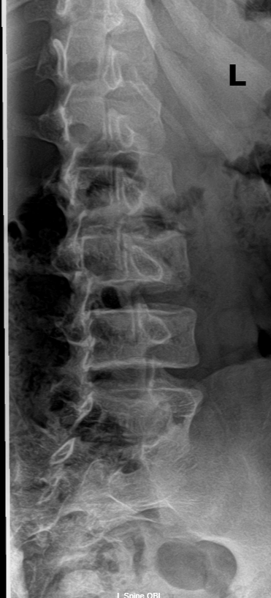
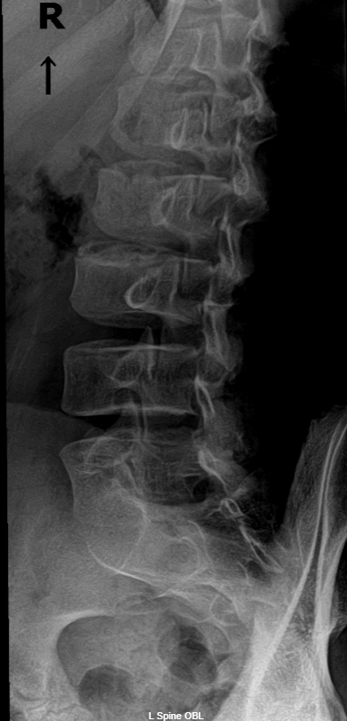
13 YOA Male - Stress fracture

Slide 8
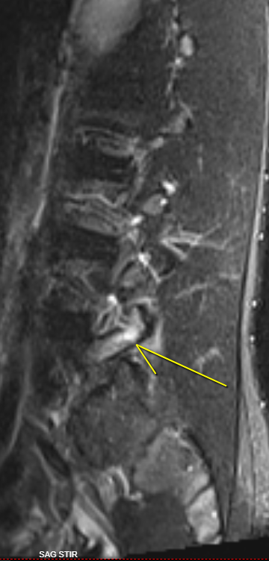
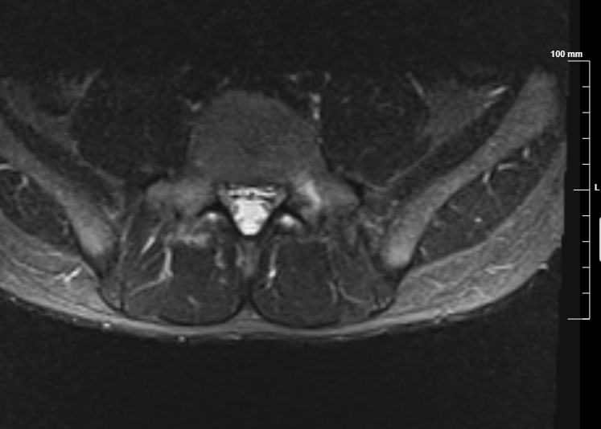

Slide 9
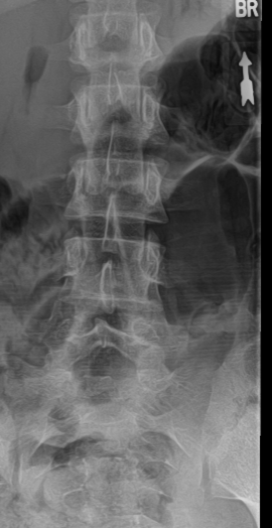
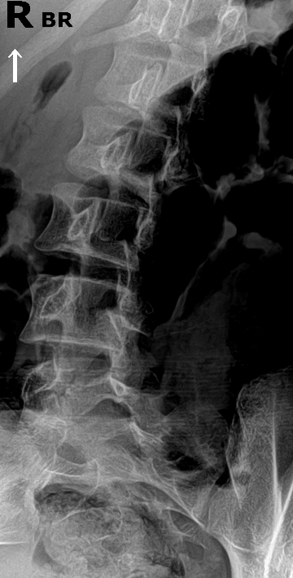
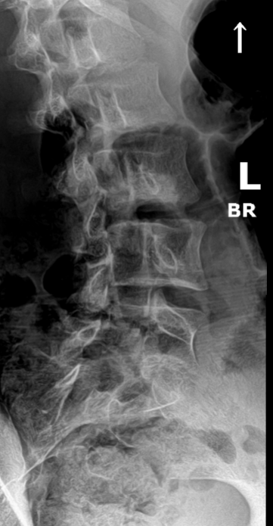
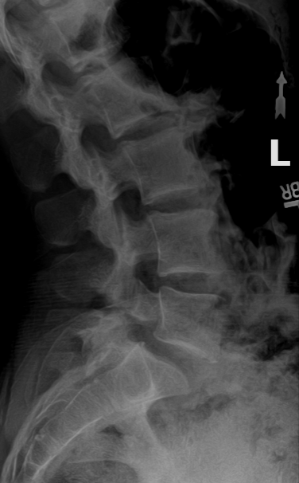
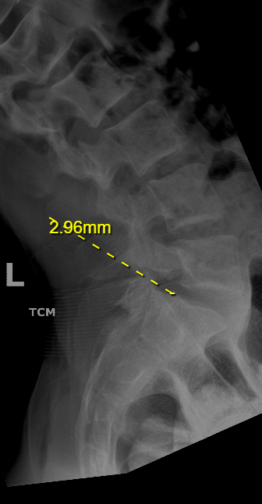
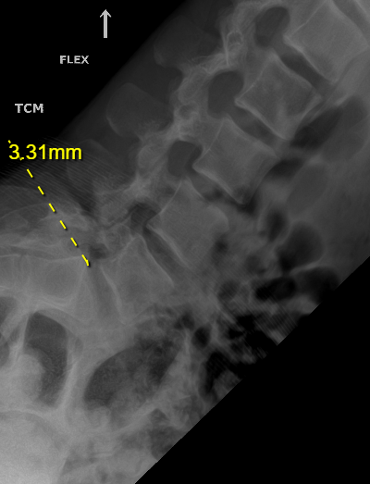

Slide 10
Knechtle, D, Jastrzebski, et. Al. Vitamin D and Stress Fractures in Sport: Preventative and Therapeutic Measures – Narrative Review. Medicina March 2021.
Prolonged lack of Vitamin D (25(OH)D) can lead to stress fractures
A 25(OH)D insufficiency of <75.8nmol/L is a risk factor for stress fracture
Prevalence of Stress Fractures decreased when athletes are supplemented daily with 800 IU 25(OH)D and 2000 mg Calcium
Recommendation of intake may go up to 2000 IU of 25 (OH)D per day

Slide 11
General treatment guidelines
Minimum of 12 week activity restriction, Vitamin D testing, Refrain from NSAID usage
Unilateral injury - (Warm/Form) Brace 23 hours/day
Bilateral injury - Boston Brace 23 hours/day
Physical Therapy (focus on basic stretching/core stability) 1x/every 2weeks (6 visits over 12 weeks) Lower cross syndrome
Chiropractic Manipulation (above and below involved segment)1x/month --
CT scan at 12 weeks to verify healing
Healed - increase Physical Therapy intensity to sport specific activity, Functional progression to full activity, Chiropractic Manipulation 2x/week for 2-4 weeks.
Not healed asymptomatic - progress with activity as tolerated, follow up xrays to evaluate for progression of slippage at one year
Rarely use bone stimulator

Slide 12
Disc herniations
Prevalence of adolescent Lumbar DDD 2%
Prevalence of adolescent disc herniations 5.8%
Steady rise in adolescent disc disease
Biggest risk factors are attributed to Obesity/Poor Diet and Poor Weight Training Techniques
Mechanism is typically flexion based injury and/or axial load

Slide 13
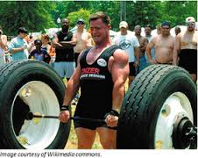
Deadlifting Injury

Slide 15
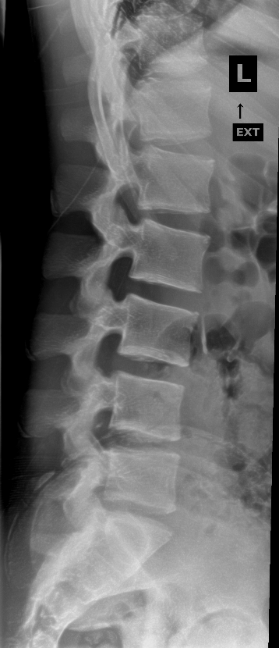
Dead lift Injury – 15 year old Male

Slide 16
15 year old Wrestler/Football Player Heard an Pop and immediate back pain while Deadlifting, Progressive Motor Deficits over 14 days

Slide 17
treatment Recommendation Chiropractic Manipulation 2-3x/week for 3-4 weeks, Physical Therapy 1-2x week for 4 weeks NSAIDS as tolerated, Limited Referral for Steroids/Epidurals. Cessation of all Olympic Lifting for 10-12 months

Slide 18
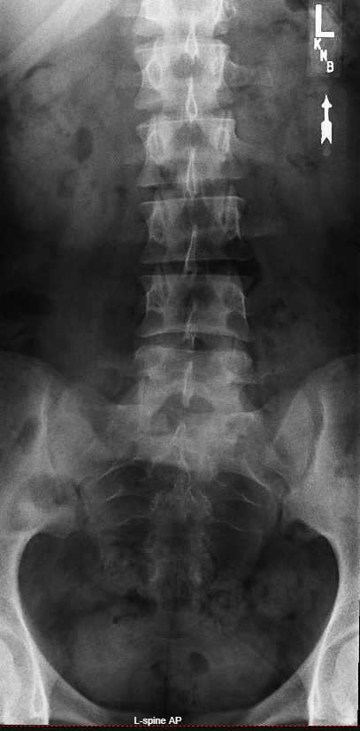
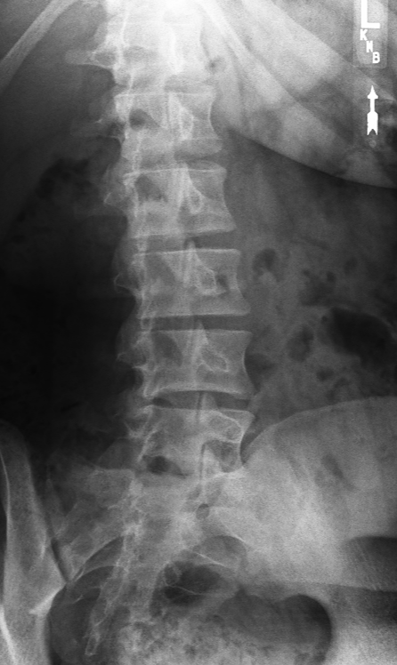
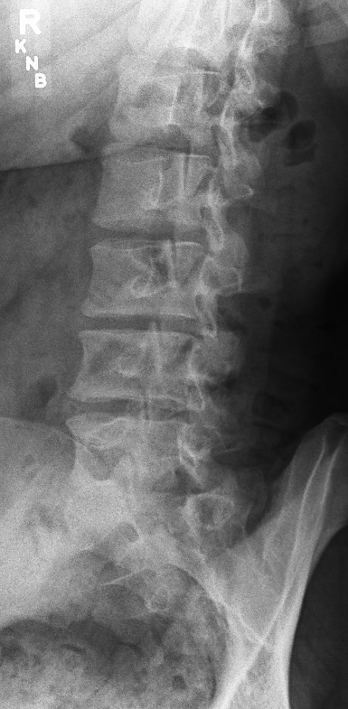
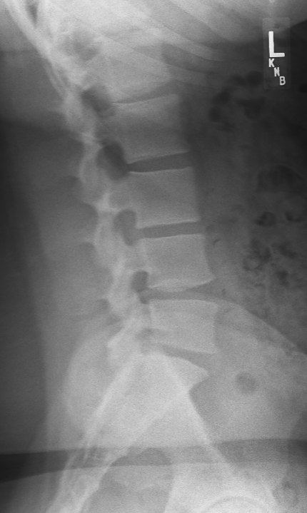

Slide 19
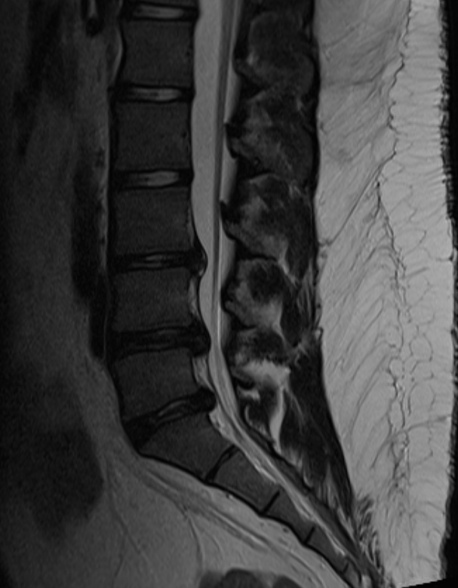
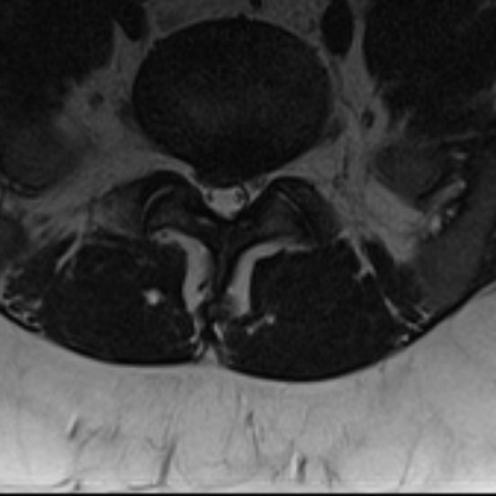
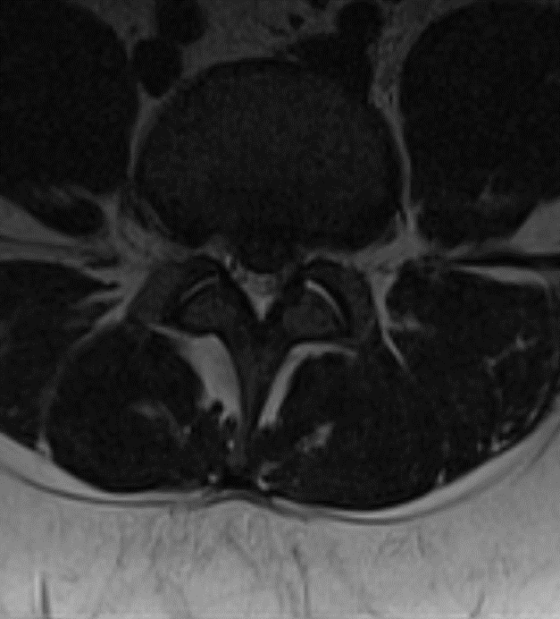
16 year old Male – I year history of LBP, treated with Chiropractic for over 1 year.

Slide 20
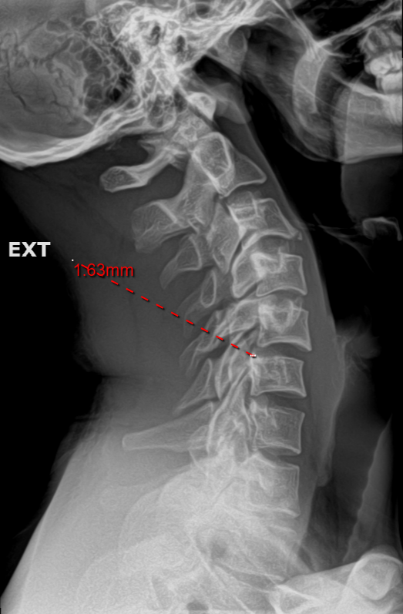
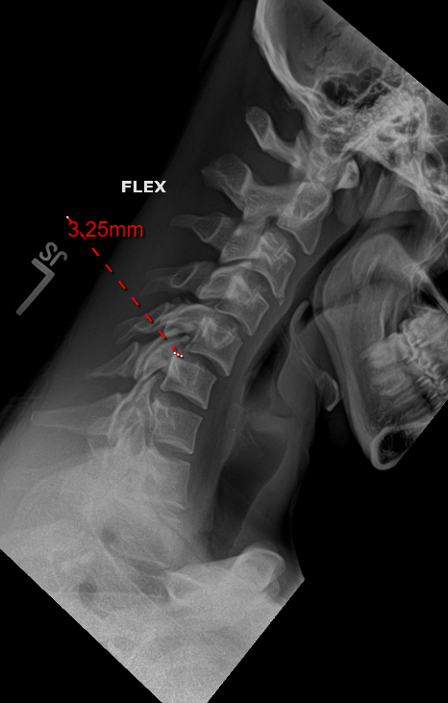
21 Male football Player Cervical Flexion/Right Lateral Flexion during Tackling Drill (1/2 speed) 4/10 VAS scale, Pain was improving, Noticed a Right Stinger Type pain down Right arm which resolved.

Slide 21
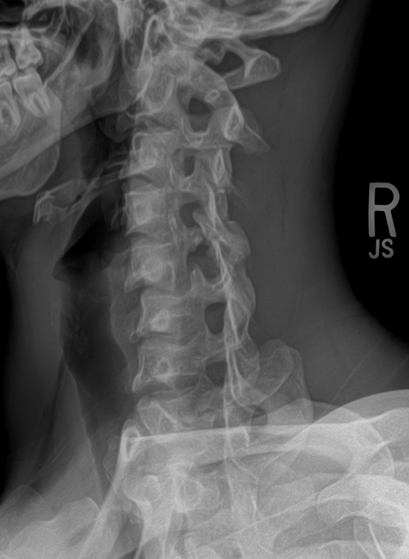
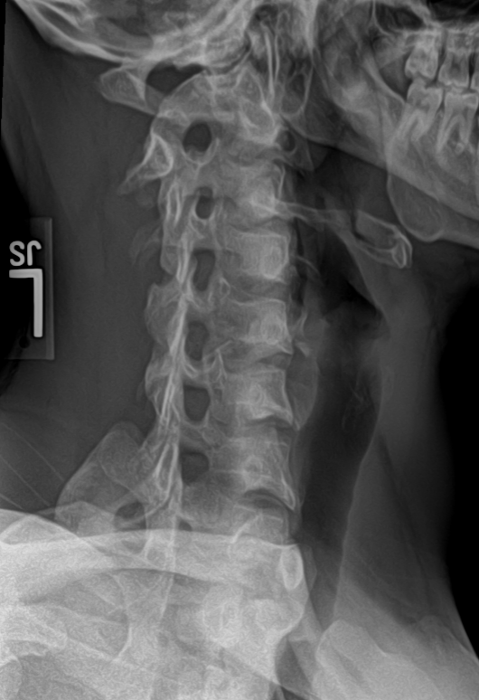

Slide 22
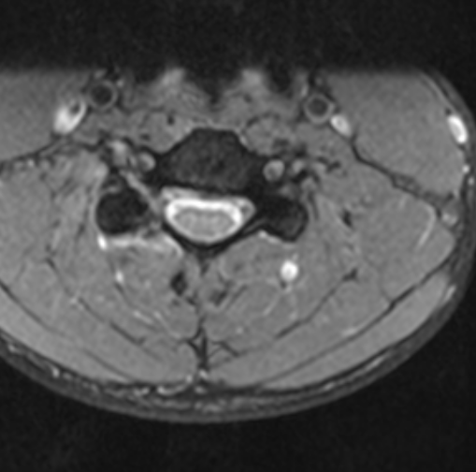

Slide 23
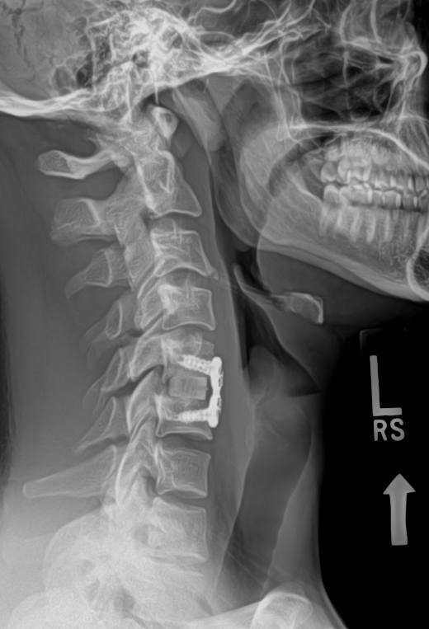

Slide 24
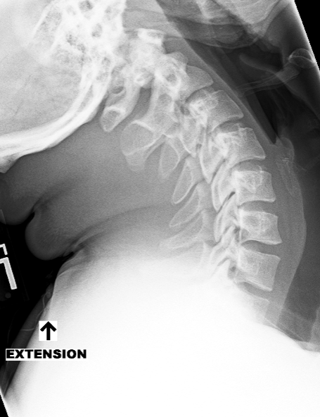
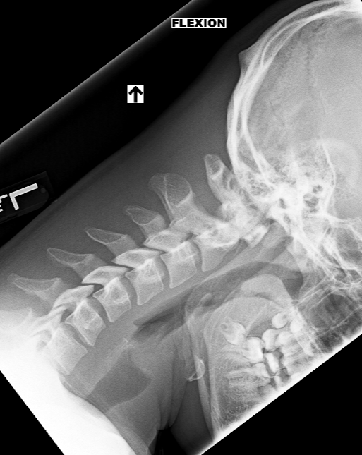
1st rib fracture

Slide 25
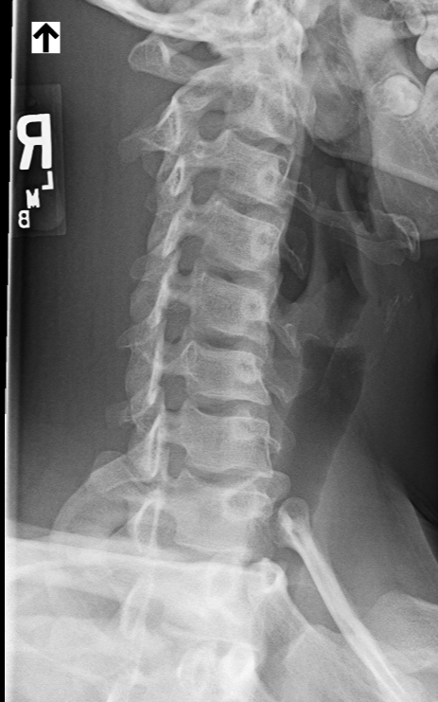
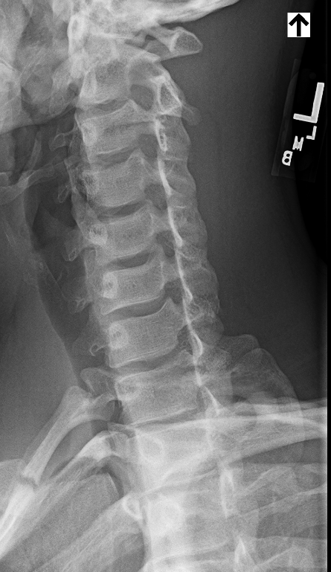

Slide 26
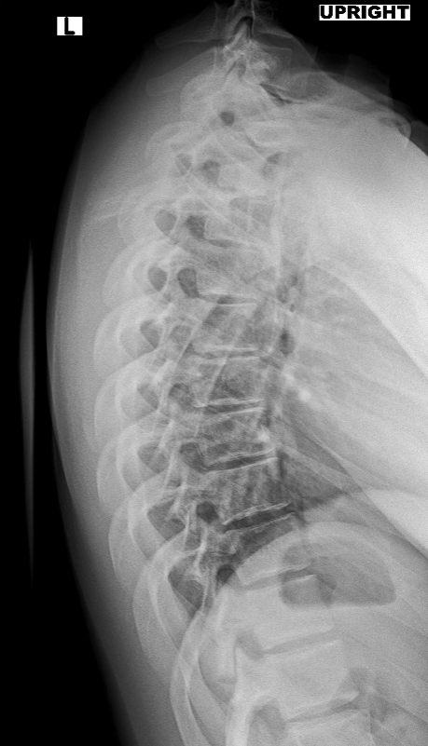

Slide 27
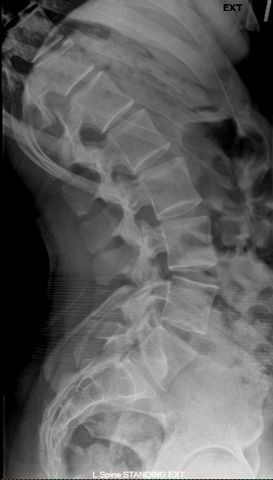
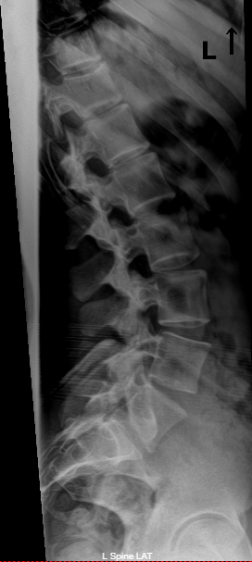
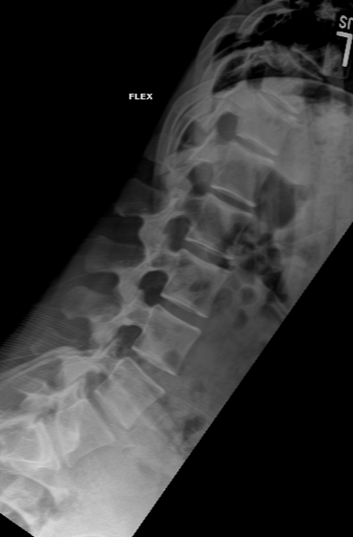
Compression Fracture

Slide 28
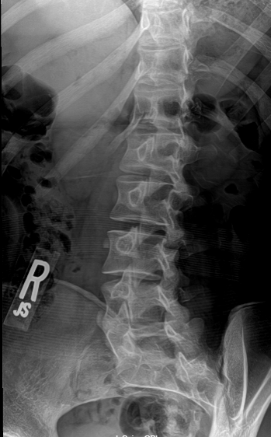
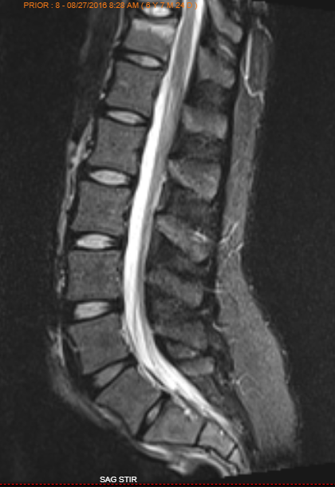
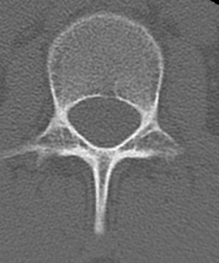

Slide 29
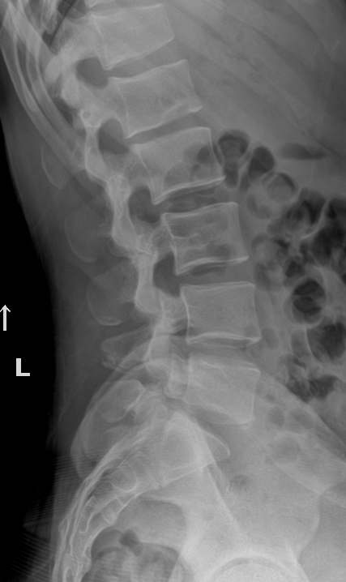
Active Schmorl’s node

