Slide 1
Ankle Arthritis: Evolving Treatment
Andrew Wohler, MD
4/29/2023

Slide 2
Disclosures
No relevant financial disclosures to report

Slide 3
Outline
Ankle anatomy
Epidemiology/Pathogenesis
Treatment Options
Non-surgical
Surgical

Slide 4
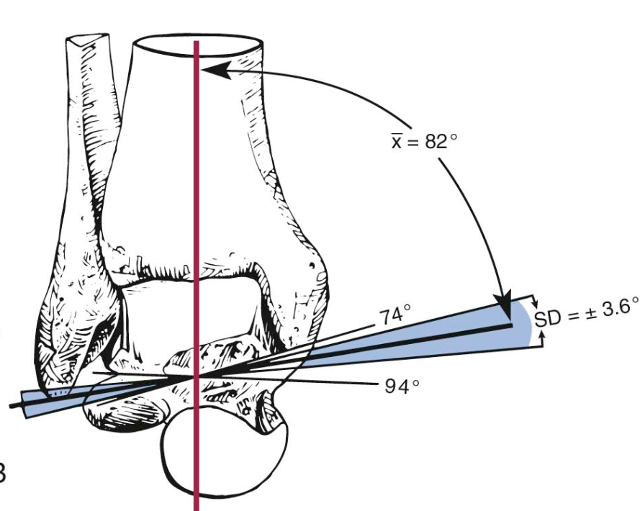
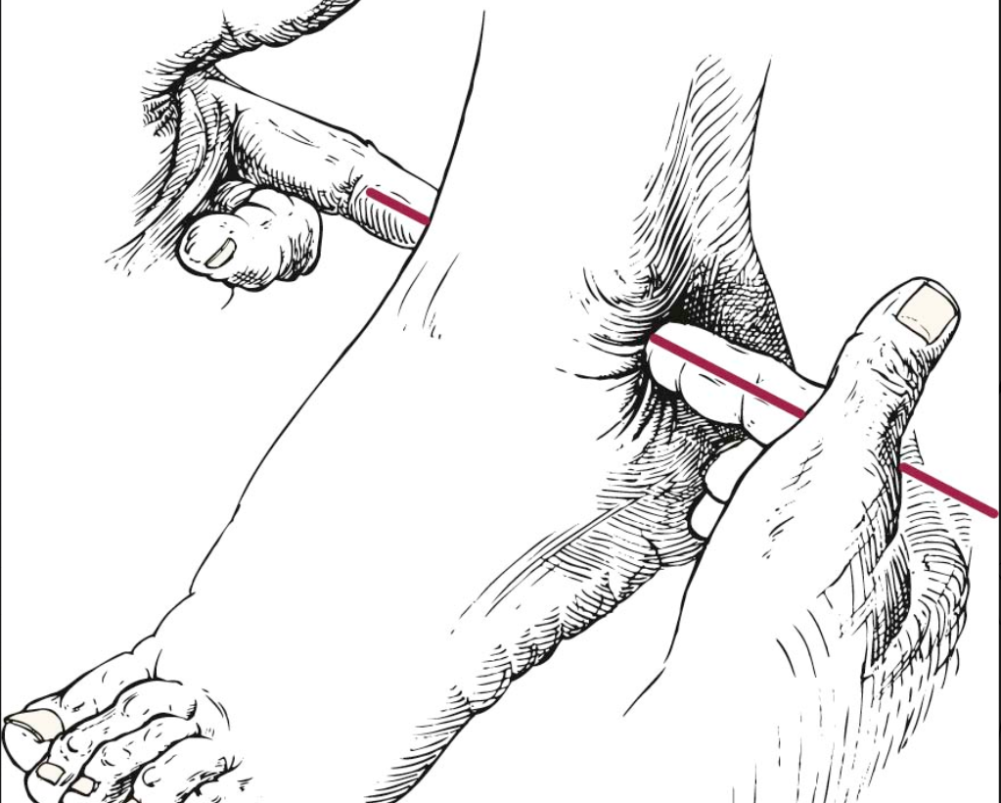
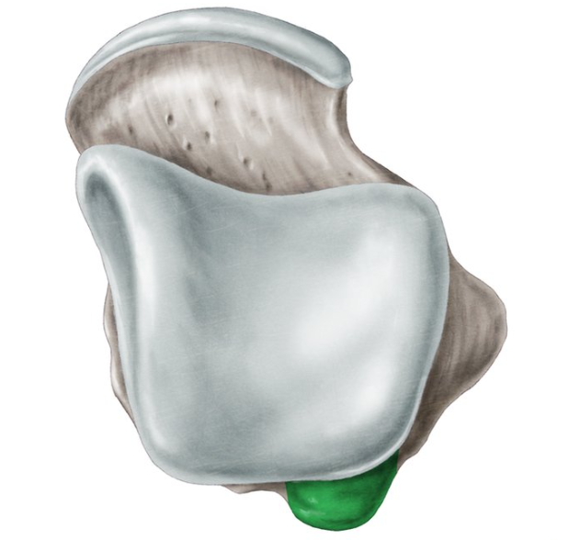
Ankle anatomy
Ankle joint
Tibia, fibula, talus
Mortise joint- bone and ligamentous constraints medially and laterally
Ankle motion
Dorsiflexion/plantarflexion
Inversion/eversion
External rotation (syndesmosis)

Slide 5
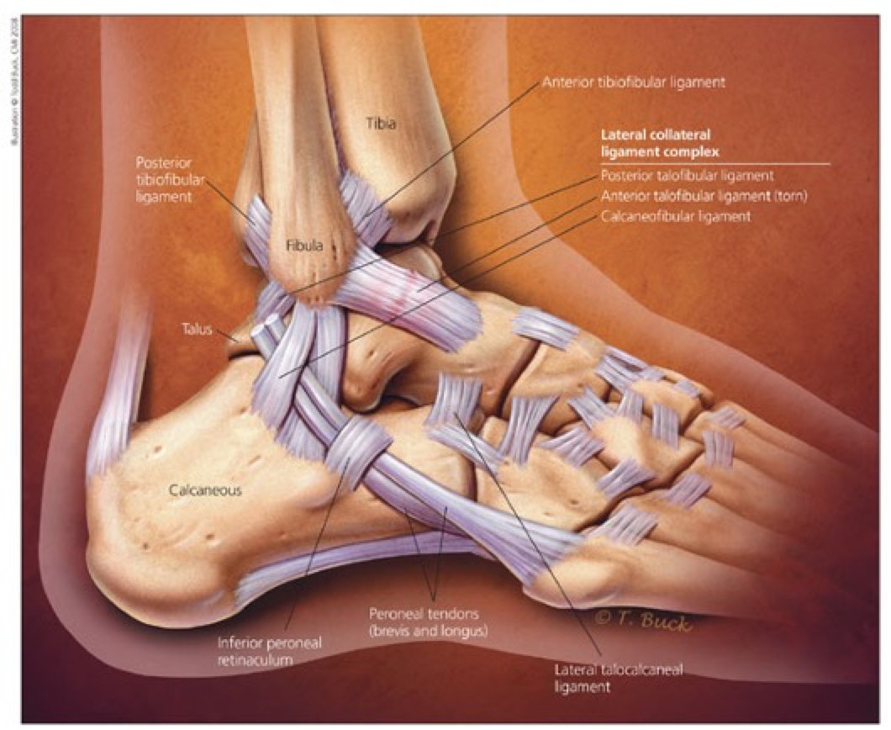
Ankle anatomy
Ligamentous stability
Deltoid- primary stabilizer of the ankle
Lateral ankle ligaments- ATFL, CFL, PTFL
Syndesmosis- AITFL, IOM, PITFL

Slide 6
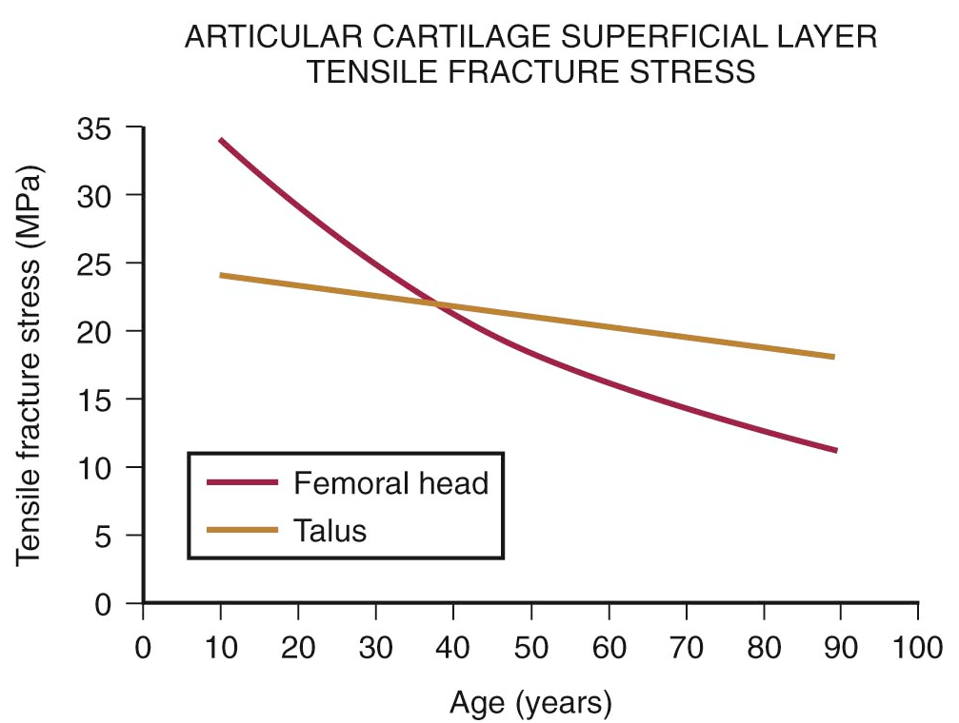
Articular Cartilage Studies
Small surface area (350mm² vs 1100mm² for hip and knee)
Higher peak contact stress
Cartilage thickness (1-2 mm)
Up to 6mm in hip and knee
Articular cartilage tensile properties more uniform

Slide 7
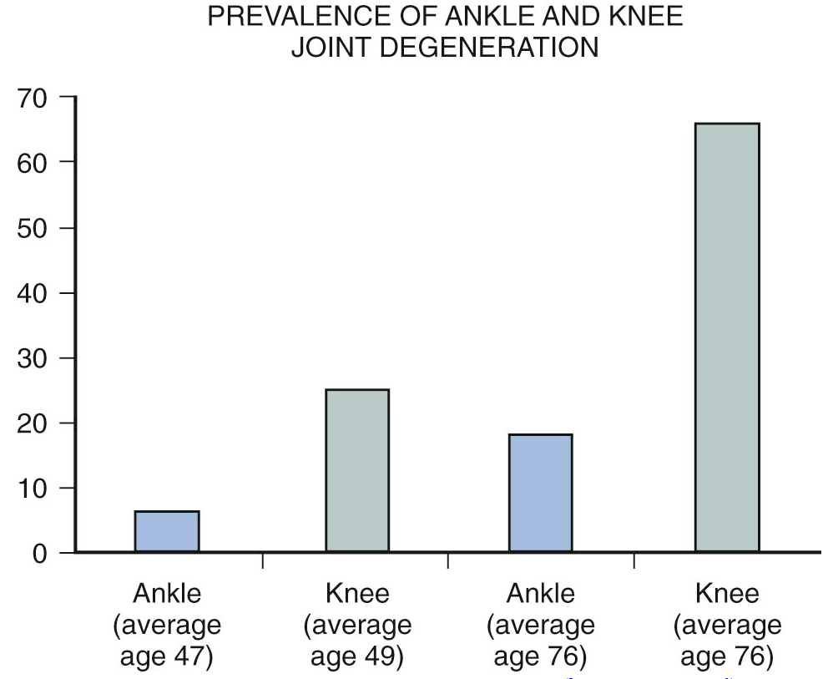
Epidemiology
Less common: 8-10x
572K THA, 3.48 million TKA by 2030 (Kurtz S et al.; JBJS, 2007)
Post-traumatic arthritis (70%)
Rotational ankle fractures (37%)
Ankle instability (28%)
Rheumatoid arthritis (11%)
Idiopathic (7%)
Age of onset- 51 years
Saltzman, CL, Salamon, ML, Blanchard, GM, et al. Epidemiology of ankle arthritis: report of a consecutive series of 639 patients from a tertiary orthopaedic center. Iowa Orthop J. 2005; 25:44–46.

Slide 8
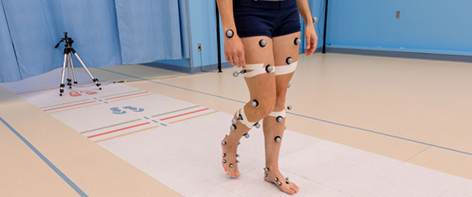
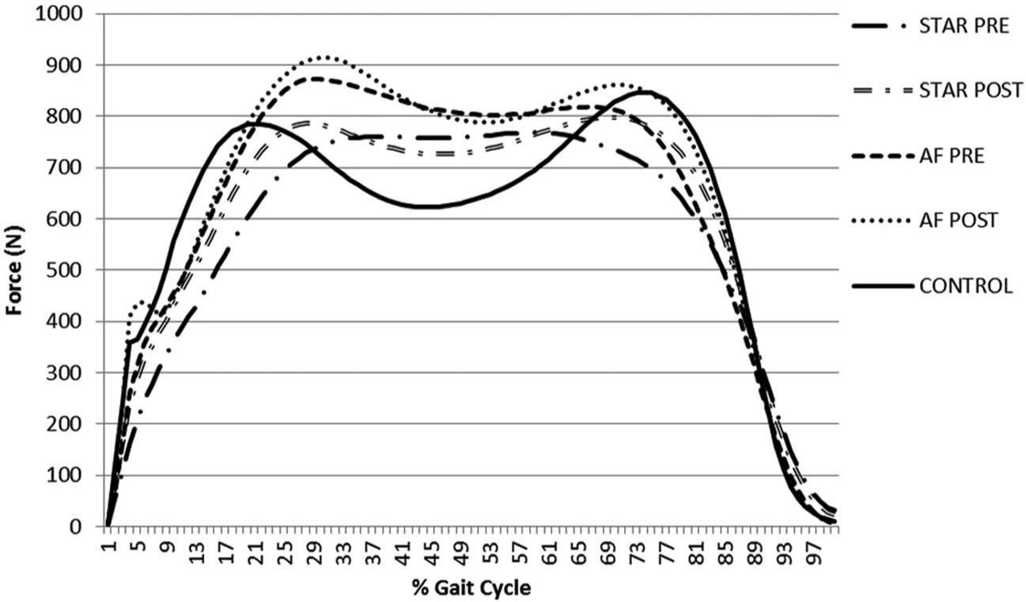
Patient Impact
SF-36 scores equivalent to end stage hip arthritis
2 standard deviations below population norms
Physical function in patients with ankle osteoarthritis is equivalent or worse than that of patients with end stage kidney disease, congestive heart failure, or cervical spine pain with radiculopathy
Gait studies demonstrate reduced ankle motion, peak ankle power, peak power absorbed compared to contralateral limb
Decreased stride length, decreased self selected gait velocity compared to population norms
Glazebrook, M, Daniels, T, Younger, A, et al. Comparison of health-related quality of life between patients with end-stage ankle and hip arthrosis. J Bone Joint Surg Am. 2008; 90:499–505. PMID: 18310699
Flavin R, Coleman SC, Tenenbaum S, Brodsky JW. Comparison of gait after total ankle arthroplasty and ankle arthrodesis. Foot Ankle Int. 2013 Oct;34(10):1340-8. doi: 10.1177/1071100713490675. Epub 2013 May 13. PMID: 23669163.

Slide 9
Ankle arthritis is different
Only 37% end stage ankle arthritis with normal alignment (Valderrabano, CORR 2008)
Major adjunct procedures required in 40% cases (Penner, AOFAS 2009)
Patients affected at a younger age and impact on QoL spans a greater percentage of adult life

Slide 10
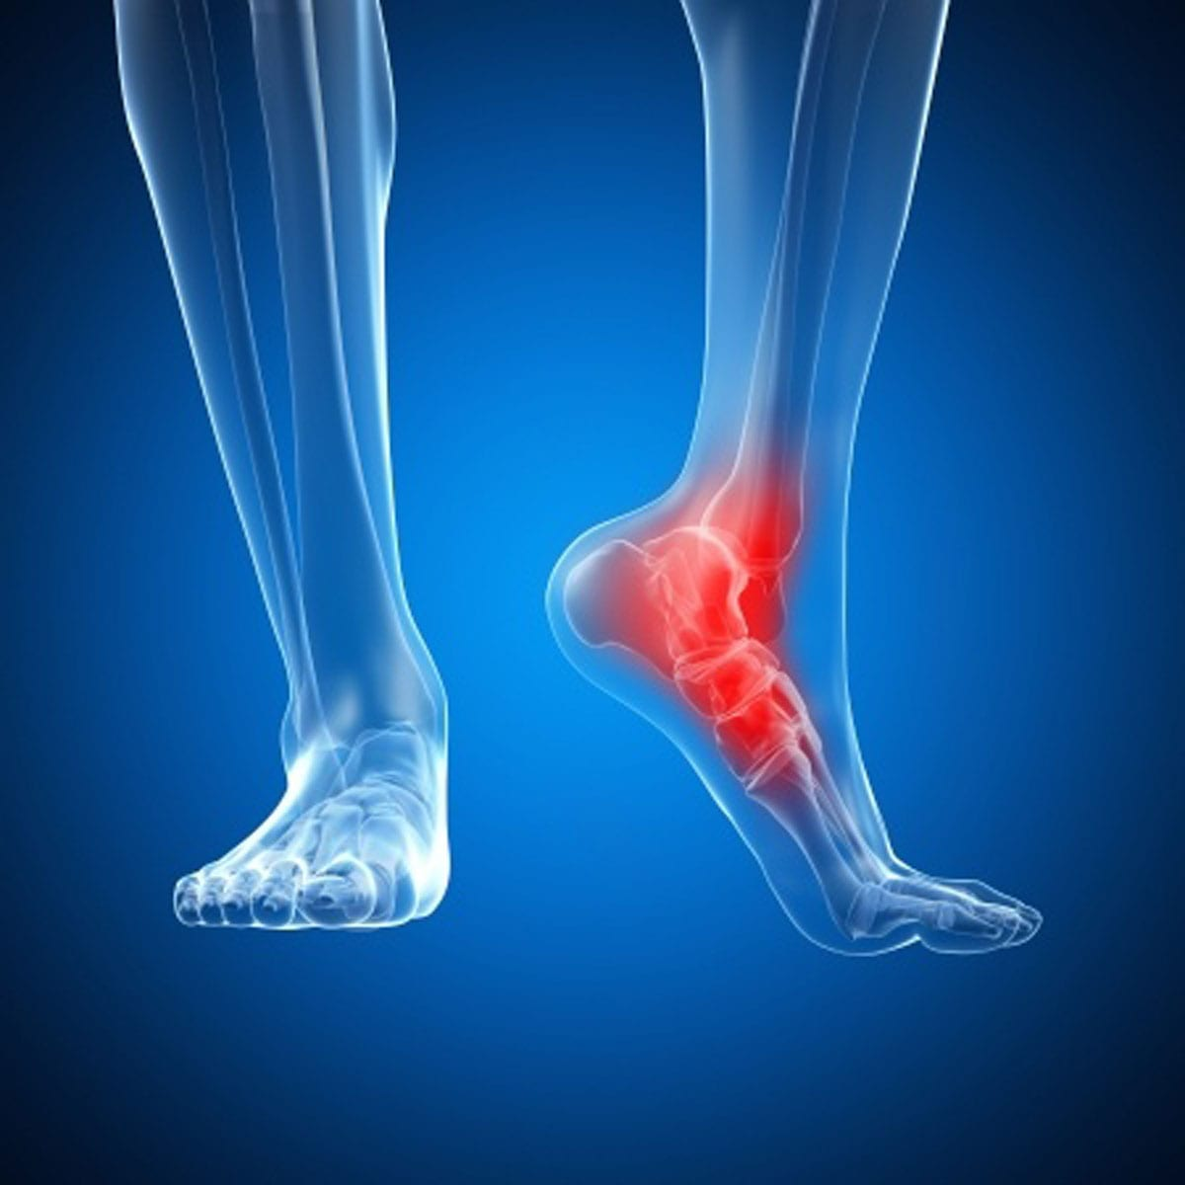
Presentation
History
Location of pain (ankle, hindfoot)
Types of activities (uphill, down inclines, uneven ground)
Relevant medical history (inflammatory arthropathy, DM, prior trauma)
Treatments

Slide 11
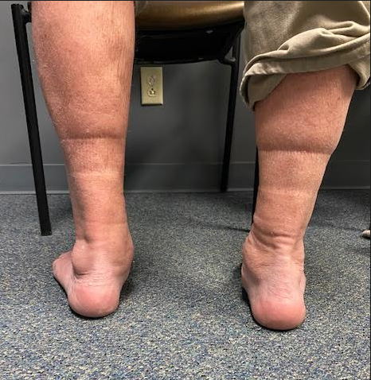
Exam
Standing and seated exam
Standing
Alignment
Gait
Mechanical axis (proximal deformity)
Seated
Neurovascular exam
Prior surgical scars
Ankle stability
Strength and motion
XR- foot and ankle, hindfoot alignment with deformity

Slide 12
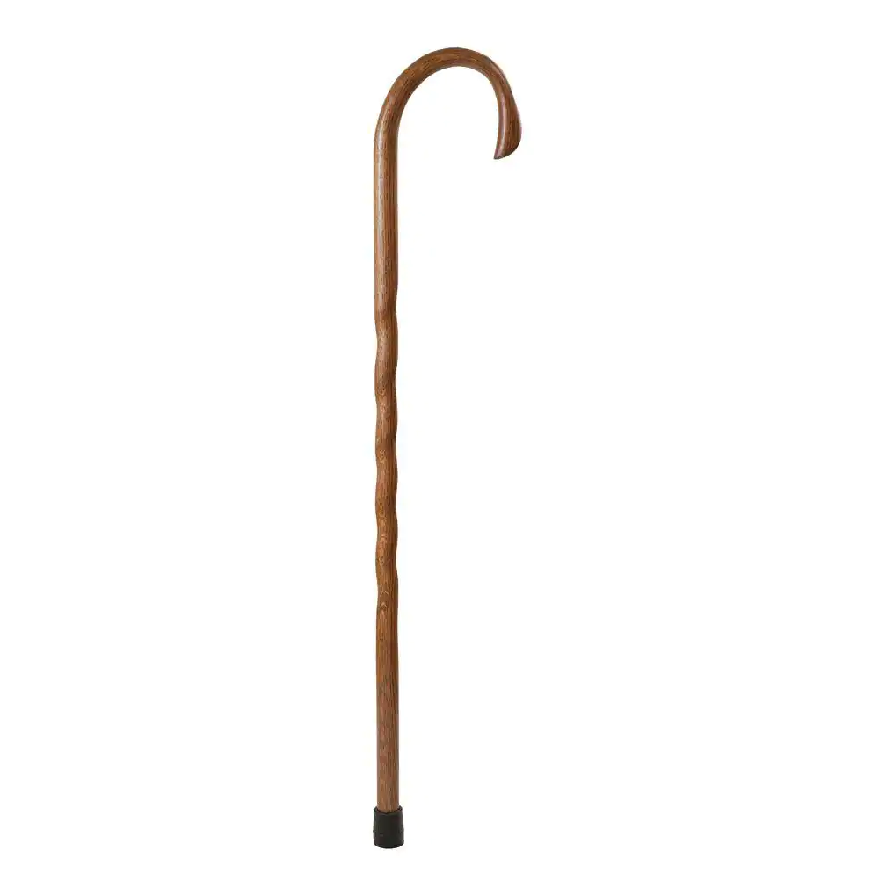
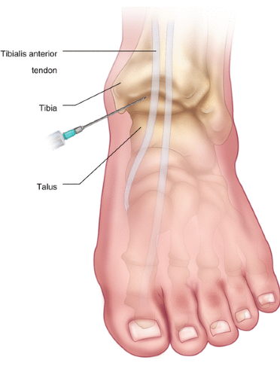
Treatment
Non-operative
Activity modification
Assistive devices
NSAIDs
Injections (steroids, viscosupplementation)
Immobilization (OTC vs custom bracing)

Slide 13
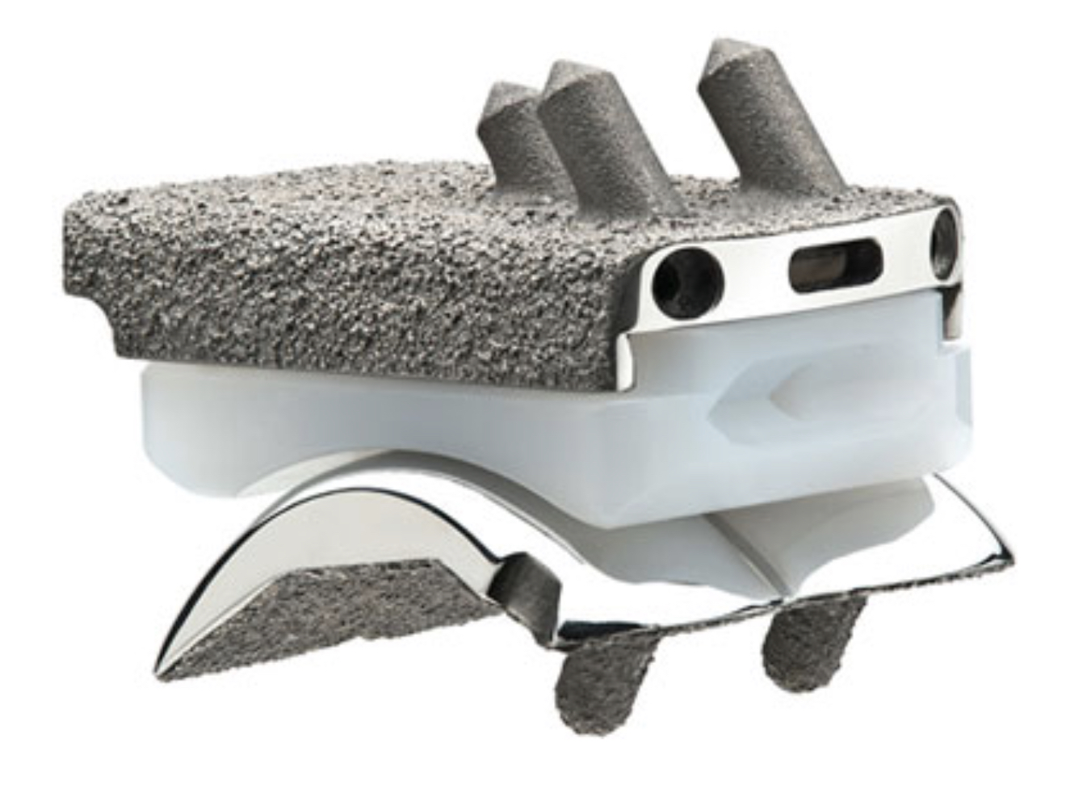
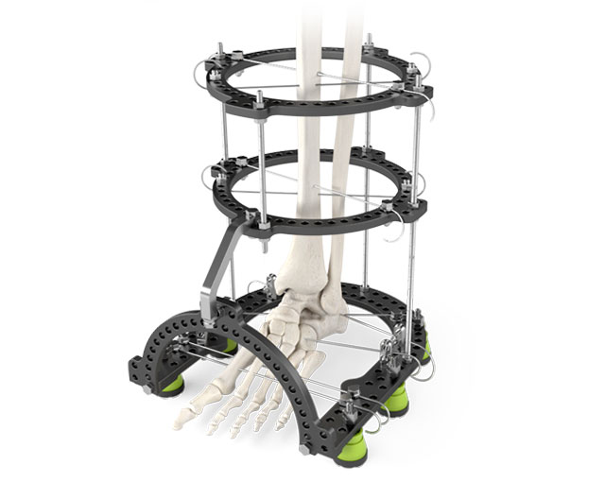
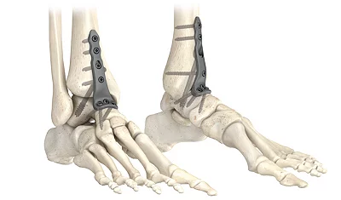
Treatment
Operative
Ankle scope with debridement
Distraction arthroplasty
Ankle arthroplasty
Ankle arthrodesis

Slide 14
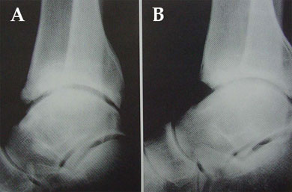
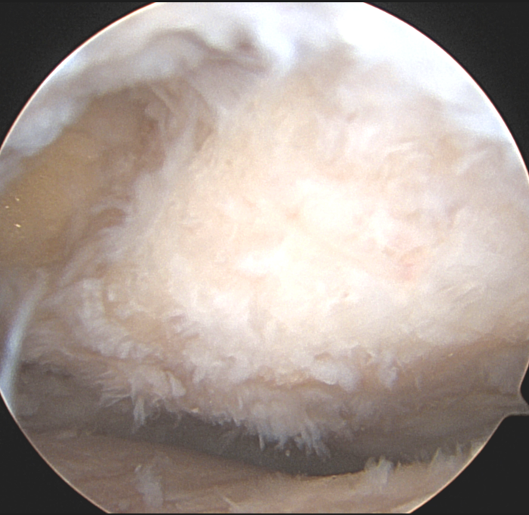
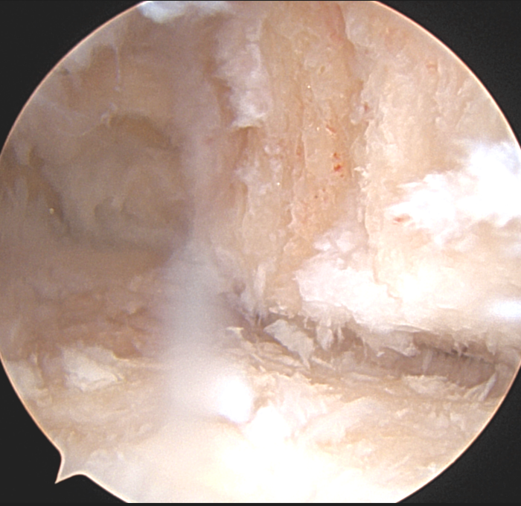
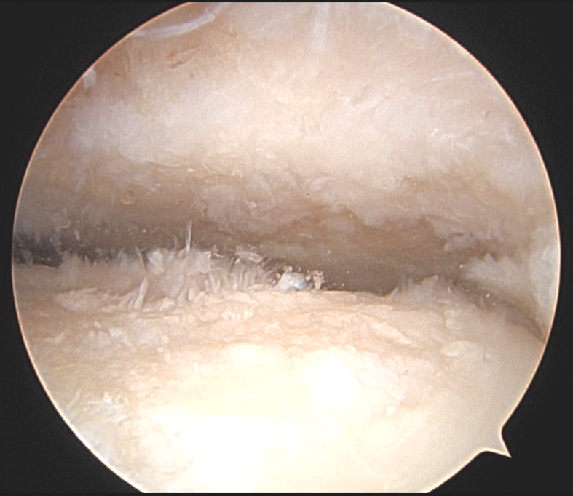
Ankle Scope Debridement
Effective for anterior ankle impingement
Document severity of arthritic change in the ankle (prognostic)
Not long term treatment option if advanced arthritic change
28% require major ankle surgery within 5 years (Hassouna et al, 2007)
Poor-fair results, only 62% satisfaction, in patients with arthritis vs 88% with primarily impingement symptoms (Ogilvie-Harris et al, 1993)

Slide 15
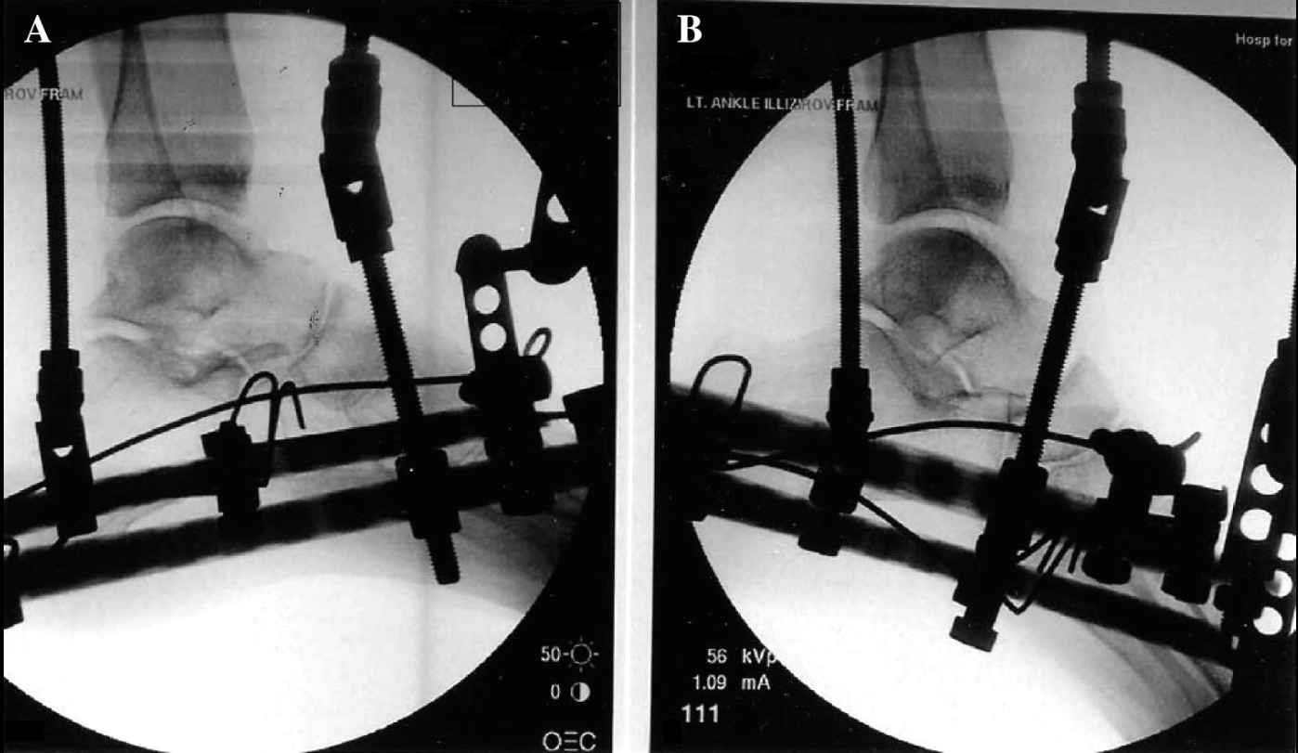
Distraction Arthroplasty
Limited subset of patient
Offload joint, allow some cartilage healing, scar formation
Tellisi et al.
21/25 patients with pain iprovements
AOFAS score 55 pre-op to 74 post-op
SF-36 scores modest improvement (pain and well being)

Slide 16
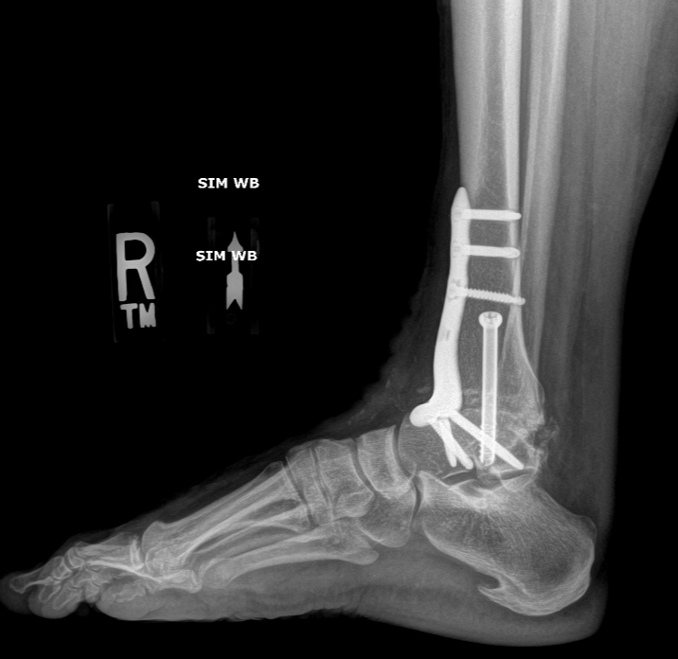
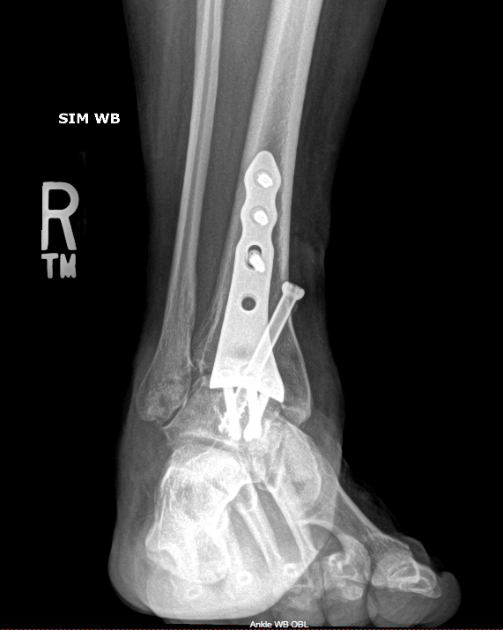
Ankle Arthrodesis
Historically gold standard for advanced ankle arthritis
Inversion and eversion of hindfoot not affected
Slight dorsiflexion/plantarflexion at transverse tarsal joints
Excellent pain relief
Risk of adjacent joint arthritis over time

Slide 17
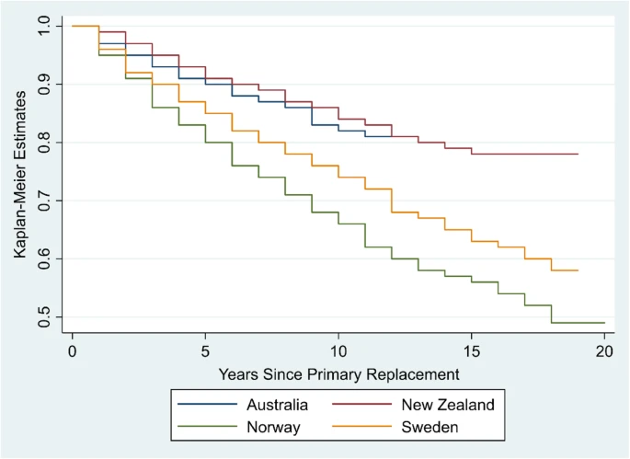
Ankle Arthroplasty
Significant evolution in design and implant survival
10 year implant survival between 70 and 90%
Re-operation free survival 70%
Return to OR for cyst grafting, gutter debridement, poly exchange
Perry, T.A., Silman, A., Culliford, D. et al. Survival of primary ankle replacements: data from global joint registries. J Foot Ankle Res 15, 33 (2022)

Slide 18
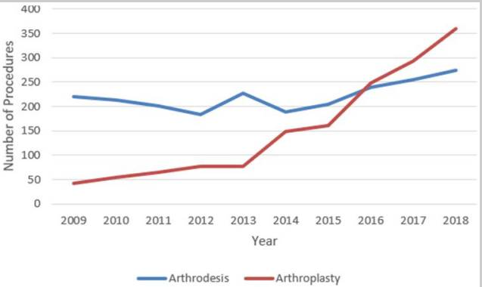
Ankle Arthroplasty vs Arthrodesis
*BOTH treatments effective for decreasing pain and increasing function across multiple studies*
Arthrodesis- risk of adjacent joint degeneration
Nonunion rates 7-43%
Adjacent joint arthritis
Radiographic in almost up to 90%
Meta-analysis show only 5-6% additional procedures
Arthroplasty- increased need for subsequent procedures (revision arthroplasty, conversion, poly, grafting, impingement)
Implant survival 78% and 77% at 5 and 10 years (Haddad et al., JBJS 2007)
Revision 17% at 5.5 years vs 7% for ankle arthrodesis (Daniels et al, JBJS 2014)
Brodeur PG, Modest JM, Walsh DF, Hartnett DA, Gil JA, Cruz A, Hsu RY. Trends and Utilization of Ankle Arthroplasty vs Arthrodesis in the State of New York, 2009-2018. Foot Ankle Orthop. 2022 Nov 10;7(4). PMCID: PMC9660445.

Slide 19
Ankle Arthroplasty vs Arthrodesis
Outcomes
“TAA preserves more anatomic sagittal plane motion and provides greater pain relief and better patient perceived outcomes compared with ankle arthrodesis”
Pedowitz, JBJS 2016
Gait and motion-TAR compared favorably to ankle arthrodesis
Faster walking speed
Increased forefoot sagittal plane motion, especially dorsiflexion
Increased hindfoot sagittal motion, dorsiflexion
Stronger ankle plantarflexion power

Slide 20
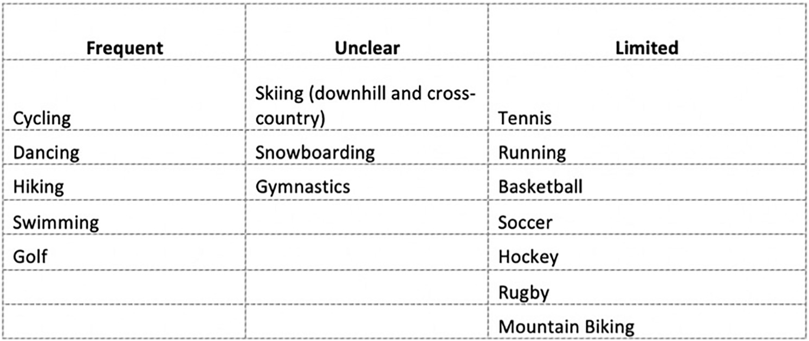
Ankle Arthroplasty vs Arthrodesis- Return to Sport
Participation in sports improved greater than 10% after treatment with TAR (41%→59%)
Remained high after treatment with ankle arthrodesis (73%→70%)
Most common sports swimming, hiking, cycling and skiing
High impact sports- tennis, soccer, running- consistently limited after either treatment
Johns WL, Sowers CB, Walley KC, et al. Return to Sports and Activity After Total Ankle Arthroplasty and Arthrodesis: A Systematic Review. Foot & Ankle International. 2020;41(8):916-929

Slide 21
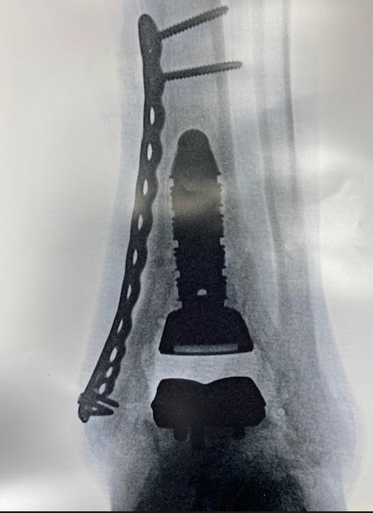
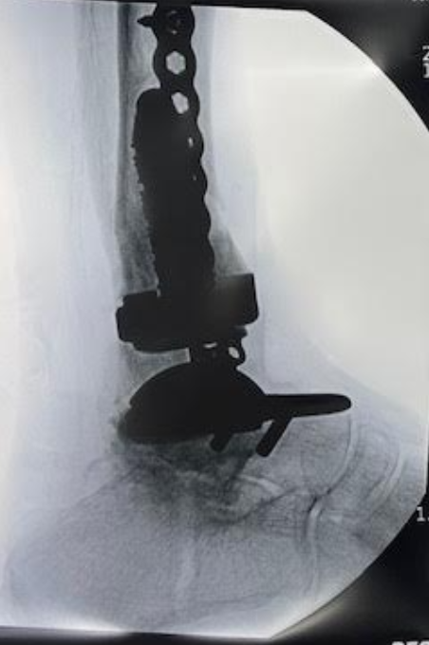
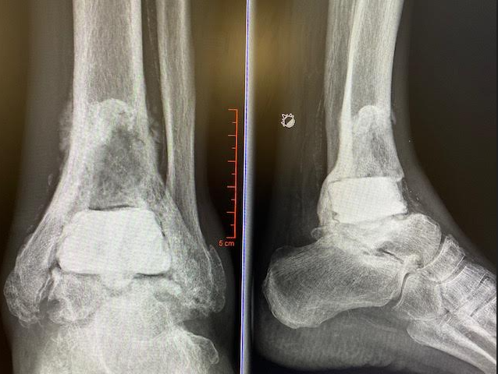
Ankle Arthroplasty and the Future
Patient selection expanding
Age
Deformity
Similar outcomes in coronal plane deformity >20 degrees
Activity
“Very few undoable TARs” –W. Hodges Davis, MD
Revision options and comfort with procedures improving
Salvage arthroplasty instead of arthrodesis

Slide 22
Take Home
Ankle arthritis is different
Younger, active, post-traumatic
Impact on QoL is significant
Gold standard has been ankle arthrodesis, though treatment strategy evolving and TAR becoming possible for more patien ts

Slide 23
forteortho.com

