Slide 1
Exercise Considerations for the Adolescent Athlete
Chris Gray, DPT, OCS, Cert DN, FAAOMPT
29APR2023

Slide 2
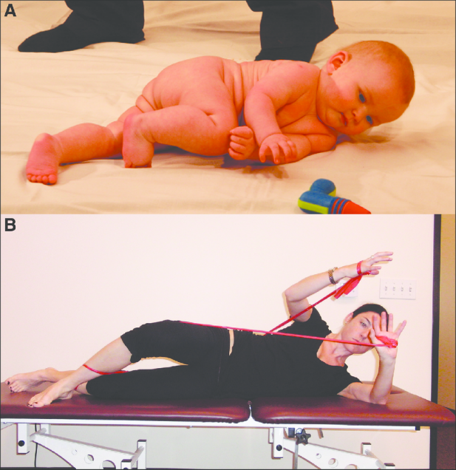
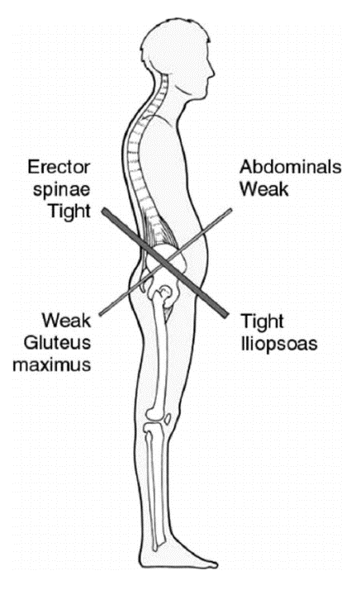
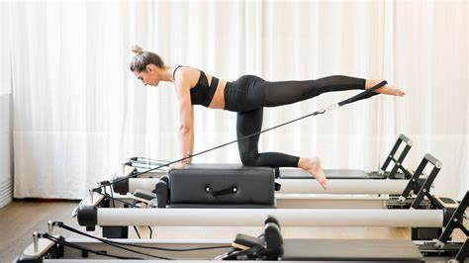
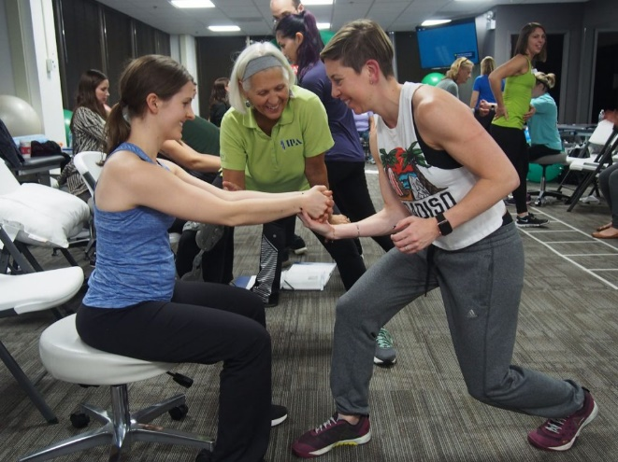
An abundance of exercise paradigms…

Slide 3
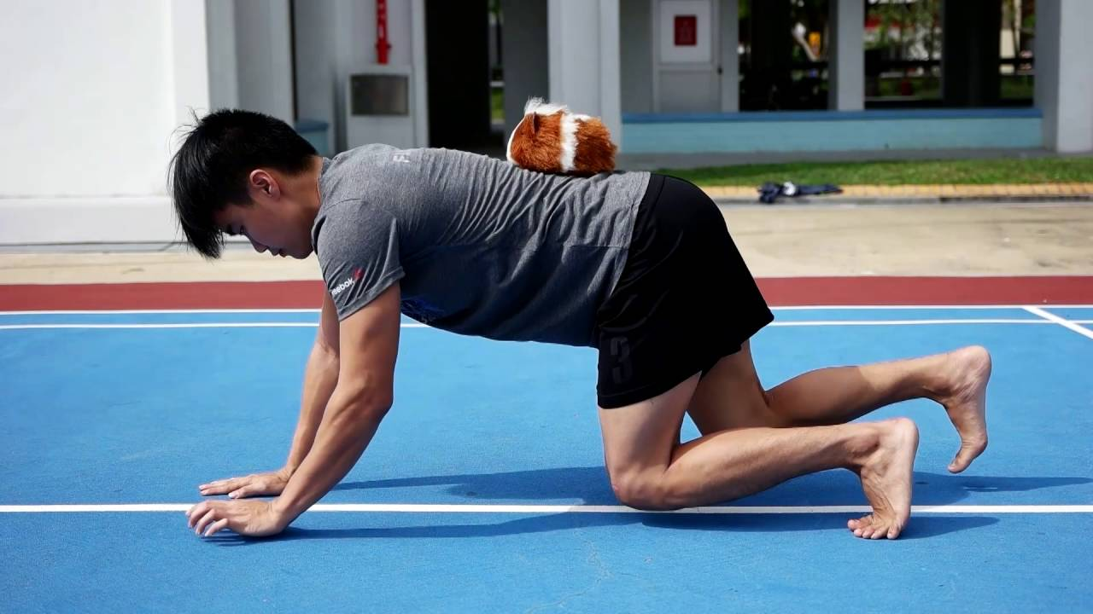
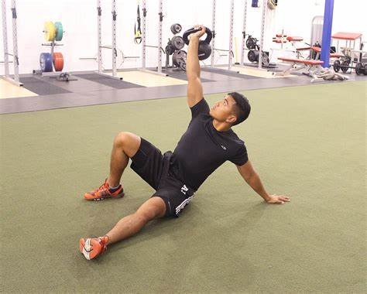
4 Principles of Exercise Prescription - Craig Liebenson, DC
Re-assurance:
Hurt ≠ Harm
Re-activation:
Safe to move
Move well, then move often
Resilience:
Load it – make it challenging (RPE > 5/10)
“It’s not the activity that breaks you, it’s the activity you’re not prepared for”
Risk Management:
Variability, novel movements
Notes:
Re-assurance:
Hurt ≠ Harm
False + scans
“The tissue ain’t the issue”
Give safety messages in our language, not danger messages
Re-activation:
Safe to move
Begin to move well, then move often
Aerobic capacity
Resilience:
Increased robustness
Resistance training
Load it
It’s not the activity, it’s the activity you’re not prepared for
Risk Management:
Variability
Novel movement
Sport-specific training

Slide 5
Acute Phase – Lumbar Spine
Pain modulation / reduction
Mobility of neighboring joints / regions (thoracic spine/ribs and hips)
Cardiovascular exercise with appropriate modality (bike, aquatic, etc)
Begin basic “core” stability program
Supine
Quadruped
Progress into directional-preference exercises when cleared
Most commonly flexion due common posterior element injuries

Slide 6
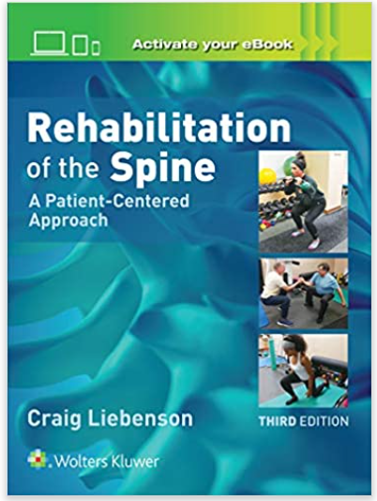
NMC System Scan (Assessment)
**Stability vs mobility**
Sagittal
Functional squat (compare with supine DKTC)
Forward bend/Toe touch (vs child’s pose)
OH reach/extension (vs PPU)
Stability buttress/plank
Frontal
Janda hip abduction test
Side plank x 45” (endurance)
Transverse
ASLR (Vleeming)
PSLR (Mens)
Single leg squat (credit to Craig Liebenson and SFMA/FMS systems)
Single leg bridge

Slide 7
NMC Correctives
Sagittal
McGill curl up
B hip flexion ISO hold
Hip hinge training
Nordics (standard/reverse)
Frontal
Side bridge
Irradiation re-set for hip ABD
Copenhagens
Hip Hike with SB at wall
Transverse
Bird dogs
SL bridge with SLR + band
Plank with elbow taps
PNF chops/lifts
SLDL progression
Kickstand DL variations
Happy baby SB series
Notes:
Then place SB between thighs and arms (not resting on abdomen)
“don’t let me move fingers”… then ball… then you (3 steps)
Then begin Happy baby roll (as one, as unit) “barrel roll exercise”
Now take R hand off and roll
Now take R hand and L knee off and roll
CAP: check rotational test (ASLR) then do happy baby series and retest

Slide 8
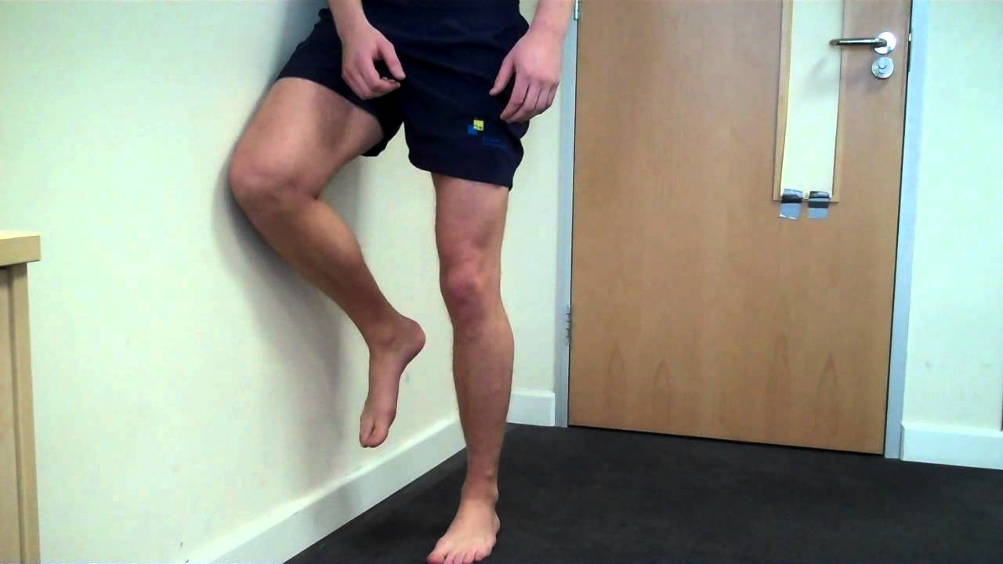
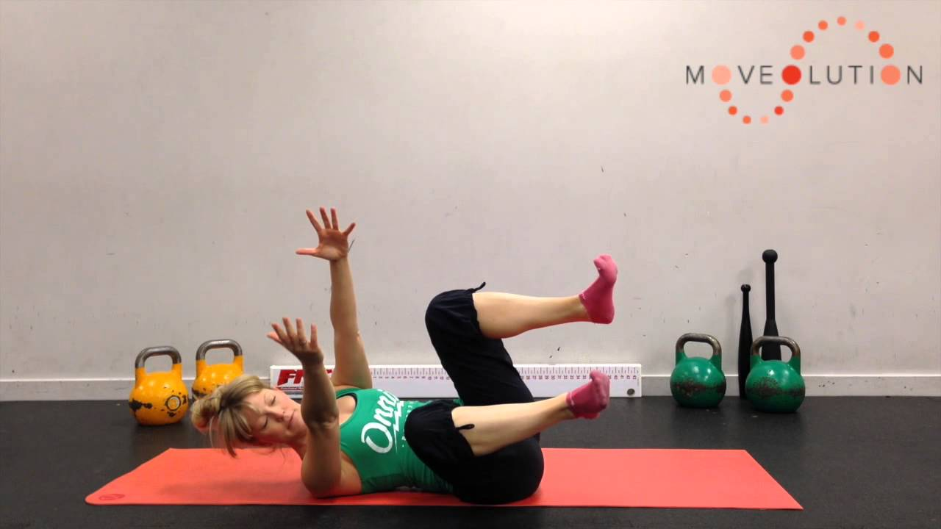
NMC Correctives - examples
Sagittal
McGill curl up
Hip hinge training
Frontal
Side bridge
Hip Hike with SB at wall
Transverse
Bird dogs
Plank with elbow taps
Happy baby SB series
Notes:
Then place SB between thighs and arms (not resting on abdomen)
“don’t let me move fingers”… then ball… then you (3 steps)
Then begin Happy baby roll (as one, as unit) “barrel roll exercise”
Now take R hand off and roll
Now take R hand and L knee off and roll
CAP: check rotational test (ASLR) then do happy baby series and retest

Slide 9
Functional Integrations - Testing
Exaggerated Carioca/Grapevine
Overhead Squat
Functional rotation
Lunge patterns
Running pose at wall
Looking for loss of pillar stacking
Vele Lean into Janda Lunge
SL hop and hold
Testing their “shocks & springs”
Another option: Jumping/Landing
Crawling/Rolling
“Every exercise is a test” – Tim Gabbett
Notes:
Franka Vele (Prague) used this since it involuntary recruits the foot intrinsics
Chance to watch the stacking of the pillar
If stacking is lost, they have a loss of high-density contraction of the posterior chain → and then forces are going to travel into other areas; like the knee and they’ll become “quad-dominant” in their movements or into the back which leads to increased stress/strain
This is the value in observation of these mvmts – seeing these stress points and pillar NMC

Slide 10
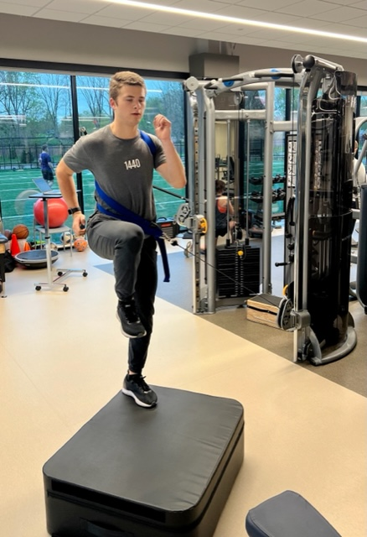
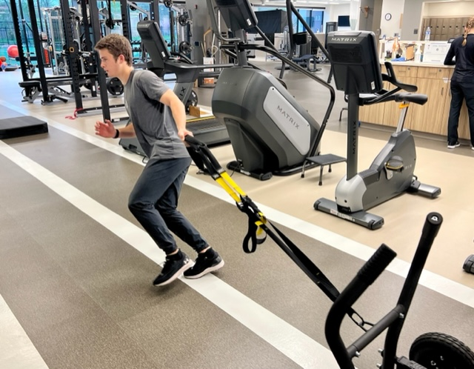
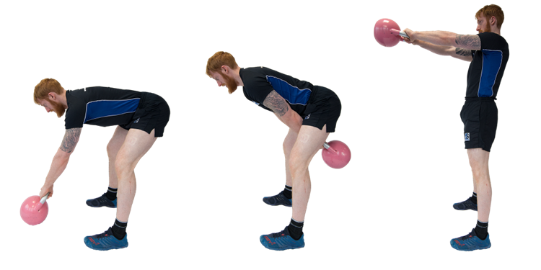
Functional Integrations
Focus on movements, not specific muscles
And…. Challenge the planes the patient needs
Sagittal – Frontal - Transverse

Slide 11
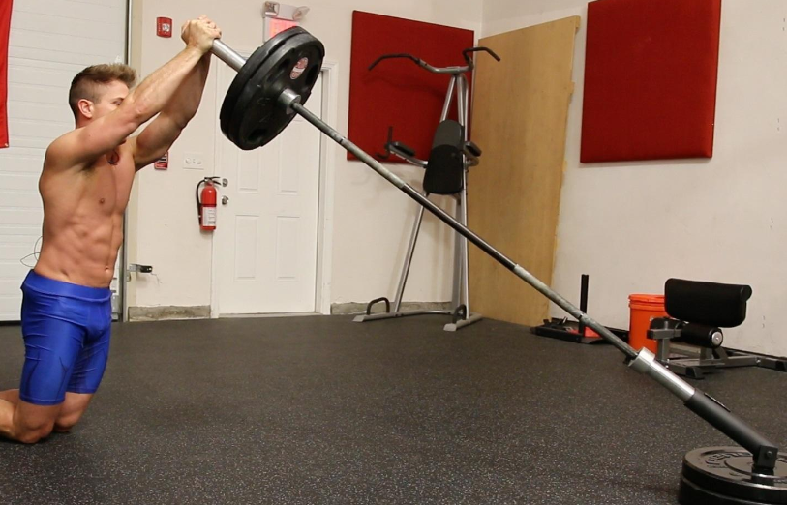
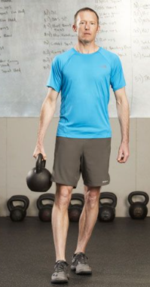
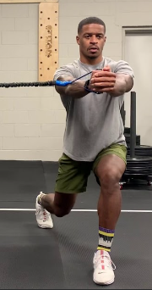
Functional Integration - examples
Sled push/pull (lateral, forward/back)
Suitcase carries
Beast crawl variations
Landmine press
Cable-strap variations
Palov variations
Kettlebell swings
Turkish Get Up (TGU)
Plyometric progressions…
Notes:
Plyo → snap downs, jump up to with landing focus

Slide 12
Putting it all together - Example
Case: 17YOM soccer player – episodic beltline LBP x 4 months
Imaging: unremarkable
Sway back posture
Limited and painful extension, “tight HS” with flexion
+ AP shear test in standing
+ rSLR (prone) bilaterally…… (transverse plane)
Limited strength/endurance with McGill curl up….. (sagittal plane)
Diffuse relative stiffness in thoracic region
Intervention Plan?

Slide 13
Putting it all together - Example
Case: 17YOM Soccer player
NM (corrective exercise)
ISO hip flexion for low ab
Hip hinge series
Tall kneeling chops
Dying Bug – heel taps
Happy baby series
McGill curl up
Reverse Nordics
Functional Progression
Plank progressions
Beast crawl
Landmine press neutral spine
…… ?

Slide 14
Exercise Interventions – Cervical Region

Slide 15
CCFT Testing – Gwen Jull, PT
Laying supine – hooklying
Neck in neutral
Tri-folded BP cuff under neck
Small towel under head may be needed for FH patients
Inflate cuff to 20 mmHg
Perform head nod (not retraction)
Hold 22 mmHg for 10”, then 24 mm…
Goal is to get above 26 (stop at 30) without any superficial compensation

Slide 16
Supine NMR considerations
Gwen Jull – cueing concepts
Patient-specific verbal cueing
KISS (keep it simple)
Consider “lengthen your neck vs a chin tuck or head nod” cueing
“feel the back of your head slide up the table”
Not a neck retraction
Consider adding slight rotation with the movement
Test-ReTest (CCFT and * signs)
How about a head lift?
Remember - many neck pain patients have altered NMC, thus have an imbalance in their sup vs deep flexors
The strong SCM is quick to take over. Adding too much load with exercise will inhibit the DNF, with SCM dominating
Once they establish good control with head on table → then consider lift
Don’t neglect the extensors….

Slide 17
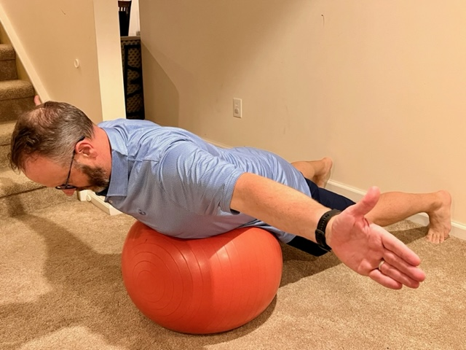
NMR Progressions
“Scapulothoracic” vs “Axioscapular”

Slide 18
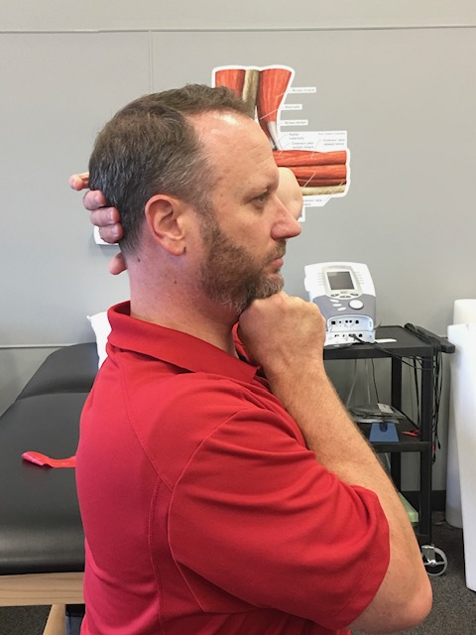
NMR Variations

Slide 19
Functional progressions
Beast Crawl Variations
Landmine Overhead Press Variations

Slide 20
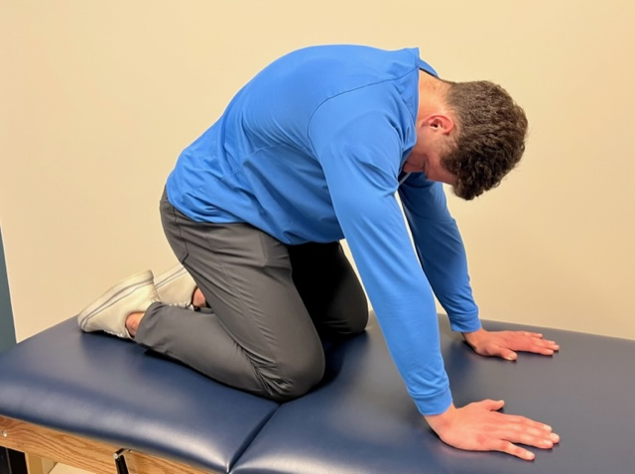
Thoracic mobility
Extension-Rotation Re-set
Thoracic Cat
Thoracic Cow

Slide 21
Any questions?
Contact info:
Chris Gray, PT
ptgraymatter@gmail.com
cgray@forteortho.com

