Slide 1
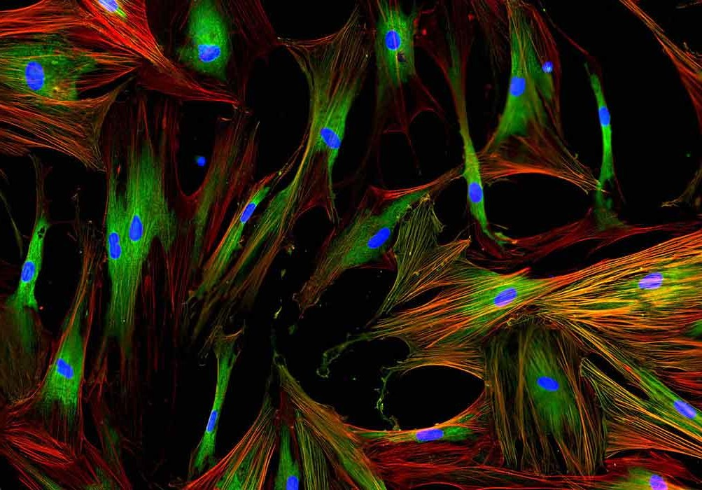
Precision Therapeutics
Shane Rose MD
Rayus - Regenerative Medicine

Slide 2
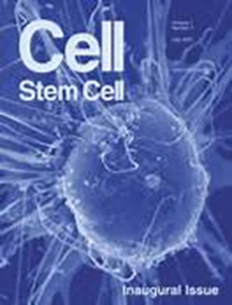
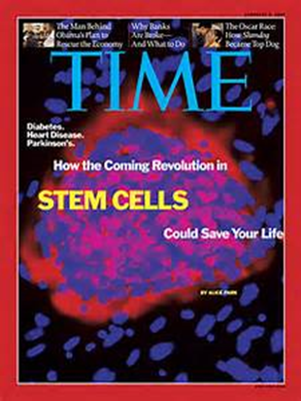
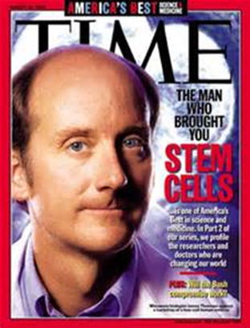
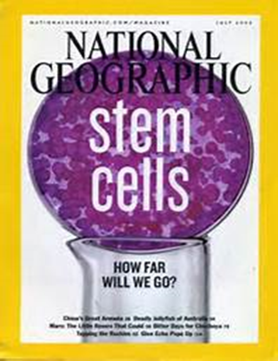
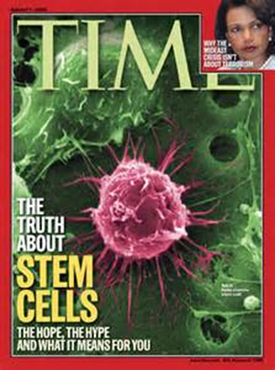

Slide 3
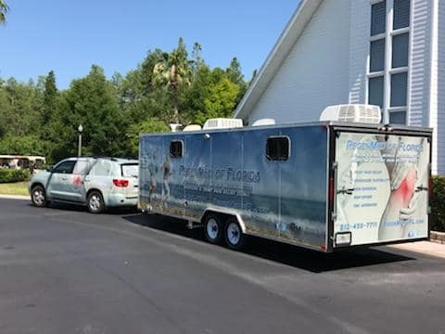

Slide 4
Regenerative Medicine
The intentional and active promotion of the repair response regarding diseased, dysfunctional or injured tissue utilizing stem cells and/or their derivatives.

Slide 5
Intentional and active
Physician intervention
Best Orthobiologic
Precise and complete placement

Slide 6
Intentional and active
Physician intervention
Best Orthobiologic
Precise and complete placement

Slide 7
Physician intervention
Highly trained and experienced MD or DO who understands the theory, options, techniques, and pitfalls of each disorder and procedure.
First and greatest responsibility - Should this be done?
Chiropractors cannot legally perform injections of any material.
Nurse Practitioners and Physician Assistants do not have the legal standing to prescribe Orthobiologic treatments.

Slide 8
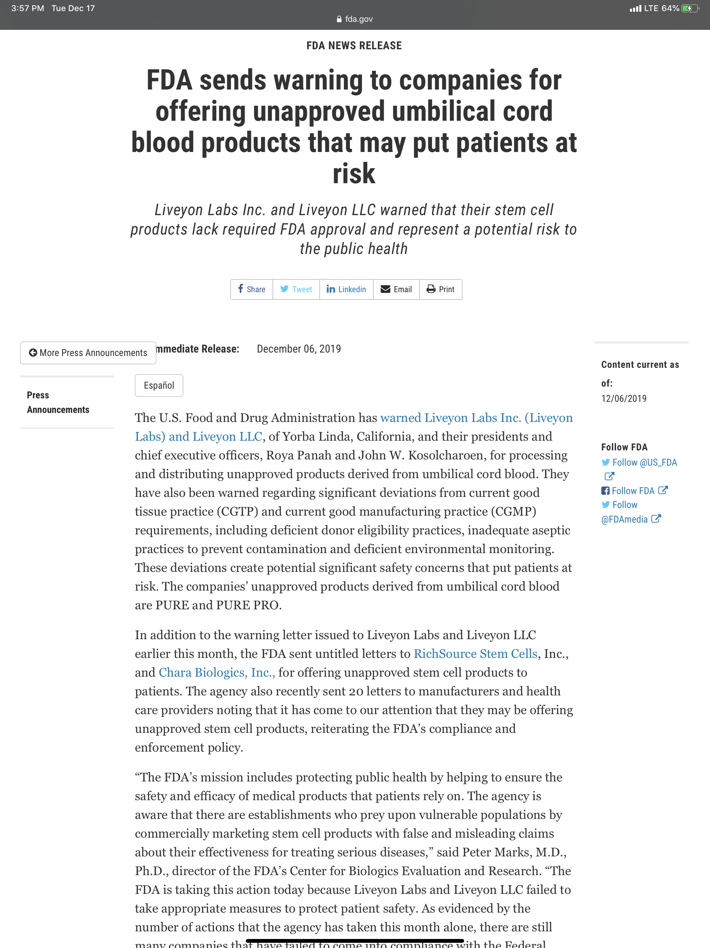
FDA letters to major Peri-natal derived producers stating non-compliance
Liveyon
Chara Biologics
RichSource Stem Cells
20 other smaller companies

Slide 9
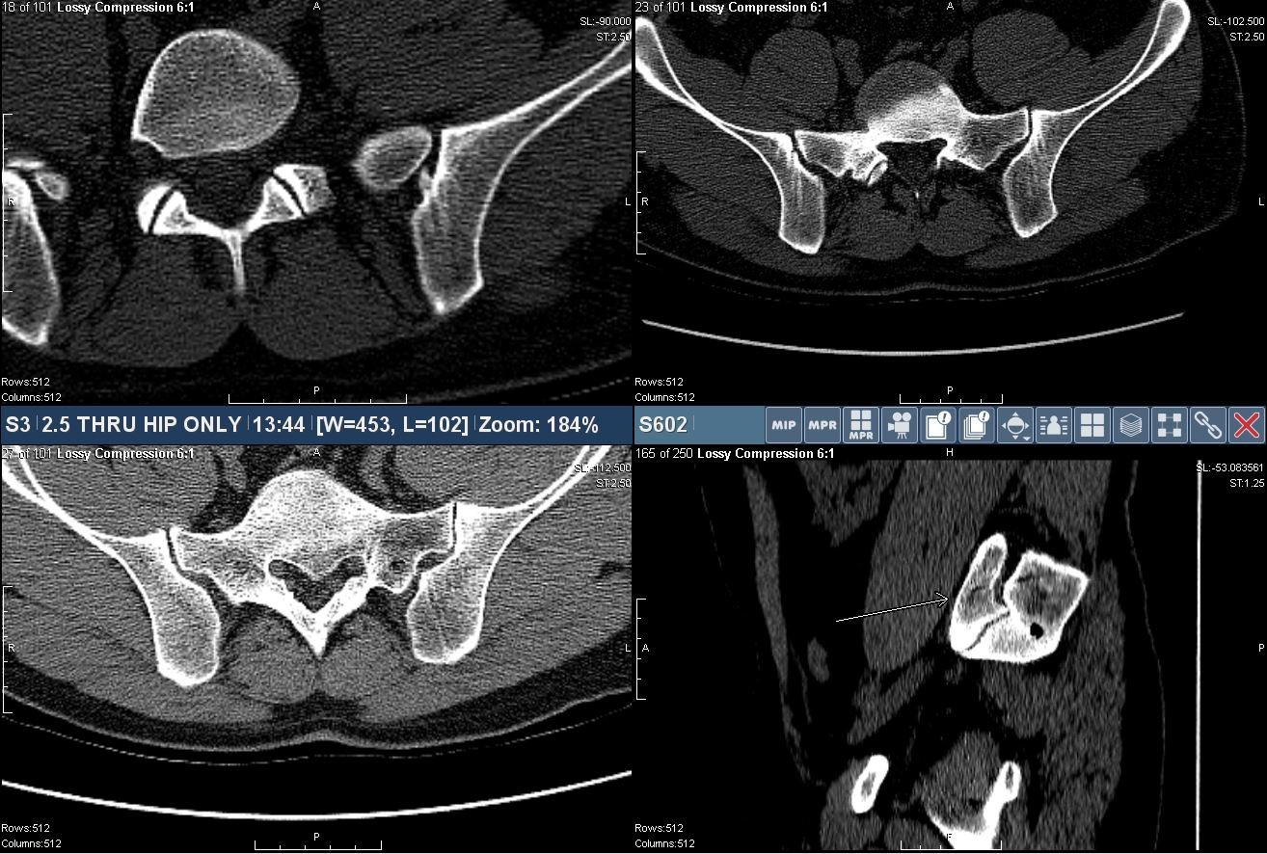
Importance of experience and technique
28yo male now complains of severe buttock and hip pain after BMAc

Slide 10
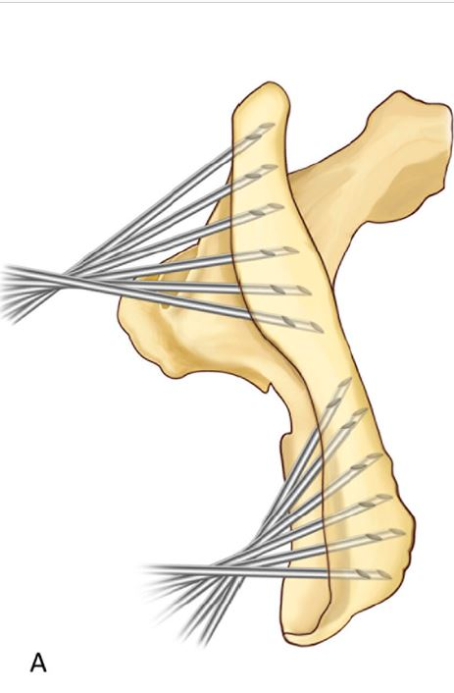
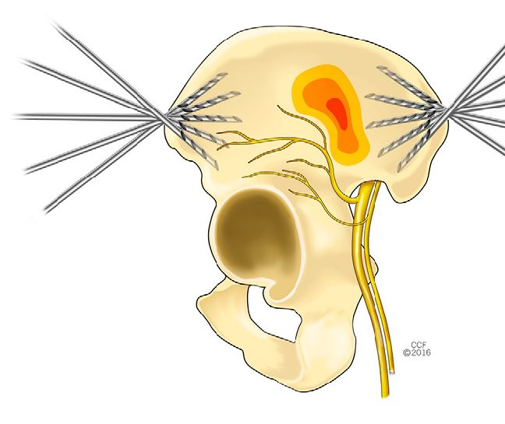
Illiac crest needle placement options for optimal BMAc quality. - Piuzzi 2018

Slide 11
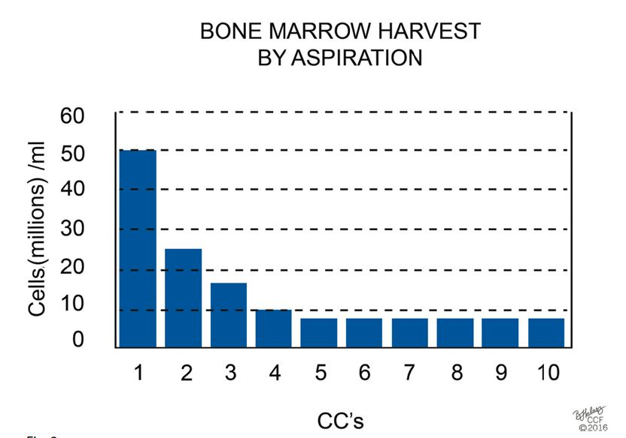
85% of all marrow-derived cells available from a given site were collected in just a 2-ml aspirate. - Piuzzi 2018
It is critical that multiple small volume aspirations from multiple sites be completed to insure the best BMAc MSC quality.

Slide 12
Intentional and active
Physician intervention
Best Orthobiologic
Precise and complete placement

Slide 13
Best Orthobiologic
PRP - Platelet Rich Plasma
LR or LP (Leukocyte Rich or Poor)
PPP - Platelet Poor Plasma
PL - Platelet Lysate
BMAc - Bone Marrow Aspirate concentrate
A2M - Alpha-2 Macroglobulin
Integrated sclerosing agent
* Adipose derived *

Slide 14
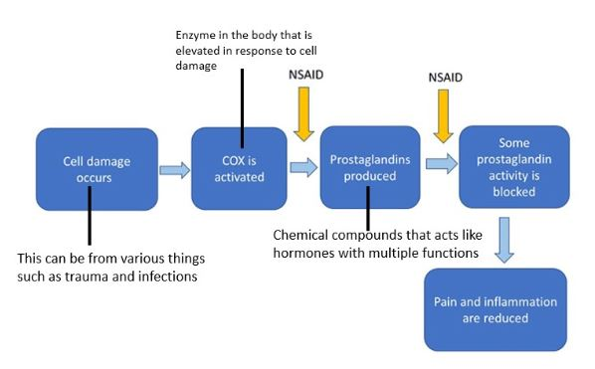
NSAIDS
NSAIDs moa is via COX 1-2 disruption, blocking the inflammatory cascade, thereby decreasing aggravation of nerves and subsequent pain.
The inflammatory cascade is part of the HEALING cascade in which recruitment of cells produce cytokines and growth factors which are intended to heal the initial injury.
By using NSAIDs for pain, we are essentially turning a 'healing acute' injury into a 'non-healing chronic injury'.

Slide 15
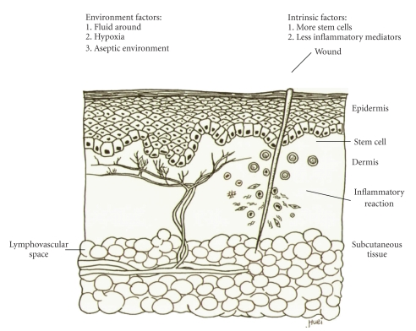
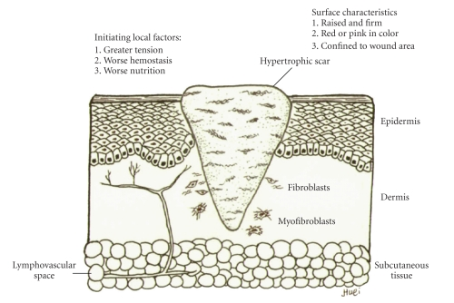
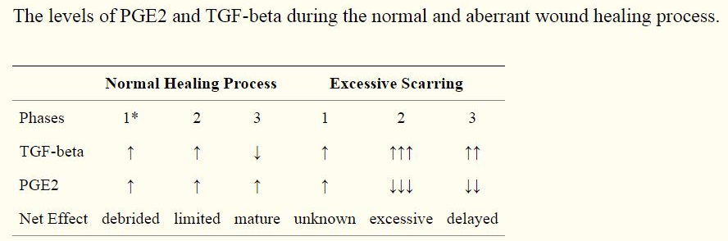
Fetal
NSAID

Slide 16
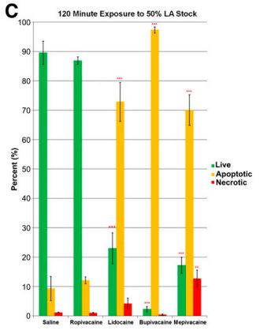
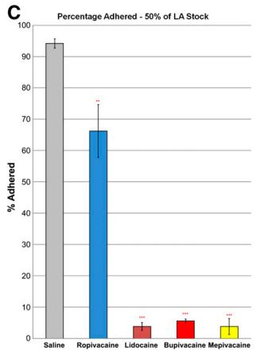
Local Anesthetic
Local anesthetics are commonly added to the PRP/Stem cell injectate or the area is heavily anesthetized prior to injection.
Lidocaine, Ropivacaine, Mepivacaine, and Bupivacaine all resulted in significantly increased apoptosis.
Dregalla 2014

Slide 17
Best Orthobiologic
What is not ready for use at this time?
Birth derived origin
Placental
Amniotic
Umbilical cord blood
Wharton's Jelly
Embryonic
* Urine *
Exosomes

Slide 18
Do birth derived 'Stem Cell' products contain living Stem cells?
Panero et al - Are Amniotic Fluid Products Stem Cell Therapies? A Study of Amniotic Fluid Preparations
"MSCs could not be identified in the Commercial AFPs or unprocessed amniotic fluid." - PalinGen, FloGraft, and Genesis AFPs
Becktell et al - Proteomic analysis and cell viability of nine amnion-derived biologics
"amnion-derived products do not enact their positive effects by serving as a source of live cells or growth factors." - Arthrex, MiMedX, Amniox, Integra
Berger et al - In Vitro Evaluation of Injectable, Placental Tissue-Derived Products for Interventional Orthopedics.
"Do not likely contain viable stem cells once they are thawed per the manufacturer's recommendatons." - AmnioFix, BioDRestore, FloGraft Freedom, Ovation Cellular Repair
Centeno et al - Review of Utah Cord Blood Products. - CSU Translational Medicine Institute
"No viable stem cells found in culture." - LiveyonPure, StemVive, CharaCore, RichGen, StemL

Slide 19
Colony forming units (purple dots) representing living stem cells in original "cell" preparations.

Slide 20
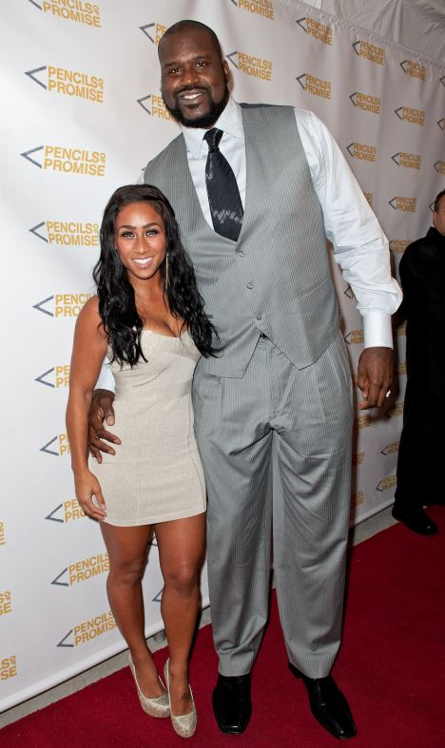
Volume and concentration are critical
The concentration is proportional to the initial blood volume obtained.
The proportion of growth factors and platelets is directly proportional to the concentration.
Both of these are directly proportional to the outcome.
Requirements depend on size and age of patient, body part, type and degree of injury, current state of injury (ie chronic vs acute), and other associated factors.

Slide 21
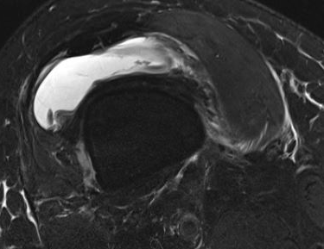
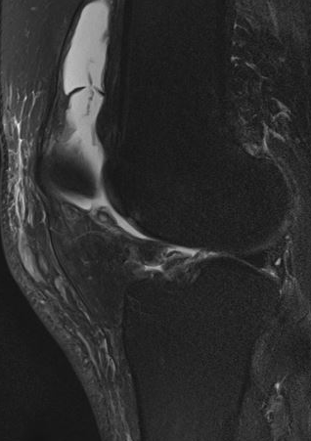
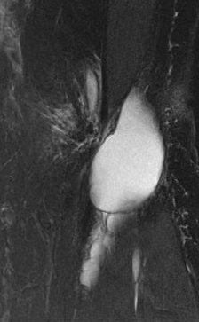
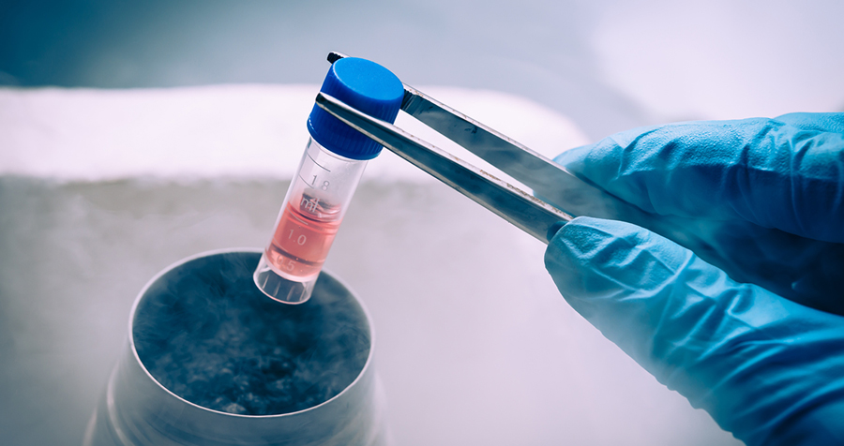
Knee volume
V = 1.6 height (cm) - 135
Pt. 6'2" (188cm)
Effusion volume of 165ml

Slide 22
Intentional and active
Physician intervention
Best Orthobiologic
Precise and complete placement

Slide 23
Precise and complete placement
Best and most accurate modality for any given situation
Fluoroscopy, Ultrasound, and/or CT
Precise placement of injectate
Membranes and fascial planes matter
Complete injection of all associated structures
Rarely a single injection. Typical knee requires between 4-10 needle placements in order to fully address all involved structures.

Slide 24
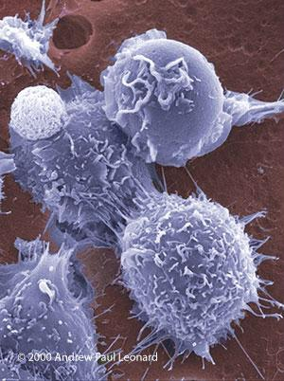
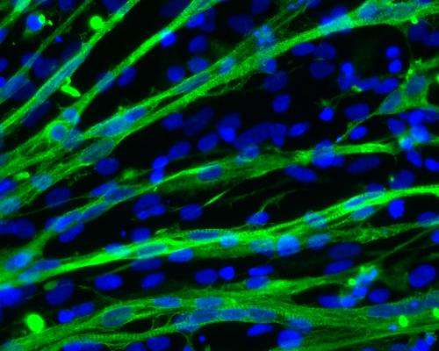
Stem cells tend to stay where they are placed. This micro-environment is called the niche. And it largely dictates the ultimate fate of the stem cells.

Slide 25
Niche
Stem cells migrate via sensing of a biochemical gradient. (chemotaxis)
It is critical that the injection be completed as close to the location of injury as possible, as all current treatments consist of both cells and growth factors which will maintain the higher gradient in the area of injection.
Fascia, sheaths, plica, membranes, etc can all mitigate diffusion of injectate thereby negating cell migration away from the location of injection. - Labusca 2018

Slide 26
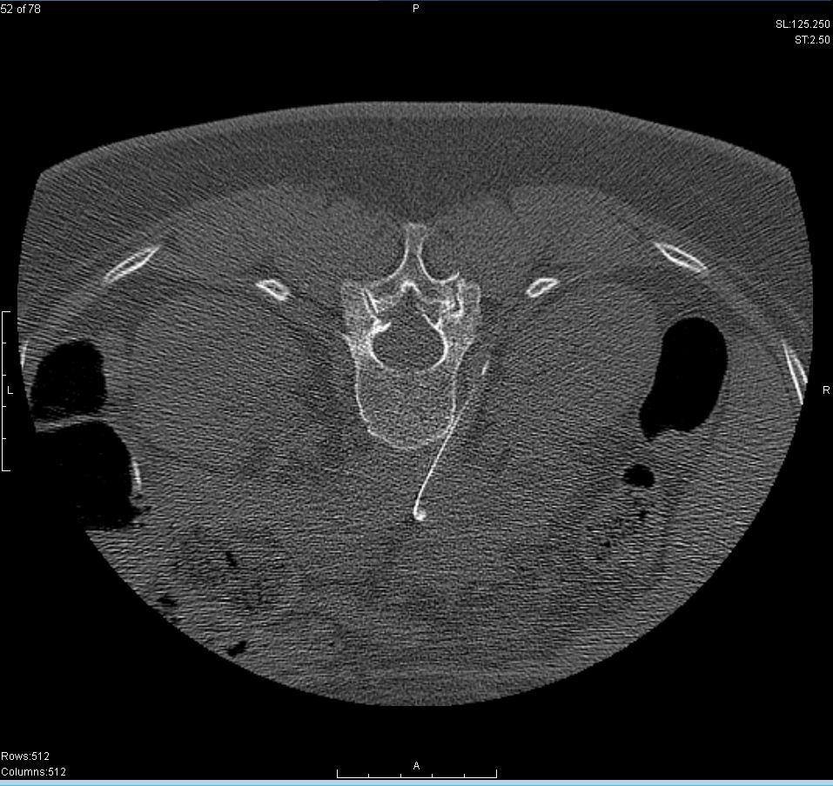
Results = No room for error

Slide 27
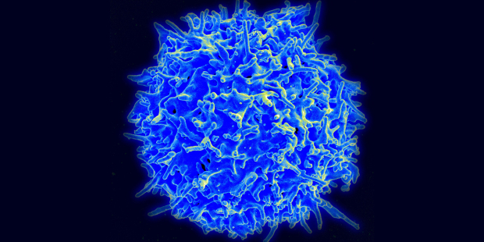
Regenerative Medicine
The intentional and active promotion of the repair response of diseased, dysfunctional or injured tissue using stem cells and/or their derivatives.

Slide 28
Promotion of the repair response
Intracellular proteins
Extracellular matrix
Exosomes *
Leukocytes
granulocytes (neutrophils, eosinophils, and basophils), monocytes, and lymphocytes (T cells and B cells)
Platelets
Stem Cells
Growth Factors
TGF-β1, VEGF, PDGF-BB, FGF-b, SDF-1, GCSF, MMP-9, etc
mRNA
Vesicles

Slide 29
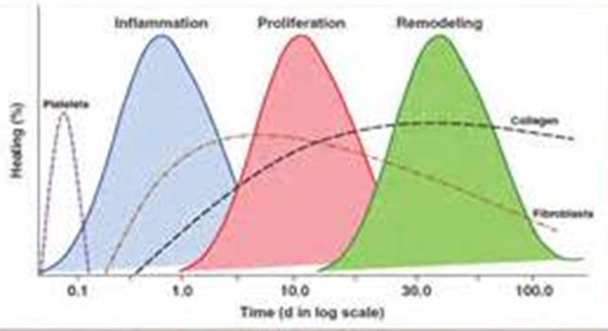
Healing Cascade
Bleeding - regenerative cells and growth factors to the site of injury
Low vascular environments (joints, cartilage, ligaments, etc) have poor delivery of these healing factors.
Concentrating and precisely delivering them initiates, speeds, and augments

Slide 30
Normal Metabolism
Highly regulated balance:
synthesis vs degradation
Growth factors promote
Anabolism
Other components inhibit
Catabolism

Slide 31
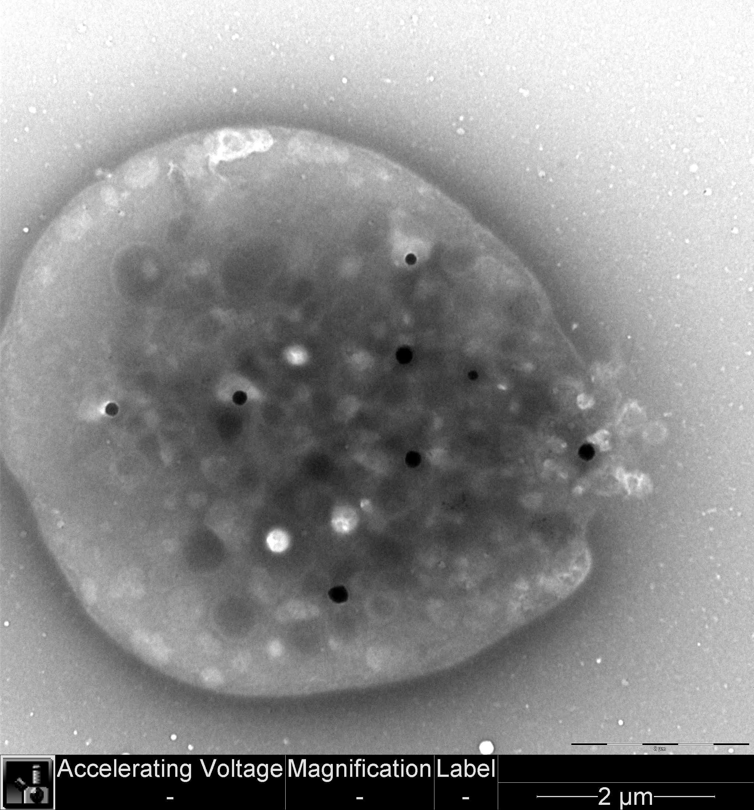
Platelets
Platelet Rich Plasma (PRP)
Platelet Poor Plasma (PPP)
LR-PRP
LP-PRP

Slide 32
Promotion of the repair response
Intracellular proteins
Extracellular matrix
Exosomes *
Leukocytes
granulocytes (neutrophils, eosinophils, and basophils), monocytes, and lymphocytes (T cells and B cells)
Platelets
Stem Cells
Growth Factors
TGF-β1, VEGF, PDGF-BB, FGF-b, SDF-1, GCSF, MMP-9, etc
mRNA
Vesicles

Slide 33
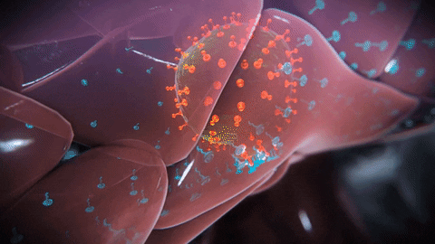
Stem cells

Slide 34
Embryonic stem cells
Embryonic
- from Pre-implantation stage embryo.

Slide 35
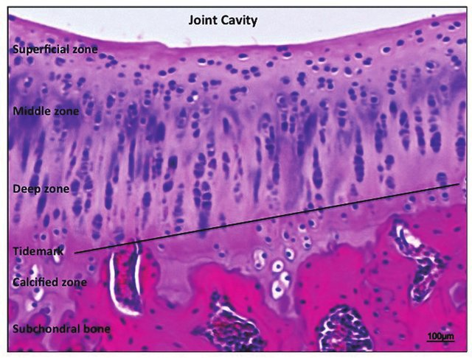
Healthy articular cartilage

Slide 36
Promotion of the repair response
Intracellular proteins
Extracellular matrix
Exosomes *
Leukocytes
granulocytes (neutrophils, eosinophils, and basophils), monocytes, and lymphocytes (T cells and B cells)
Platelets
Stem Cells
Growth Factors
TGF-β1, VEGF, PDGF-BB, FGF-b, SDF-1, GCSF, MMP-9, etc
mRNA
Vesicles

Slide 37
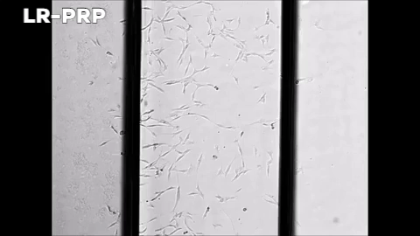
Growth Factors
Primarily act as recruiters and directors
TGF-β1, VEGF, PDGF-BB, FGF-b, IL -1, SDF-1, GCSF, MMP-9, etc

Slide 38
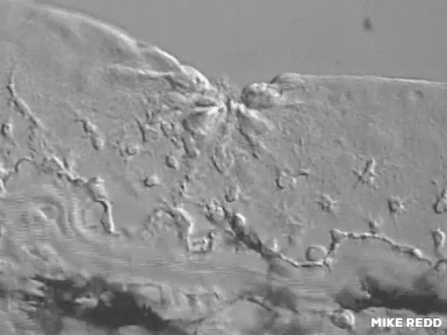
Chemotaxis

Slide 39
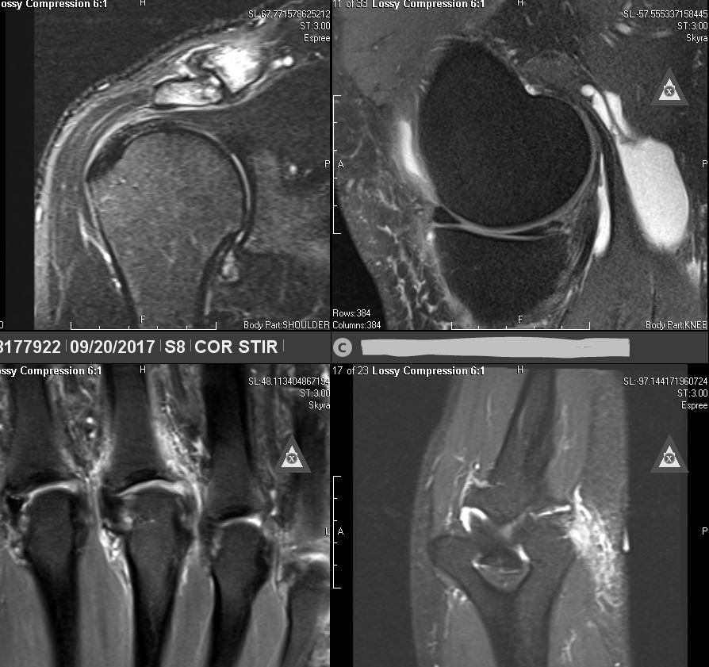
Regenerative Medicine
The intentional and active promotion of the repair response of diseased, dysfunctional or injured tissue using stem cells and/or their derivatives.

Slide 40
Diseased, dysfunctional, or injured tissue

Slide 41
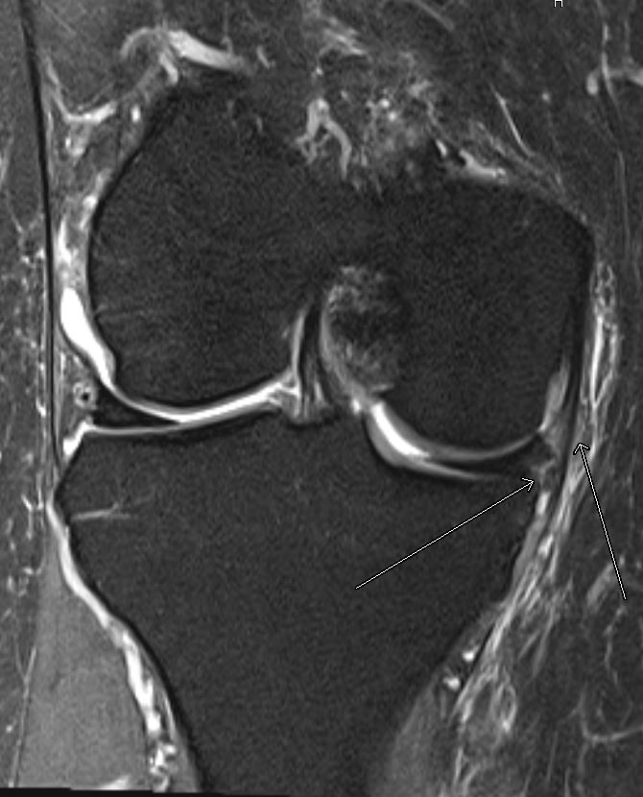
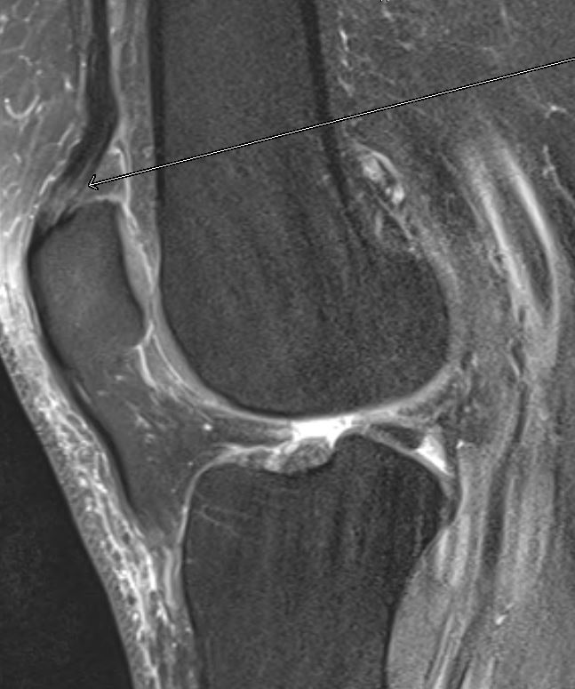
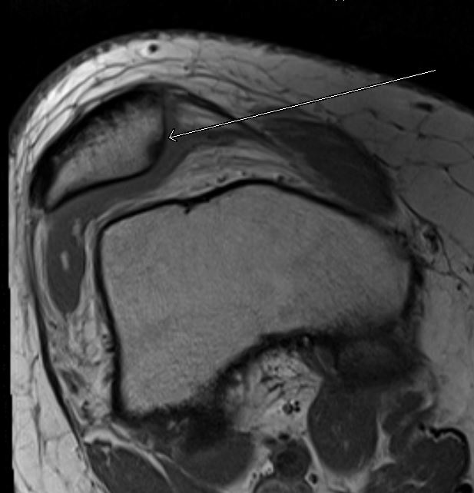
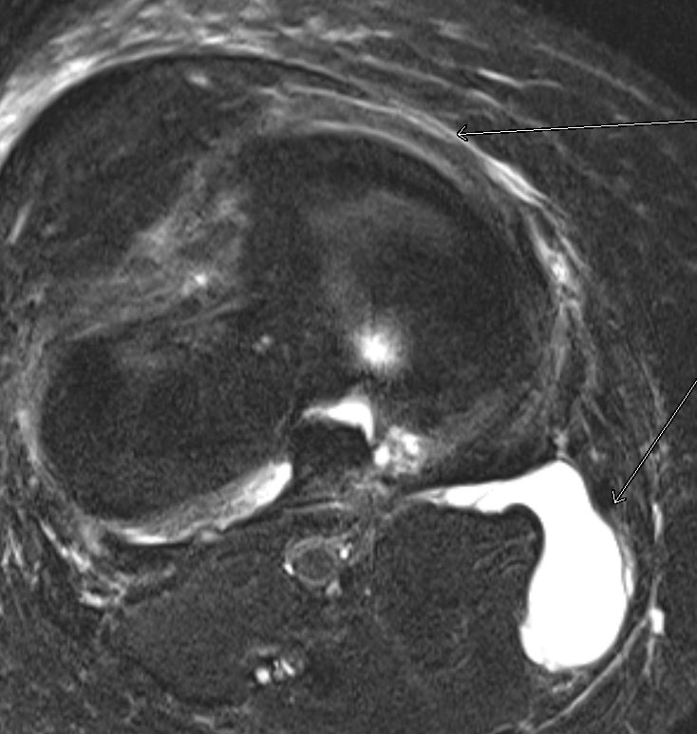

Slide 42
50yo male new onset knee pain.
Dx - 'undersurface apical flap tear of the meniscus'.

Slide 43
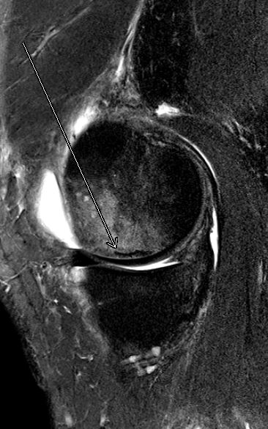
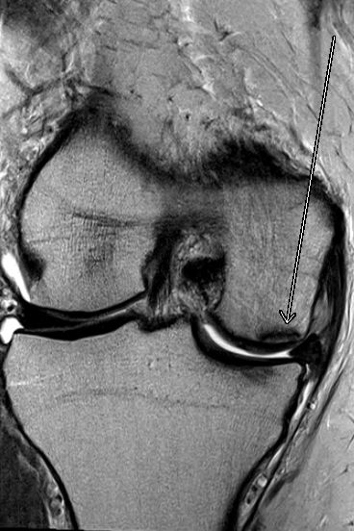
2 weeks s/p medial meniscectomy, pt had large persistent effusion limiting ROM.
MR demonstrates subarticular stress fx of medial fem condyle.

Slide 44
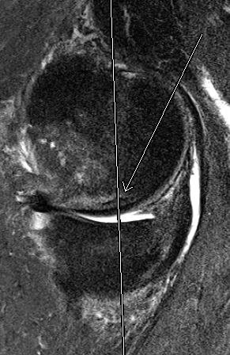
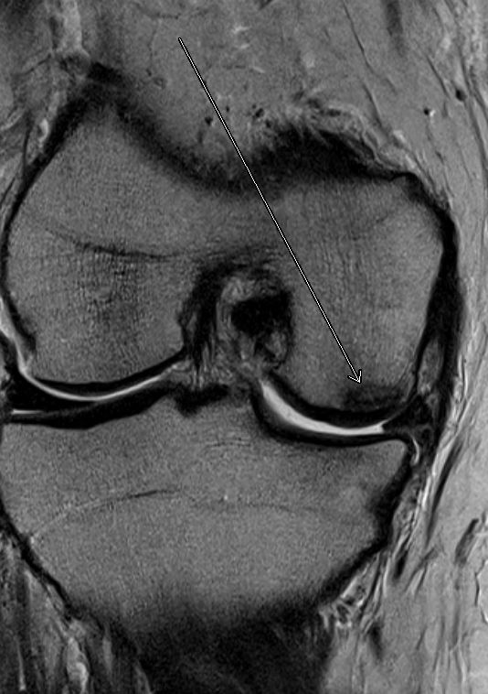
Non weight bearing for 4 weeks. Sxs improved and f/u MR demonstrated progressive healing and patient was allowed to return to exercise.

Slide 45
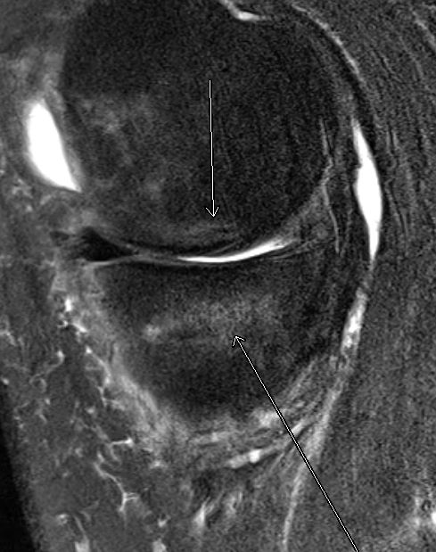
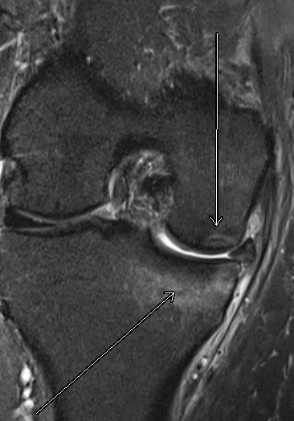
1 month after return to exercise, pt continued to have persistent effusion and developed very slight lower medial knee pain (3/10)
- MR demonstrates developing tibial stress fx along the med tib plateau.

Slide 46
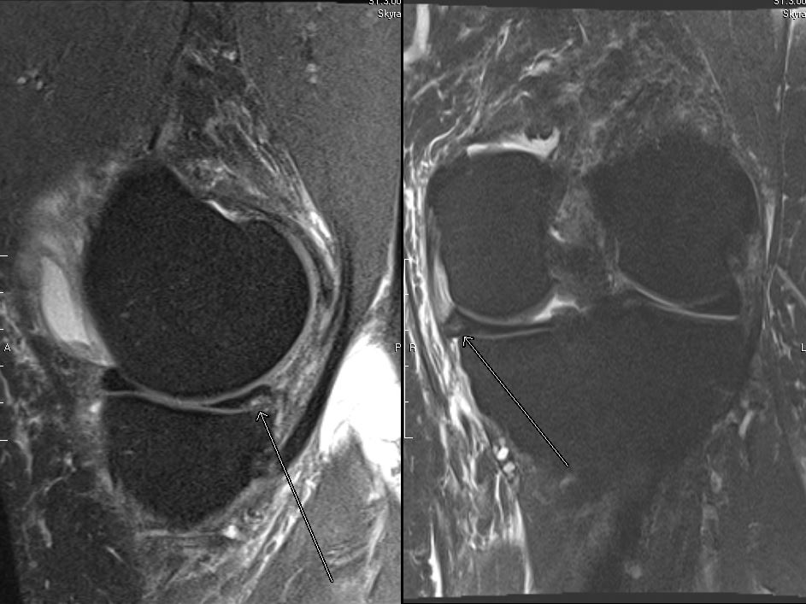
6mo after initial onset of right knee pain and subsequent surgery, pt develops almost identical left knee sxs.
- MR apical flap tear of posterior horn of medial meniscus.

Slide 47
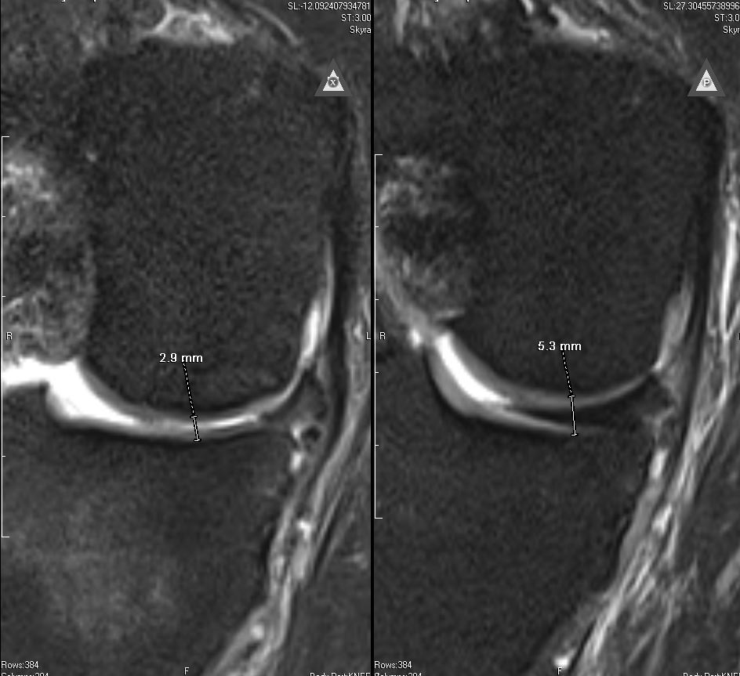
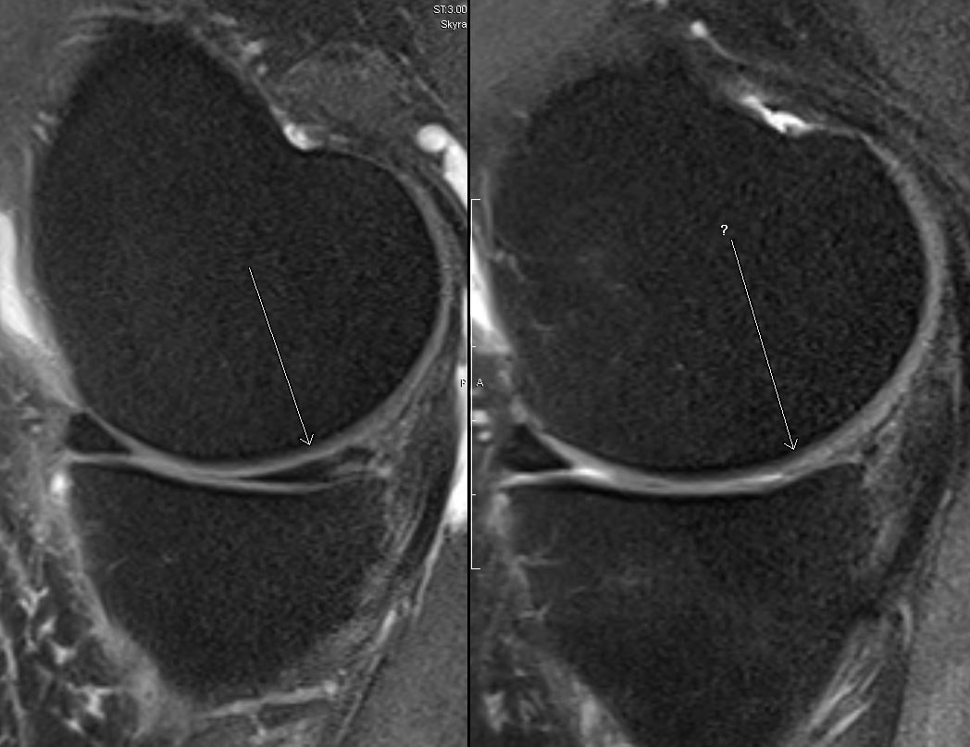
12mo post op, right knee is mildly unstable and there is significant articular cartilage thinning.
2.9mm
5.3mm

Slide 48
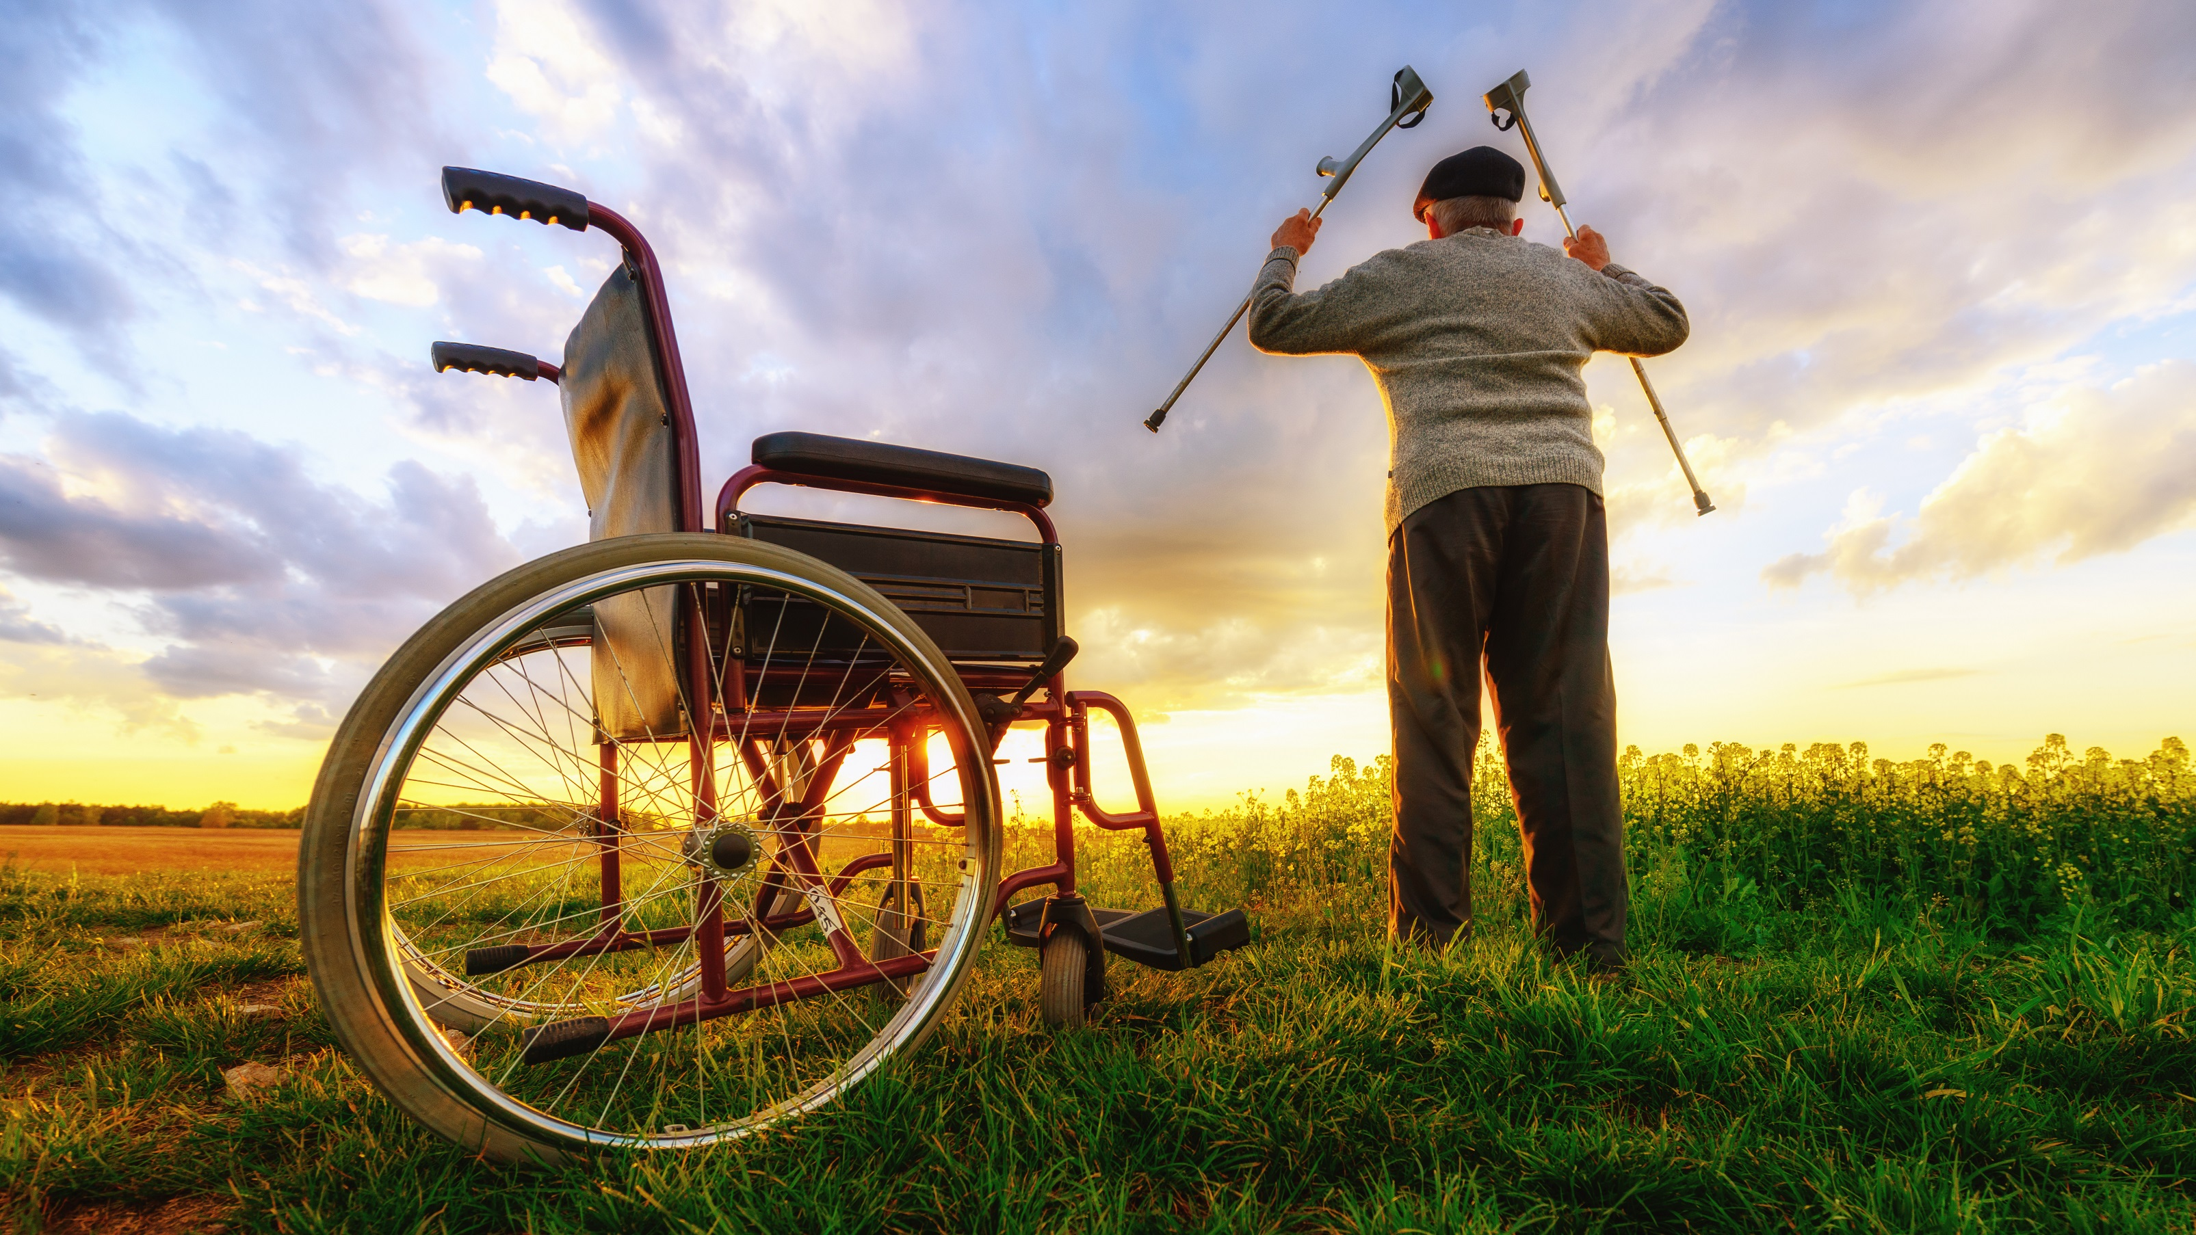
What can we currently do?

Slide 49
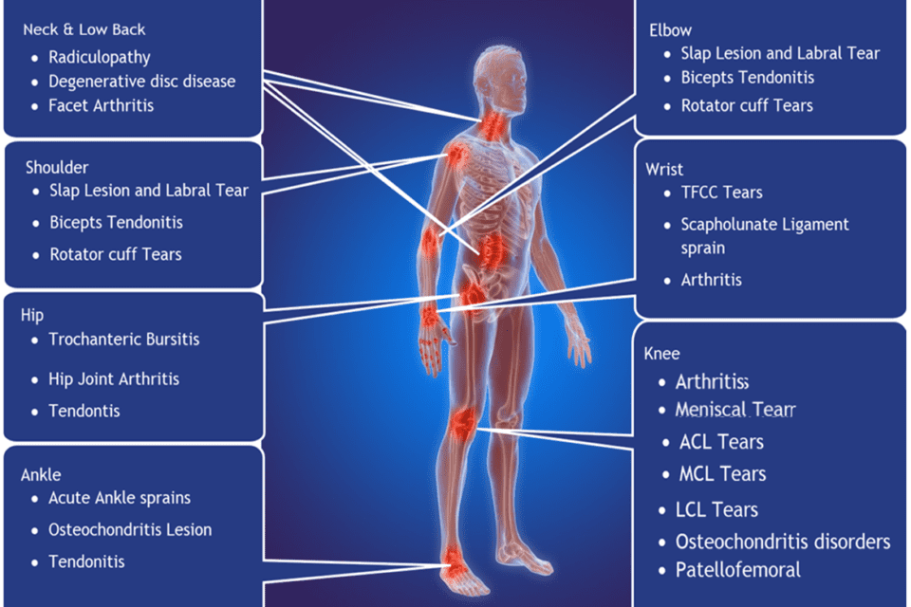

Slide 50
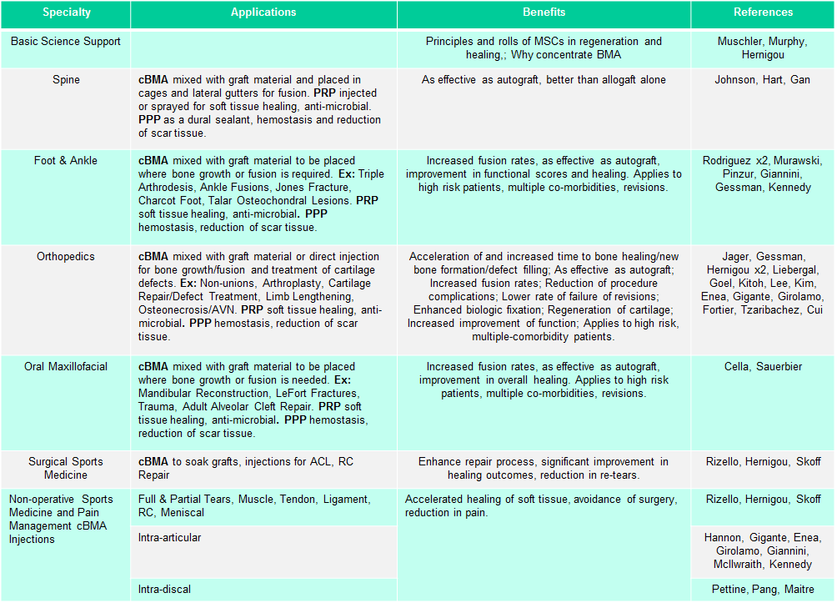

Slide 51
The biggest question is should it be done.
Joints
Ligaments
Tendons
Muscles
Nerves
Fractures
And combinations therein

Slide 53
Transient Positional Pseudarthrosis of the Spinous Processes (TPPS)*
Transient compression of the interspinous ligaments, usually of the lumbar spine, secondary to pseudarthrosis of the spinous processes during extreme hyperextension.
Most commonly seen in gymnasts, cheerleaders, and dancers.
<20yo
Workup is often negative. Often missed on MR due to subtlety of findings or radiologist inexperience.
Physical findings typically direct midline pain exacerbated with hyperextension and flexion. Tenderness on palpation of spinous processes and interspinous ligaments.
Tx consists of termination of all hyperextension activities and/or US guided high dose PRP (>7x)

Slide 55
14yo volleyball player with unilateral L5 pars fx.
Tx - bracing, reduction of activities, and 2 PRP injections.
9mo persistent pain with fibrous non-union
BMAc at 9mo after initial Dx
7mo later, pt reports no pain and fx demonstrates complete healing

Slide 56
Future of Regenerative Medicine

